Slide 1
Developing Objective Criteria for Promotion
C. Heather Scalf
Library Assessment Conference
December 6, 2018

Slide 2

History

Slide 3
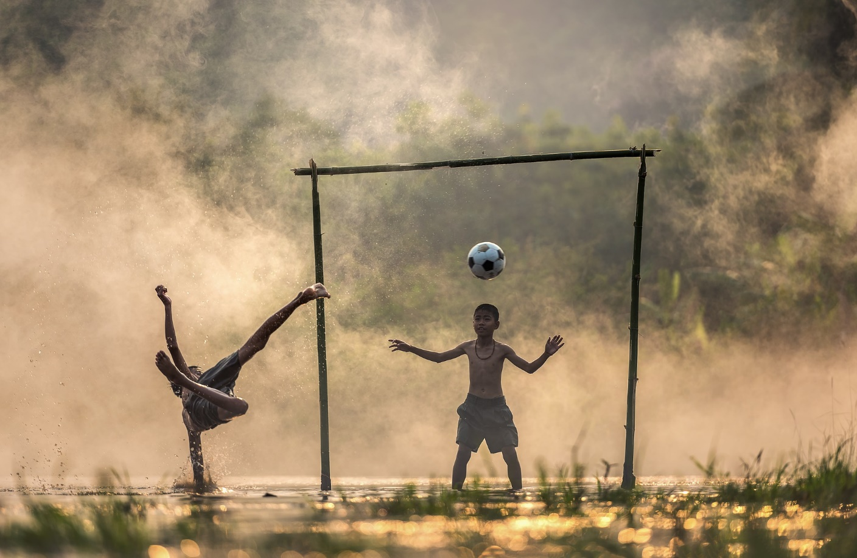
Goals
Coaching and mentoring
Clear, usable guidelines
Opt in/out provision
Objective criteria
Built in feedback mechanisms

Slide 4
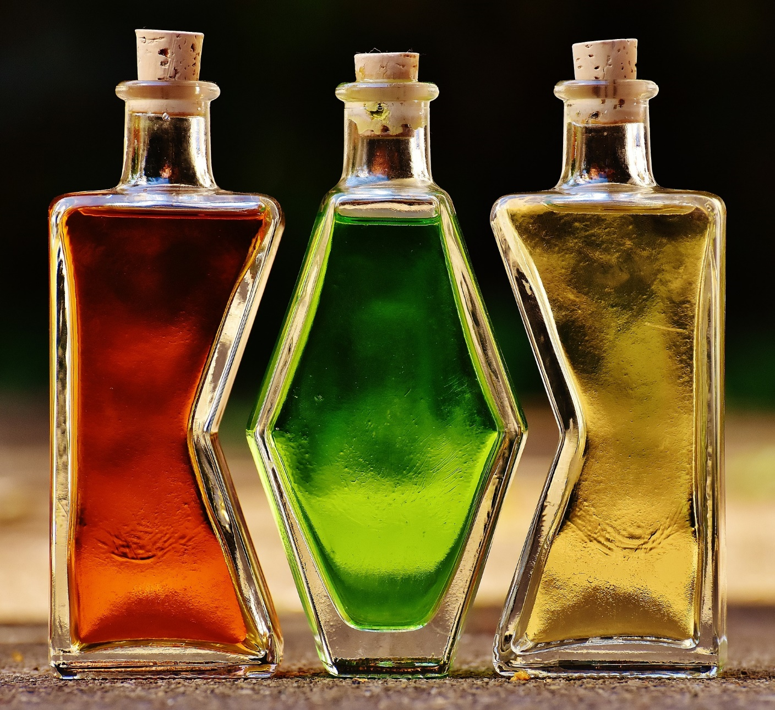
Categories
Librarianship
Scholarly materials and activities
Service

Slide 5
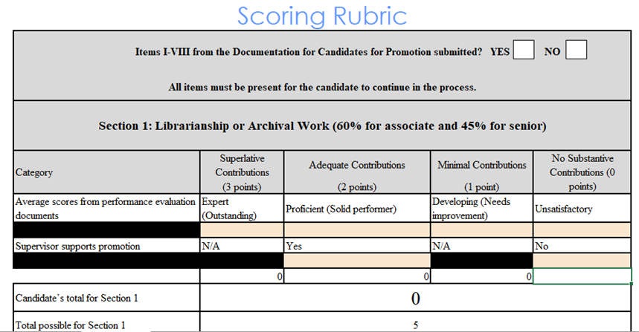
Librarianship

Slide 6
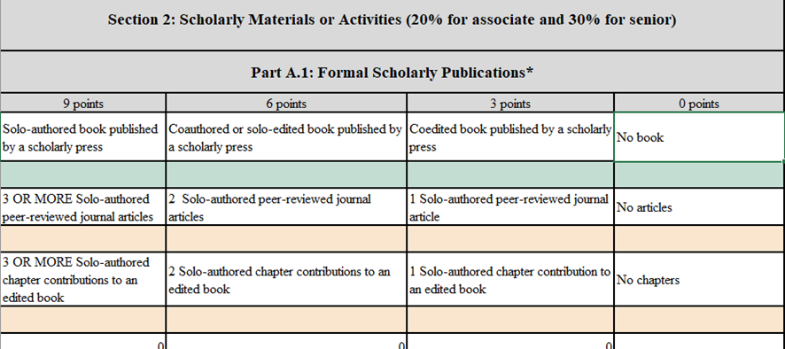
Scholarly Materials or Activities

Slide 7
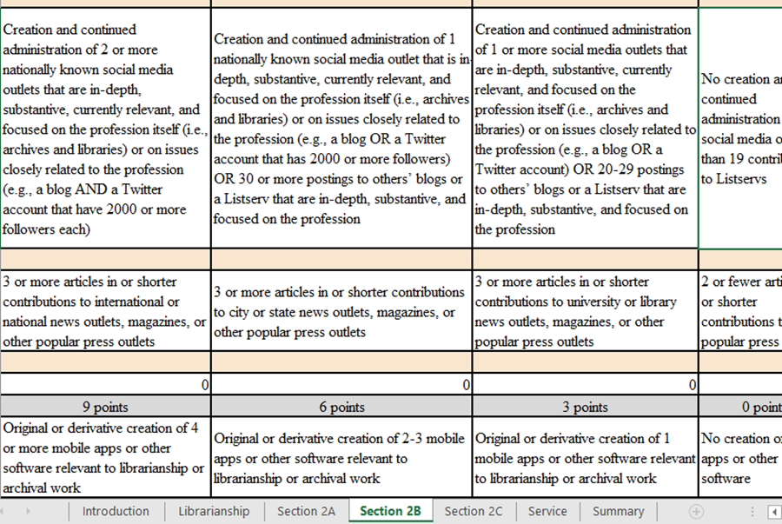
Scholarly Materials or Activities

Slide 8
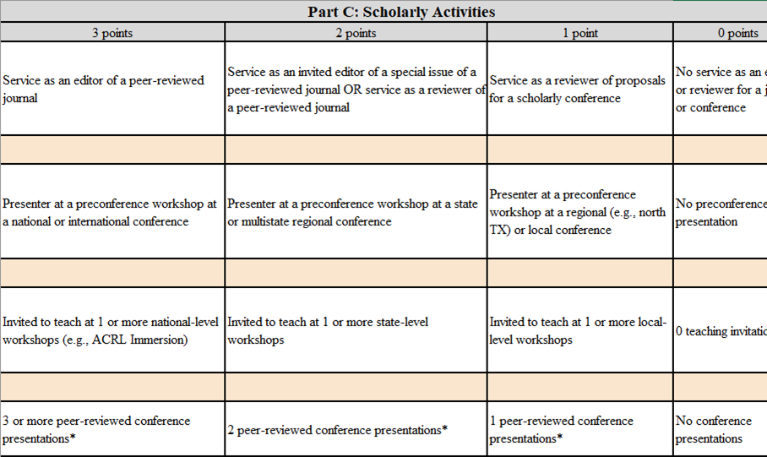
Scholarly Materials or Activities

Slide 9
service

Slide 10
Summary

Slide 11

Final thoughts
Crowdsource
Norming is good
Communicate
Train your constituency
Use useful and usable tools

Slide 12
questions
scalf@uta.edu

