Slide 1

Finding Value in Unusual Places:
Transforming Collaboration Workshop Data
Using Collaborating with strangers™ workshops data to inform a strategic plan
ARL Library Assessment Conference Houston, TX. December 3-7, 2018
Laura I. Spears, PhD. | Assessment Librarian University of Florida Bess de Farber, MNM, CPF | Grants Manager

Slide 2
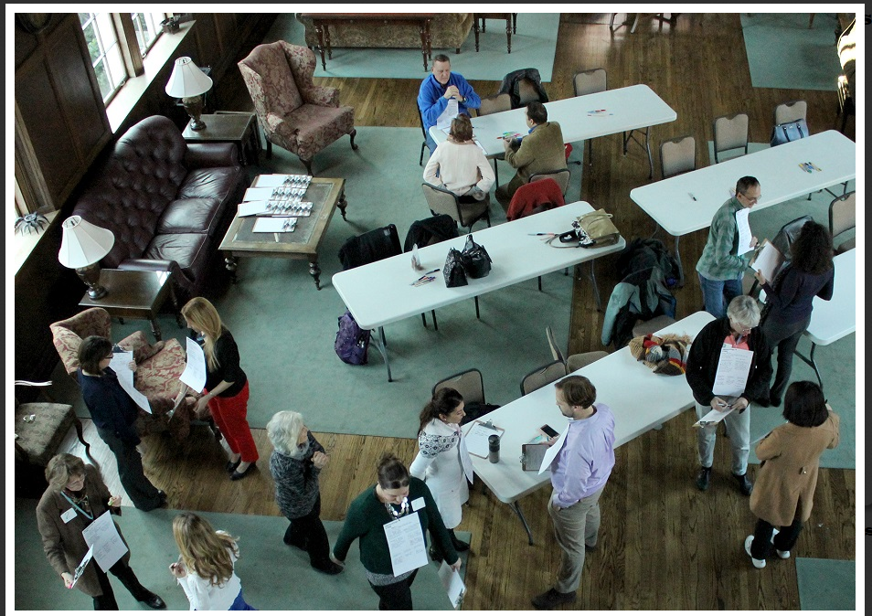
CoLAB Planning Series®
A team effort by the UF Libraries to connect students and faculty to on-campus resources, networks and creative opportunities.
Collaborating with Strangers Workshops
Notes:
CoLAB Planning Series® is a large group facilitative process that supports one-on-one “speed meetings” where participants quickly reveal their passions, skills and resources that may otherwise take months of conversations to uncover. The goal of Collaborating with Strangers is to create a safe and engaging environment in which participants from various fields can meet each other, exchange ideas and, together, build new foundations to start or improve on campus-wide projects.

Slide 3
Collaborating with Strangers at the 2017 Northeast Library Information (NEFLIN) Conference
119 participants + 45 minutes
7, one-on-one, three-minute speed-meetings, generating profile cards produced during the workshop to practice
1) Conversing with others
2) Discovering untapped resources
3) Initiating cooperative, collaborative, or mentoring partnerships
Notes:
CoLABs offer methods for breaking down barriers, encouraging participants to share ideas and create new connections, resulting in productive and memorable sessions experienced in a conference setting. The challenge of first encounters is that most people avoid conversing or working with "strangers," disrupting their ability to access other people's assets, the basic ingredients necessary for innovation. However, experience shows that discovering available individual or community-held assets, in a library, classroom, or at a conference, can dramatically lead to a greater sense of community and awareness of resources.
Talk to Me Global. It’s Good to Talk: Overcoming Barriers That Stop Us Talking to Strangers. (Executive Report, 2016). Available at http://talktome.global/images/Its_Good_to_Talk_Report.pdf.

Slide 4
Action Research for Strategic Planning
Who are these stakeholders?
What findings are meaningful for NEFLIN leadership to include in their strategic plan?

Slide 5
Strategic Planning for Public & Non-profit Organizations
John M. Bryson, 2017.
Ask the Stakeholders
Enable participants to be forthcoming about their knowledge, their assets and their aspirations, as a method to gather stakeholders’ points of view.
Identify what is important for stakeholders to assess how well the organization performs “from the stakeholders’ point of view…they are the experts about their lives and communities and are aware of what is working and what is not.”
Notes:
Specifically, the CoLAB process does not seek to provide answers to any particular problem but instead, creates an environment in which participants self-identify assets and engage in interactions in which the shared information results in synergized, new assets with which they can both interact, collaborate, connect or appreciate as moments of self-discoveries.

Slide 6
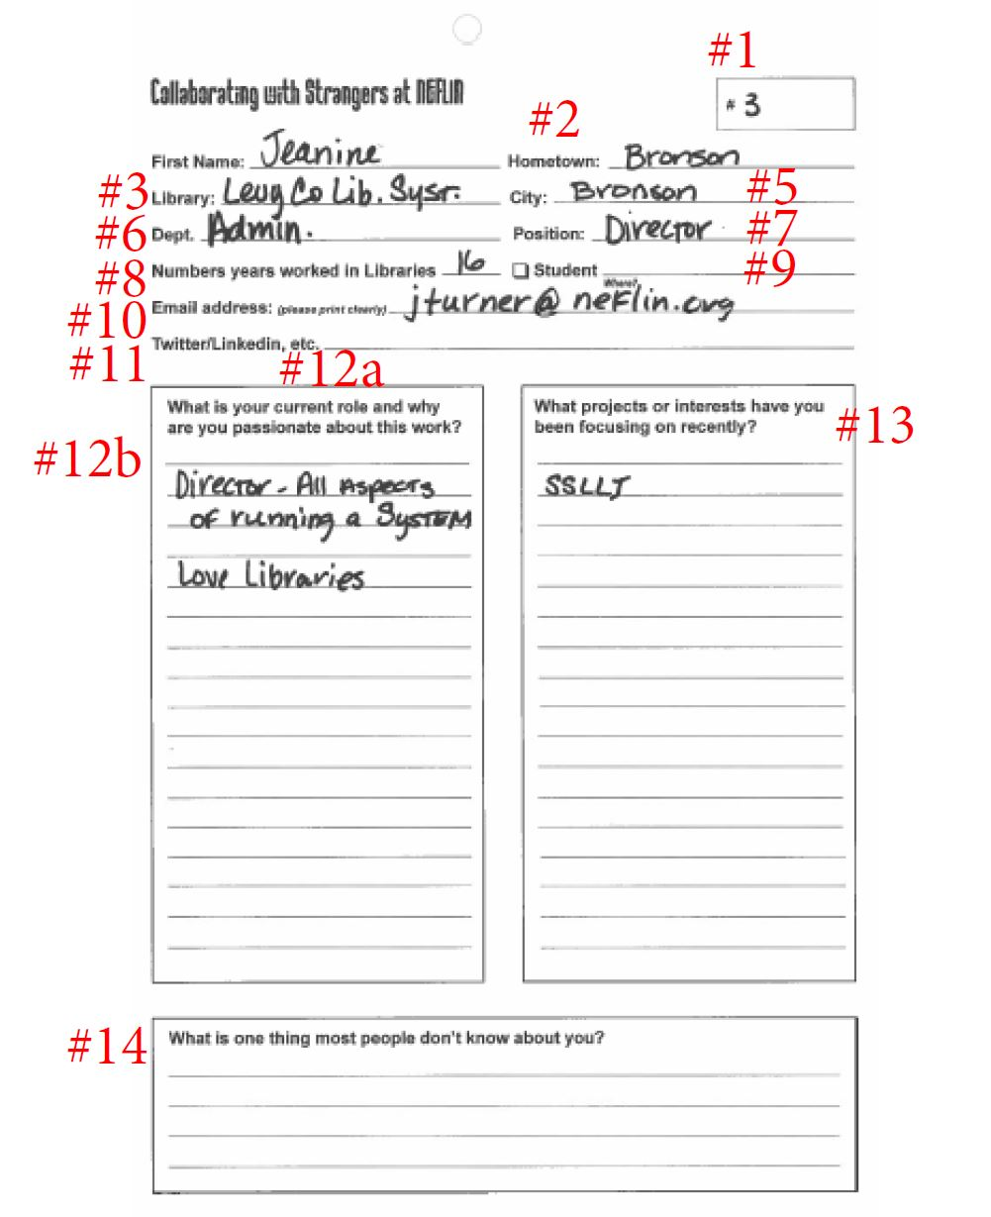
Appreciative Inquiry
Developing awareness of knowledge and interests as elements of social innovation rather than as a method of problem-solving
Notes:
Participants, as agents of their environments, experience Appreciative Inquiry for its potential to initiate “… collaborative change, [that] erases the winner/loser paradigm in favor of coordinated actions and closer relationships…” employing a process of “systematic discovery” to reveal untapped assets. AI is a seminal framework used in action research by researchers along with community stakeholders to “actively forge co-generative relational processes and outcomes.” Whitney, D. & Cooperrider, D. (2011). Appreciative inquiry: A positive revolution in change. In Eds., Peggy Holman, Tom Devane, Steven Cady & Associates, The Change Handbook, p. 276. San Francisco, CA: Berrett-Koehler Publishers, Inc.
Kevany, K.M., & MacMichael, M. (2014). An appreciative inquiry into rural wellbeing. Gateways: International Journal of Community Research and Engagement. 7, p. 34-51.

Slide 7
What is your current role?
Why are you passionate about this work?
Q1b: Why are you passionate about this work? | Themes | Code | Subcode-P | Subcode-P
My favorite tasks involve graphic design/marketing and makerspace workshops. I like to think of myself as one of the libraries "makers". I love when I'm able to bring somthing new to the library. | PASSION, DUTIES | P, D | P-CREATIVITY
I enjoy the challenge of the work and learning about RDA and MARC formats. | PASSION | P | P-CHALLENGE | P-LEARNING
Transforming lives. Organizational Development. Innovation. Leadership Develop. Marketing. | PASSION, DUTIES | P, D | P-IMPACT | P-INNOVATION

Slide 8
Profile Questions
What is your current role and why are you passionate about this work?
What projects or interests have you been focusing on recently?
What is one thing most people don’t know about you?

Slide 9
“Person of many hats”
91 unique hometowns, from as far as Algeria, Africa to Lake City, FL. Most responses named Jacksonville, Florida as their hometown.
48 unique libraries or library systems
48 participants from academic libraries
60 from public libraries
7 Other
31 cities throughout North Florida.
42 unique positions including deans, directors, branch heads, managers, coordinators, reference-collections-tech svcs librarians.
Notes:
Analyzing the data provided a rich description of the stakeholders comprising NEFLIN’s service area which covers 550 libraries from 24 counties in Northeast Florida. The median length of tenure in libraries was 14 years, with a high of 44 years and a low of less than one year. The most frequently reported length of service was 10 years; most of the participants with more than 30 years of service listed their positions as dean, director, department head or manager. Ten participants listed themselves as current students.

Slide 10
Roles
Projects
Interests

Slide 11
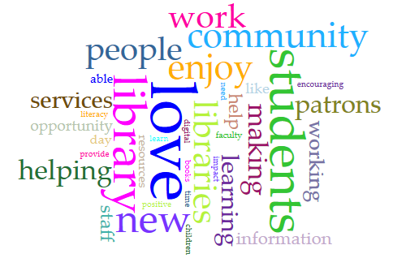
Why are you passionate about your job?
library as place
the library story
key element in a childhood
library resources
library as living organization
place that patrons own
source for meeting community needs
source for technology
The library is a critical part of helping people navigate the
“time of exploding information/new technology/and educational changes.”
Notes:
While librarians love libraries, technology, makerspaces, ESOL programs and “seeing new books first”, 61 of the comments featured the desire to help people, serve their communities, “improve teen services” and developing their librarian staffs. People are described as the center of what the participants are passionate about. Some key examples include:
“I love seeing libraries from patrons’ perspective and making improvements for them. I love getting to know our community via outreach work.”
“Love libraries; love my job; love the patrons because I love books. Love to encourage children to read and find the right book for them.”
“I’m passionate about this work because I love the library. I’ve always loved the library.”
“Love,” as another frequently occurring term, was found in 37 comments, often in connection with the term library(ies) but also with many other aspects including “the work,” books, marketing, social media, teaching ELL/ESOL, “telling our library story,” being creative about teaching information literacy and even “I love numbers so it’s easy – more than that, I KNOW how important the library is so putting the two together is ideal.” Other examples include:
“I love doing this because I love outreach and meeting new people.”
“LOVE to help students. LOVE to share library resources, skills, knowledge w/others. FUN. Positive experience.”
Terms collocated with the term “love” include help(ing), encouraging, telling (the library story), challenge, working with people, share library resources, “facilitating learning and discovery,” “love the administrative side,” love outreach, and “love my job.”
Finally, in response to question 12B, the term “enjoy” occurred 16 times and referred to challenges, “running a smooth & happy ship,” interacting, encouraging, working with, helping connect, and finding hidden resources. These participants indicated that the basic nature of the job that they are passionate about includes enjoyment of serving people and facilitating the growth, health, economic welfare, and technology use of their communities.

Slide 12
Idea Board Notes #1
/
Synergies:
Group Similarities (39)
Group Identities (14)
01
Connections:
Positive (16)
Neutral (21)
Personal (6)
Professional (32)
02
Discoveries:
Positive (20)
Neutral (23)
Personal (3)
Professional (42)
03
“Some Librarians are introverts,
I was surprised.”
“Empowering others is important
to us.”
“Connection to another
Academic librarian about new
ILS & challenges.”
“As an academic lib, I am intrigued
by the variety of interests and work
being done by public libraries.”
Notes:
Synergies:in reviewing the synergy responses during axial coding, group similarities and group identities emerged as categories which we used to assess each response. Using these two categories, 39 responses referred to group similarities –skills, knowledge, abilities, that participants share; 14 responses referred to group identity – a description of a personal characteristic - that all participants were said to share; finally, five responses were positive observations of types of synergies experienced within the group. All responses were coded for sentiment – positive, negative or neutral – and most were positive or neutral; only one sentiment was coded as negative.
Definition: The interaction of elements that when combined produce a total effect that is greater than the sum of the individual elements, contributions, etc.
Connections: The connections focused on their service, helping people, love for libraries, the type of work they do (e.g., academic, public; administrative, service), their love for learning and their shared experiences.
Definition: association or relationship (as between crime and poverty); link, bond.
Discoveries: Only three were personal discoveries while the remaining 42 were professionally-oriented. Seven comments referred to the experience of the workshop itself, either commenting that sharing hometowns is a good conversation starter, and the revelation that “These people are interesting.” Several of the comments indicated the participant was learning about rural and small libraries, both public and academic, noting “As an academic lib, I am intrigued by the variety of interests and work being done by public libraries.”
Definition: a person, place or thing that have been found or newly gained, created, revealed or developed.

Slide 13
Idea Board Notes #2
“Try to attempt more cross-disciplinary/departmental collaboration.
We are all passionate about the same basic tenets, so it's possible!”
“…that libraries aren’t
afraid to take risks.”
What Participants Learned
Next Steps
“I enjoy talking to Strangers”
“That there's a huge difference
between urban and rural libraries.”
“KEEP MOVING FORWARD WITH THE
RENEWED CONFIRMATION I AM IN THE
RIGHT PROFESSION FOR ME.”
“Expand my network”
“Random details about strangers.”
“Want to meet with # 109 to discuss
my past & her current position!”
“I learned that it's important for me to get out
and make connections across the state and
at different types of libraries.”
“Follow up with early-career librarian
who hopes libraries will stay vital.”
Notes:
WPL-This question received 142 responses that have been analyzed for 1) Content; 2) Response Type (Personal/Professional); 3) Sentiment; and 4) Lesson Learned (New information versus Reinforcement of existing knowledge). The content of responses elicited 153 codes in three categories including library information (74), observations about participants (58), or comments about the process of the workshop.
Content: The library information shared among the participants included 15 references to technologies being used (Makerspaces, 3D, VR, e-books, e-sports, and mobile devices); the diversity of library types in the NEFLIN system, the diverse hometowns participants are from; and the challenges of rural libraries compared to more urban settings. What is clear is that the participants learned that while they think libraries are similar, there are a wide variety of activities and technologies being used among them. Respondents showed interest in grant-writing, budgeting, mobile applications, how other libraries are partnering, the circulation of technology in different libraries, and resources available to librarians about these issues. Participant information comments focused on the diversity of librarian backgrounds, education and skills, while at the same time being comforted that they are not alone in their lack of ease with social media and the knowledge that others share the same struggles, especially within the school librarian environment.
Next Steps: The majority of respondents clearly expressed the “Next Steps” as professionally-related actions (105). Many respondents will seek technical expertise, such as implementing passport services or a “cataloging idea,” learning more about another library’s strategic planning process, learning more about digitization projects and getting grant-writing help to fund makerspaces. Professionally-related actions were further coded into five categories, Connect(41), Technical(30), Programs(25), Self-development(9), Makerspaces(5) and Library Visits(4), based on the frequency of explicit statements in those categories. Responses coded as “connect” primarily indicated intent to contact a specific individual and follow-up on a program or some technical detail discovered during the speed meetings, so some of these actions overlap. “Technical” responses were focused on specific details sought about library operational issues such as cataloging, specific services, staff training, social media or Makerspaces.
Participants made only nine comments about collaborating with others and only nine comments about implementing a plan or idea. However, participants provided 68 responses indicating they would seek to learn about something and 55 responses indicating their intent to connect with someone.

Slide 14
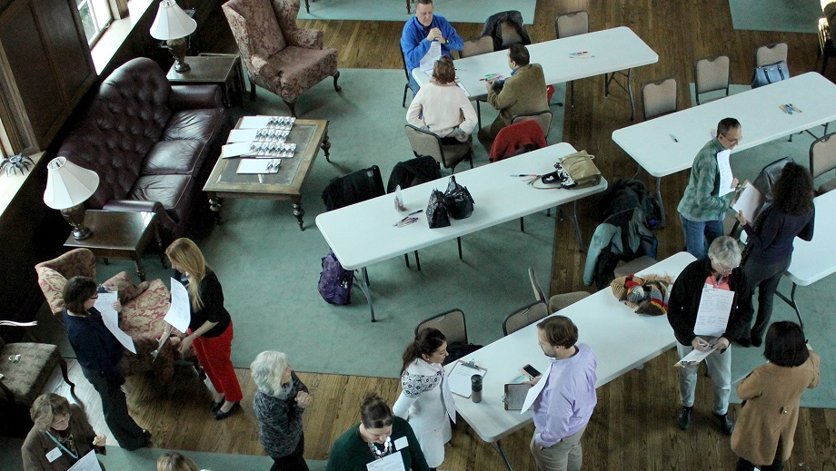
What is one thing most people don’t know about you?
“I'm not a librarian.”
“I can read Classical Tibetan.”
“I would love to work with the National Weather Service- I'm a meteorology geek!”
“I raise Monarch butterflies indoors.”
“Fear of heights.”
“Not much. I talk a lot!”
“I am very much an introvert…I often wonder about a more research-based position.”
“I came here to find another job.”
“I am a closet Excel failure.”
“My son has Leukemia.”
“Cancer survivor.”
Notes:
I feel that this question’s responses, the last on the profile card, are an indicator of the strength of the Appreciative Inquiry approach. The use of peer interlocutors, in an environment that felt comfortable and anonymous, encouraged participants to offer very poignant, often personal, self-reflection. Using the strategic planning model to analyze responses, we were able to understand how these stakeholders see themselves, their mission, their value, their needs and their assets. Observing their own and others’ assets is a stronger way to understand what they bring to the table as they consider collaborations and opportunities to learn from others.

Slide 15
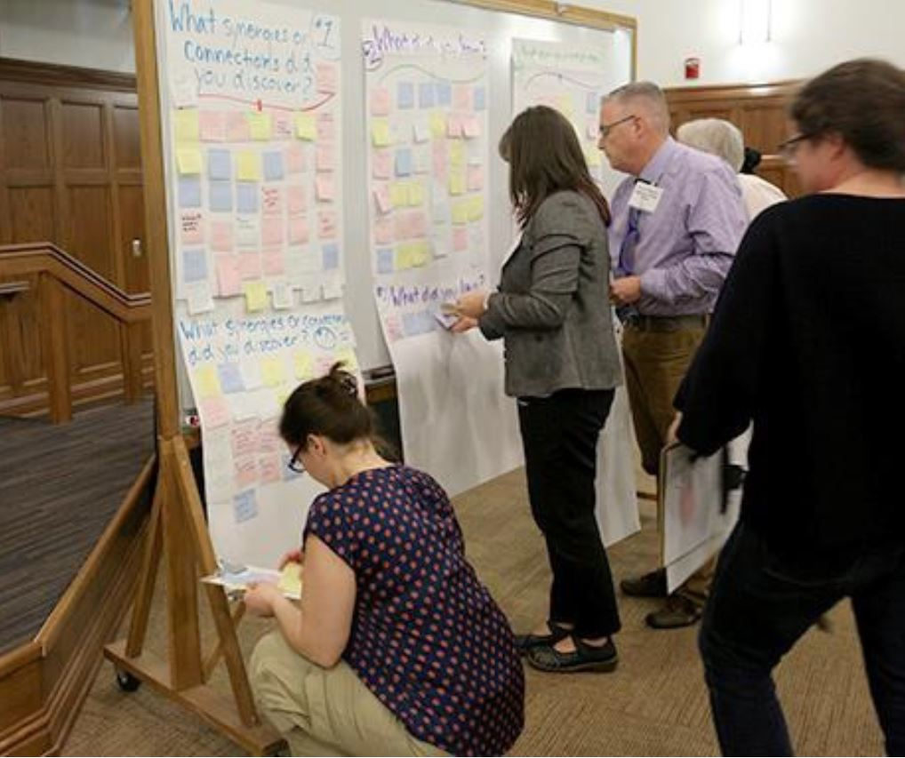
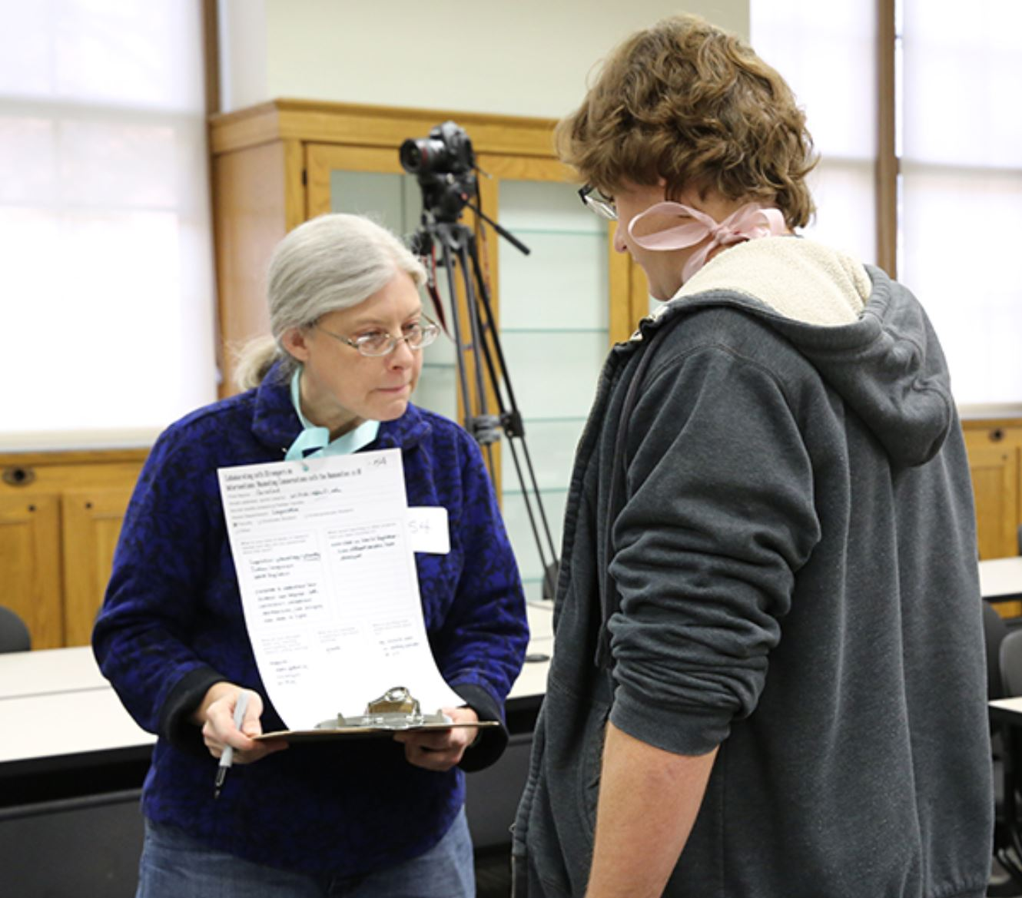
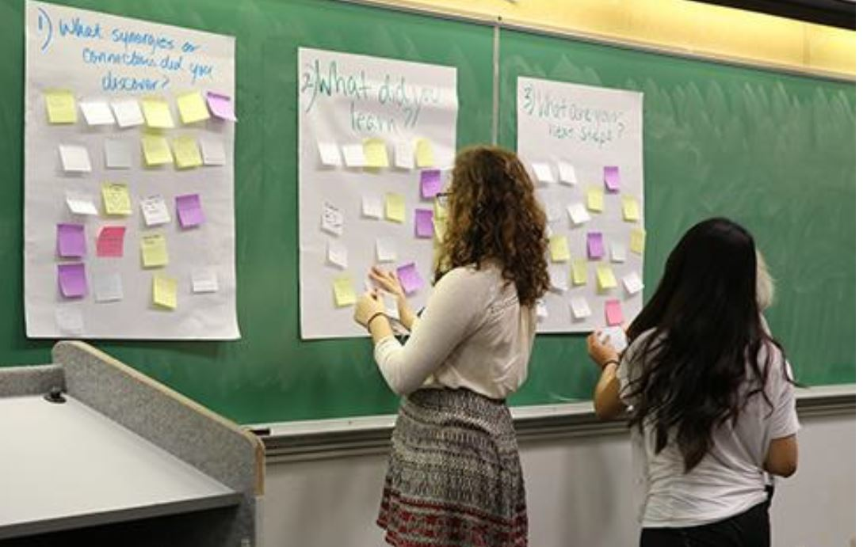
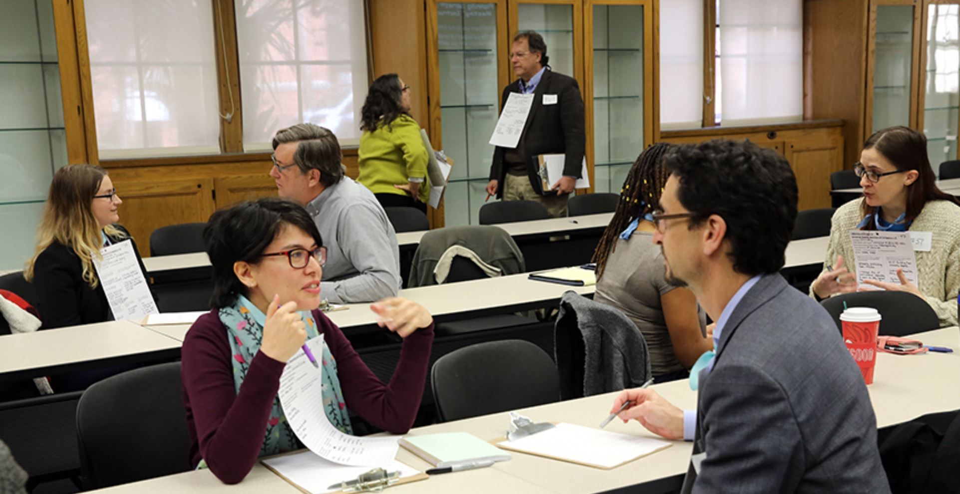
Recommendations
Visit other libraries, including guided tours and funding for fellowships.
Mentoring relationships to cover specific topics and expertise.
Focus on Makerspaces, “to get my makerspace off the ground in a meaningful way.”
Asset Map of the NEFLIN region, including an inventory of expertise available in this consortium.
And of course, provide a variety of program training and professional development.
Notes:
Post-workshop activities will enable participants to follow-up with “strangers” they couldn’t meet during the live workshop session through the CoLAB website. The goal of providing online access to participant information is to expand the impact of the workshop for learning about on-campus networks, promoting creative resource-sharing and inspiring collaborative project ideas. Participant profiles (created during the workshop) and photographs (taken at registration) will be posted and made accessible using Gatorlink logins. Participants also can access the information of those from other Collaborating with Strangers workshops.
From just 7 questions, 118 participants in 45 minutes, we were able to obtain 746 statements about librarians, staff, administrators in a wide variety of positions to comments on what they do, what their work is, their motivation for their professional commitment and estimations of their own personal and professional assets. This led to our recommendations for NEFLIN, including:

Slide 16
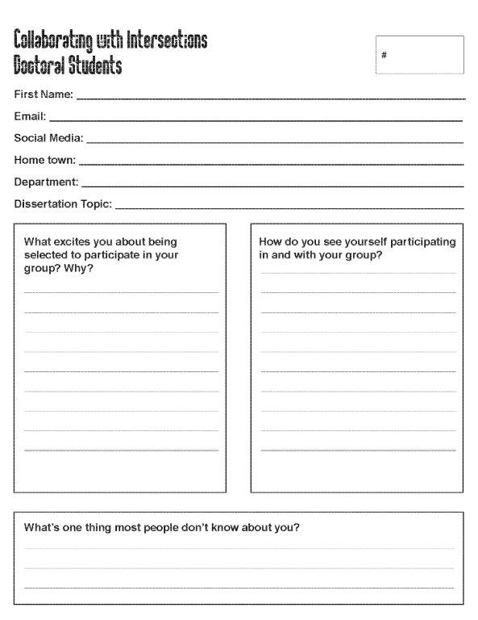
Future Applications in the Academic Sphere
Is Appreciative Inquiry a more effective method for Delivering results for action research?
Can the use of peer to peer interviews provide valid and reliable data?

Slide 17



Questions?
Thank you!
Contact Me:
Laura Spears
laura.spears@ufl.edu

