Slide 1
Where Students Want to Spend the Night: A Two-Phase Examination of Overnight Study Spaces
Laura I. Spears, PhD.
University of Florida
George A. Smathers Libraries
Association of Research Libraries
Library Assessment Conference
December 3-7, 2019, Houston, TX.

Slide 2
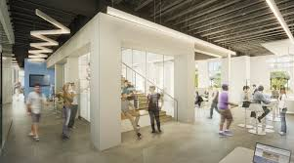
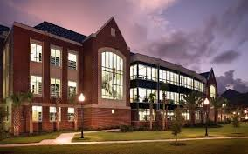
Facility Features & Capacity
Newell Hall | Library West
4 floors | 5 student floors (1 admin)
365 seats | 1600 seats
Learning commons orientation, with open floor space and collaborative spaces; No stacks, no public access computers, printing available, 2 group study rooms | Public access computers, video creation room, disability resource center, proctor-U studio, accessibility studio, video creation studio, group study rooms, quiet floor, graduate study floor
Open 24/7 except spring break, football games, homecoming weekend. | Open 24/7 except spring break and school holidays.
Study Questions
What are the traffic and occupancy levels of the Library West Newell Hall from 12 a.m. to 8 a.m.?
What are students’ preferred features of an overnight study space?
What features and services are visitors actually using from 12 a.m. to 8 a.m.?
Notes:
Space studies began with the MvL study, as the decision to move the overnight study space from its longstanding place at Library West the previous Fall was met with great resistance. Initially, this choice was based on the thought that students would prefer the newly renovated Marston Science Library, that boasts a variety of space features such as a learning commons, collaborative creative spaces as well as floors designated as quiet. The newer furniture is inviting to a livelier student use but the space ascends to the upper levels that maintain stacks, quiet floors, older library furniture and traditional public access technology.
Library West has all traditional features but includes a more secluded and restricted graduate only floor, a quiet floor with a lot of group study rooms, accessibility studio, a video creation center and dedicated space for proctored student testing.
Newell Hall was designed as a learning commons, an alternative type of gathering space for students. It is controlled by the UF Student Government, who, until it opened in April 2017, funded the overnight library hours at Library West. Once Newell Hall opened, SG decided to hold overnight study hours there.
But then feedback about a lack of space and quiet study areas motivated our 2nd study on student preferences for where to locate the overnight study hours.
At this time, the assessment program has studied overnight hours twice, the graduate-only study space, and the renovations at the Education branch library. We are currently looking at the overnight study spaces again this term, with another different method.

Slide 3
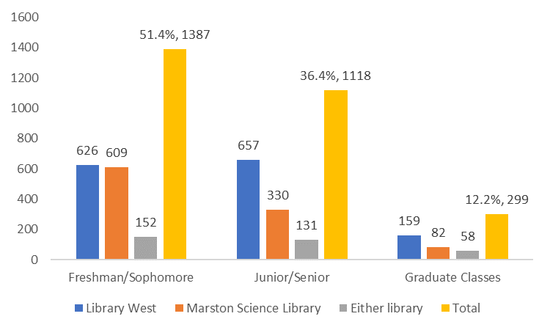
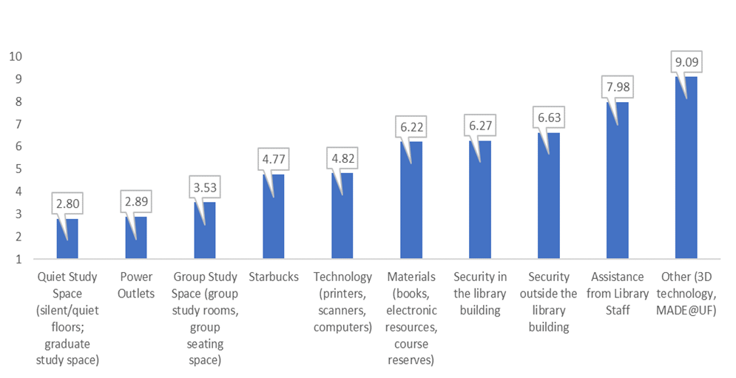
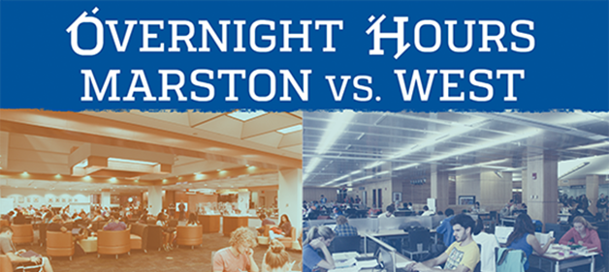
Spring 2016

Slide 4
Fall 2017 Survey Says:

Slide 5
Frequency of Use (n=5585)

Slide 6
Reasons for not using Library West

Slide 7
Reasons for not using Newell Hall

Slide 8
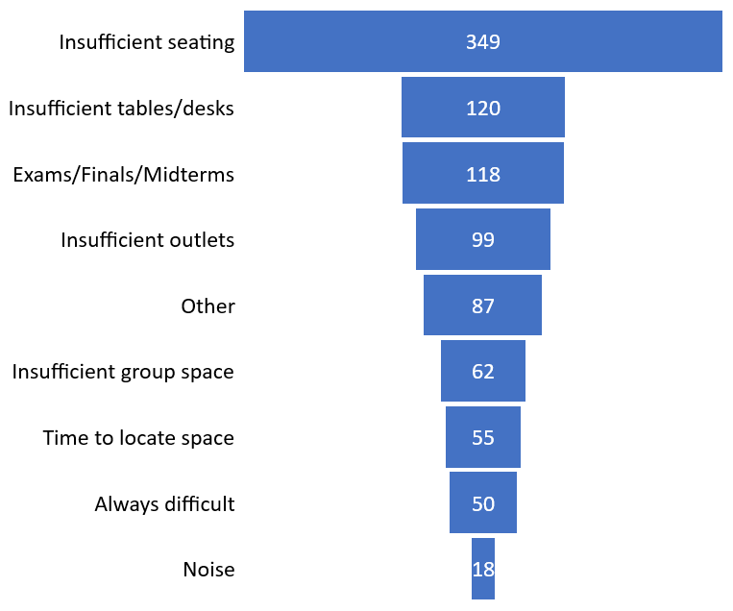
Why did you have difficulty finding space at Library West? (n=703)

Slide 9
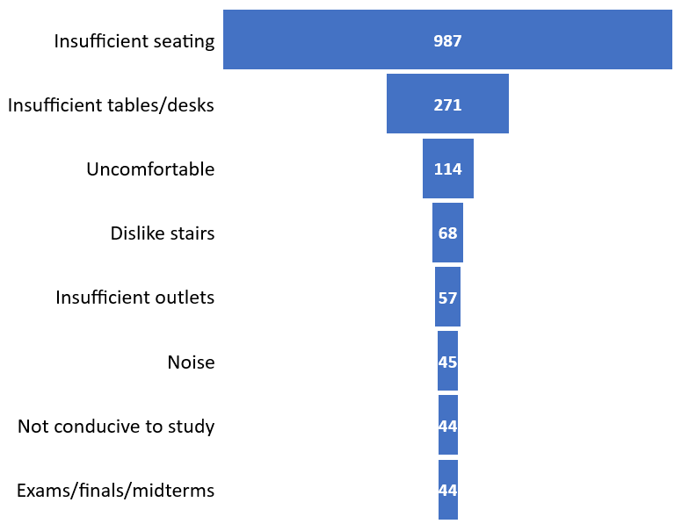
Why did you have trouble finding space at Newell Hall? (n=1214)

Slide 10
Library West Self-reported Feature Use

Slide 11
Newell Hall Self-reported Feature Use
Notes:
In spite of the large N and the consistency of the comments compared to the 2016 survey regarding Quiet study and power outlets, the Provost wanted more data to show that Newell Hall could house the number of users studying overnight. Also, the nature of many comments indicated that users were referring to experiences at the libraries at a variety of times of the day. It is clear that Library West has ample space to accommodate the traffic overnight. However, the Provost wanted occupancy data and hard evidence of what students were truly using during their visits overnight.

Slide 12
Capacity Utilization
NH Occ + LW Occ/Capacity of each
EX: 100+404=504/365
138.1% of Newell Hall capacity | 31.5% of Library West capacity
Notes:
is a sample of the hourly chart with which we tracked occupancy by hour and capacity utilization for both Newell Hall and Library West. Total capacity is 1965, the combined maximum seating capacity of both facilities (365 For Newell Hall and 1600 for Library West). Total occupancy for each hour is determined by adding the occupancy in both buildings. With this data, we can illustrate the effect of the total occupancy by hour for each facility and present the percent of capacity utilized. For instance, in the table below, on Tuesday, February 27, the sum of occupants in both buildings from 12 a.m. to 1 a.m. equals 504 occupants. Dividing that number by the total seating capacity of Newell Hall shows that seating demand (504) exceeds capacity (365 seats) by 38.1%; for Library West, the seating demand (504) would utilize just 31.5% of its capacity (1600 seats).
During the six-week study period, there were a total of thirty hours in which the total occupancy exceeded 75% of the capacity of Newell Hall. Of these, there were nine hours in which the combined occupancy of both buildings exceeded 100% of the capacity of Newell Hall. Most of these hours occurred from 12 a.m. to 1 a.m. (n=21). It is important to note that Marston Science Library was still open during this time (closing at 1 a.m. on all of these evenings). The full six-week spreadsheet is available upon request.

Slide 13
Median Occupancy Per Hour 12-8 a.m.

Slide 14
Library West Features Use

Slide 15
Newell Hall Features Use

Slide 16
Median per hour use of study spaces with public access computers (Library West only)

Slide 17
Observations of Quiet Study Use
Notes:
Finally, the study team observed the occurrence of both quiet and talking behavior with each count of occupants (Figure 7). Quiet activities occurred among pairs or groups of users until 4 a.m. There was no observed activity after 4 a.m. for either facility as, at that time, most users were singles. Although the lack of designated quiet space at Newell Hall had been noted by student comments during the fall 2017 survey, the data gathered during this study do not support a lack of quiet space during the overnight hours.
Figure 7 also illustrates the instances of quiet/talking uses. Both facilities demonstrate similar trends in use of most features, especially of quiet space activities.

Slide 18
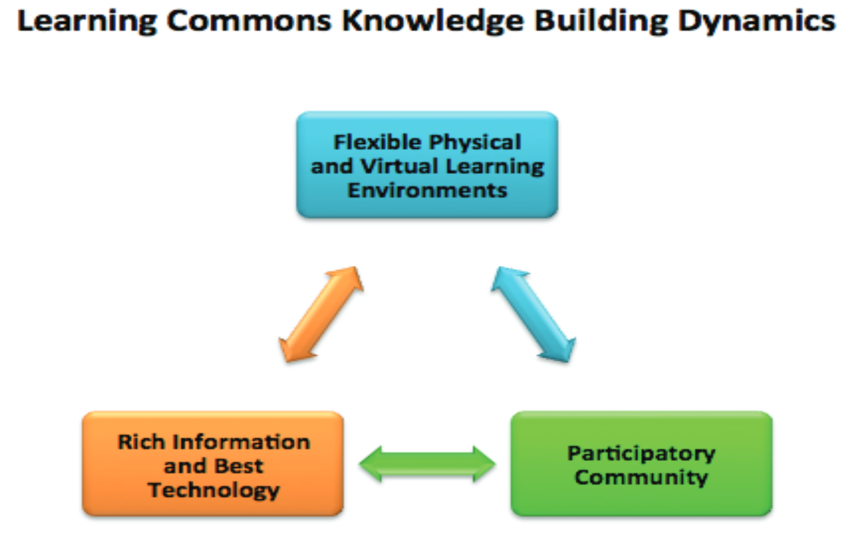
What makes it a library?
“I believe that the actual libraries should be the study spaces that have 24/7 hours, not Newell. It is usually too crowded and difficult to find a seat, and even when it is not, it does not have the same atmosphere as the actual libraries.” -Respondent To The Fall 2017 Overnight Study Spaces Survey
Loertscher, Koechlin & Zwaan. (2008). The New School Learning
Commons Where Learners Win. Spring,TX: Hi Willow.
Notes:
“Newell Hall feels a lot more secure to me as a student, so I feel more comfortable using it. Also, the desks tend to be more comfortable and theirs various types of seating. Sometimes I want to sit at a large table for a study group. some times I want to sit in a couch because I am casually looking over some work, and then other times I want to be at a private desk so I can really dig into my work. I also love you can eat anywhere in Newell (it makes it much more convenient) and it's more central to campus so all in all I prefer Newell. “
Newell Hall was never designed to include the types of features found in most academic libraries. While the phrases “learning commons” and “collaborative commons” some definitions of learning commons, which is the distinction for one of the spaces I have studied with various colleagues.
According to NC State University, The Learning Commons in D. H. Hill Library is an active, comfortable space where students can discover, create, and collaborate with peers, a space that inspires them to be more productive and successful. The description from ALA proposes “that the learning commons serve a unique
purpose in the school as a bridge between educational philosophy being practiced and the real world … known as a place for experimenting, playing, making, doing, thinking, collaborating, and growing.”

Slide 19
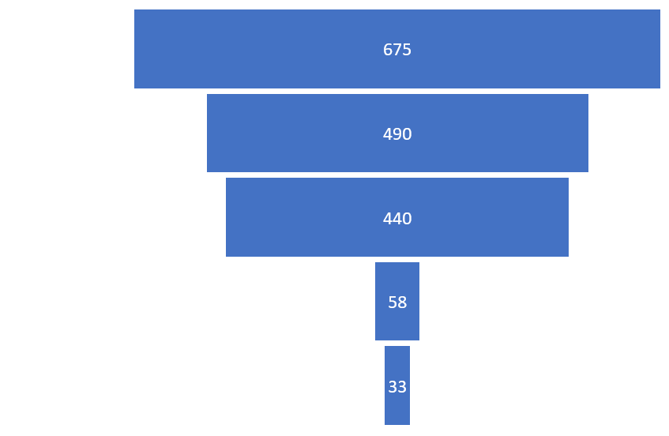
1398 Comments 1707 Codes And this survey NEVER asked about Marston Science Library
Notes:
This survey yielded 5452 comments from 5 optional open text fields. Analysis yielded 8905 discrete codes with an inter-rater reliability score of .899.

Slide 20
Questions? | Thank you!
Contact me:
Laura I. Spears, PhD.
University of Florida
laura.spears@ufl.edu
Researchers who contributed to these studies: David Schwieder,PhD Shaun Boren, PhD Jerri-Ann Berrie Michael Uwe Dietz Mohammed Gomaa

