Slide 1
Mining EZProxy Data:
User Demographics and Electronic Resources
Connie Stovall and Ellie Kohler
ARL Assessment Conference, 12/2018

Slide 2


About Virginia Tech
Land-grant institution with 34K students
STEM emphasis but comprehensive

Slide 3





About University Libraries
152 Employees
5 Branches
$23.8 M Budget

Slide 4

University Budgeting Environment
Performance Based Budgeting (PIBB)
Demonstrate Impact on Student Success
Utilize Data
Notes:
Moved from incremental budgeting to performances based budgeting
440 metrics so far in PIBB

Slide 5
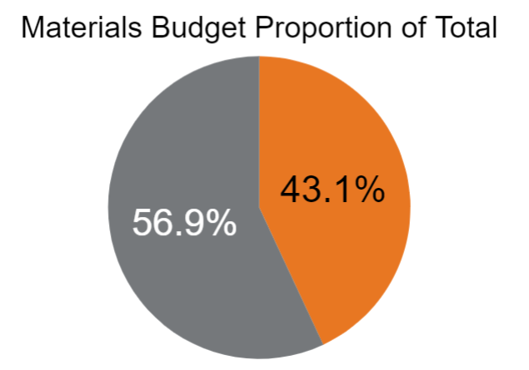
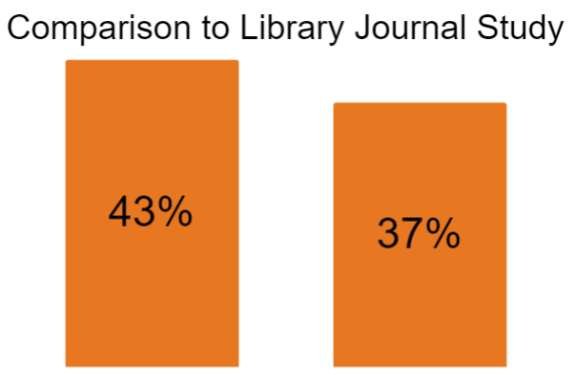
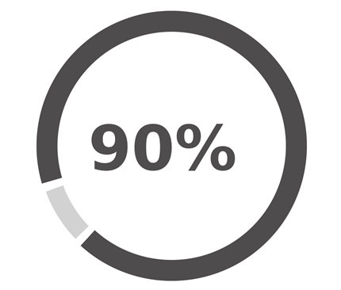
Total Materials Budget
VT Electronic Resources

Slide 6

Connecting ER to Student Success
Pilot project in Summer 2018
First step: user demographics analysis
LOCATION
COLLEGE
MAJOR
STUDENT LEVEL
GPA
ETHNICITY
AGE
GENDER

Slide 7

How much data is enough data?
How do we decide?
Can off-campus usage stand in for all database usage?
Is summer usage comparable to fall usage?
What can EZProxy data tell us that COUNTER reports don’t?
Notes:
How can we figure out if we can use off-campus usage as an appropriate sample for all campus usage?
JR1, JR5, DB1, DB5, BR1, JR1GOA, etc.

Slide 8
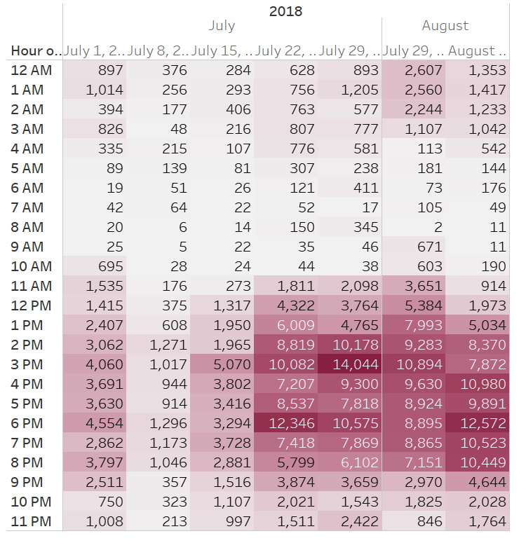
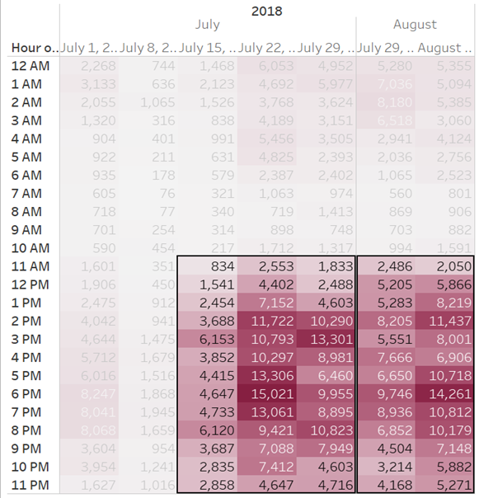
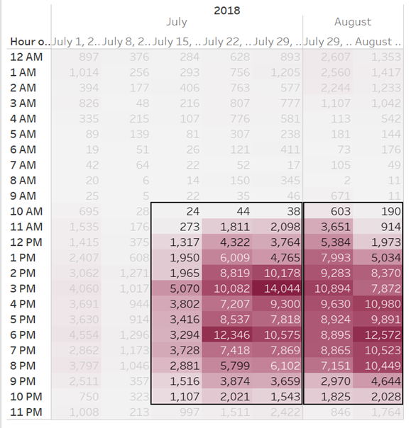
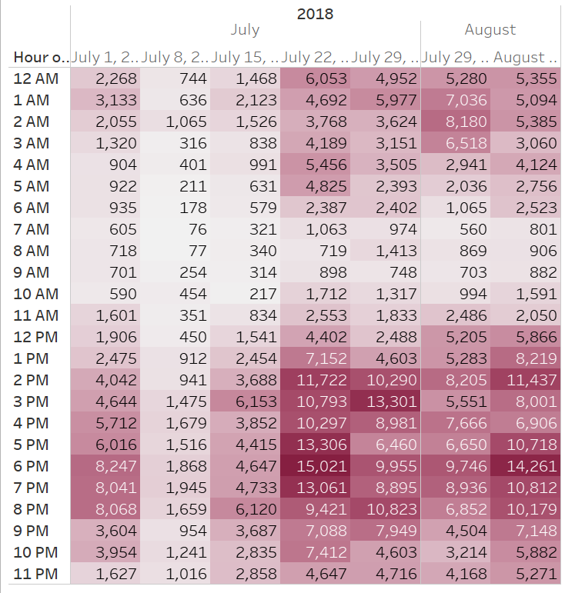
Step 1: Compare On and Off Campus Usage
(by date and time)
On
Off
Notes:
On Campus and off campus database usage- While we really wanted to look at student usage only, we began by comparing all of the data gathered from EZProxy.
Initial dataset wrangling included-
removal of “admin” (logins that said admin on them) .02% of total
removal of automated system checks “part of “on campus” usage 19.9% of total
Changing the timestamp into a recognized date/time
After looking at the data (such as what is included on the next few slides), then the dataset was filtered for only off-campus use.
In the off-campus use dataset, remote users were identified (by unique login) and then merged with university student demographic data.
Logins that had no student demographic data were removed from dataset (and considered faculty or staff users).
This data was merged by VT Academic Analysis & Reporting and returned completely anonymized
Can only see unique users, not how heavily or what databases each user went to.

Slide 9
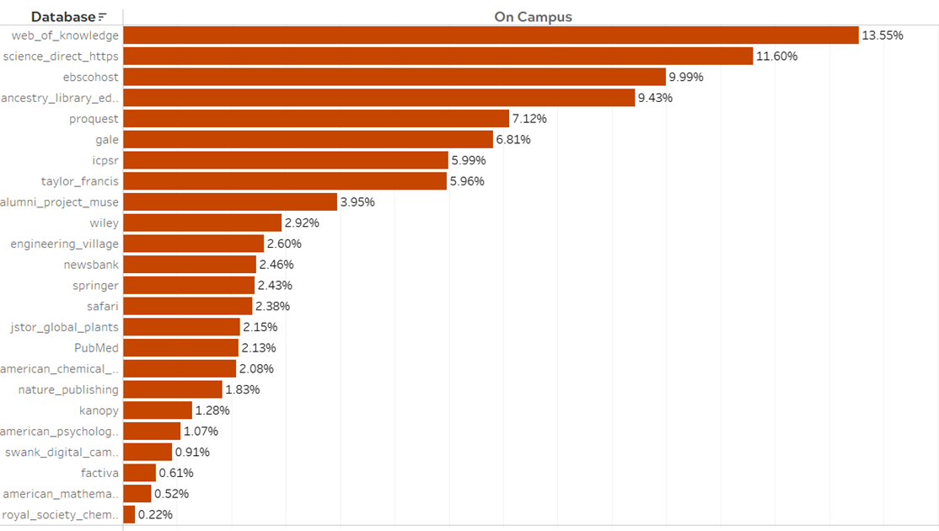
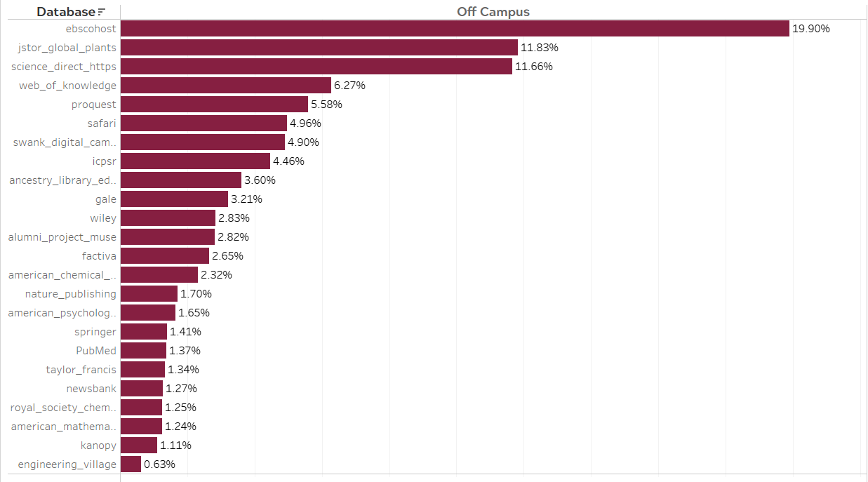
(by database)
What databases are being used?
Off Campus | On Campus
EBSCO JSTOR Science Direct Web of Knowledge ProQuest | Web of Knowledge Science Direct EBSCO Ancestry (Library Edition) ProQuest

Slide 10
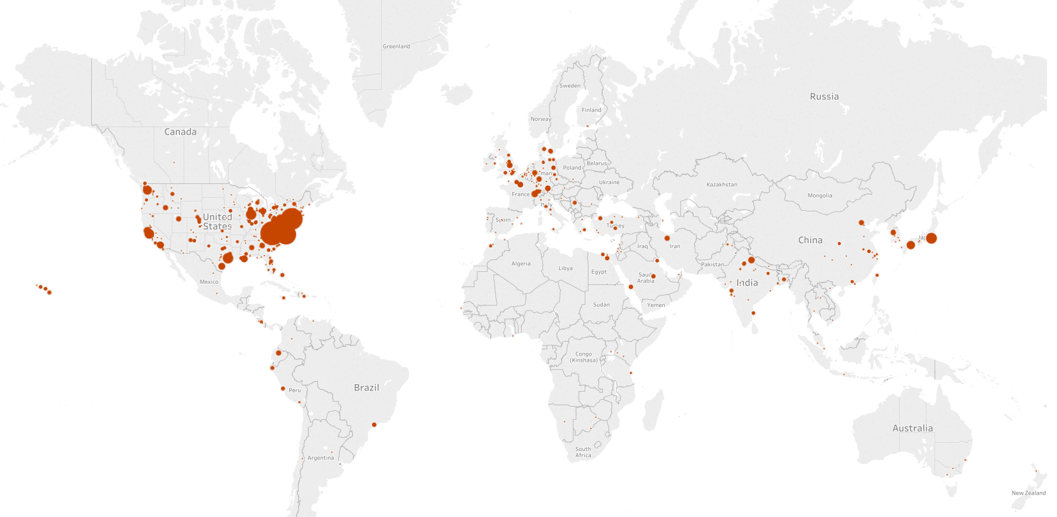
by location
Off Campus

Slide 11
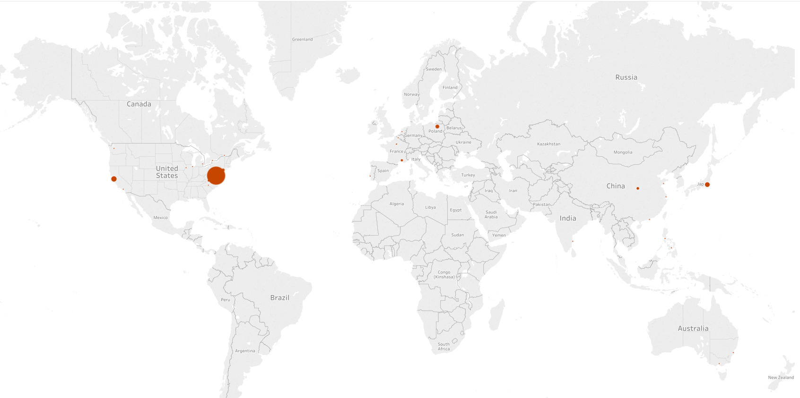
And location
On Campus

Slide 12
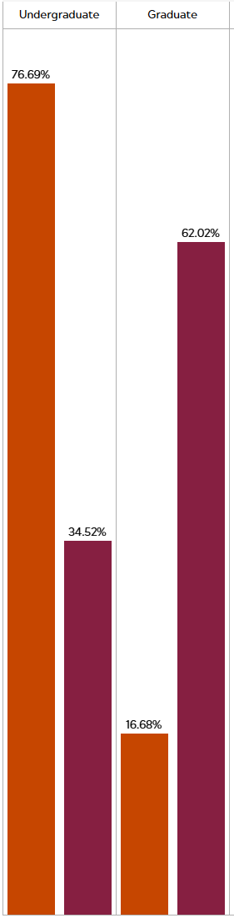

Step 2: Get demographic information and compare
(off campus use to Summer II enrollment demographics)
 | Enrollment | Off-Campus use
Undergraduate | 77% | 36%
Graduate | 17% | 62%
DVM, MD, etc | 4% | 2%
Notes:
Very unbalanced. But is this the best comparison? Maybe graduate students use databases more in the summer. Or more in general.
This is where domain knowledge is so important.
So if isn’t an accurate comparison barometer, what about gender and race?

Slide 13
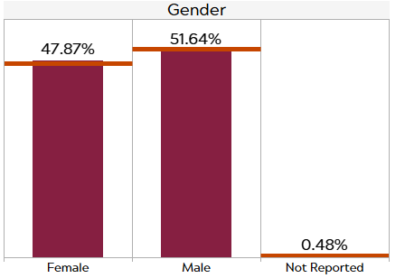

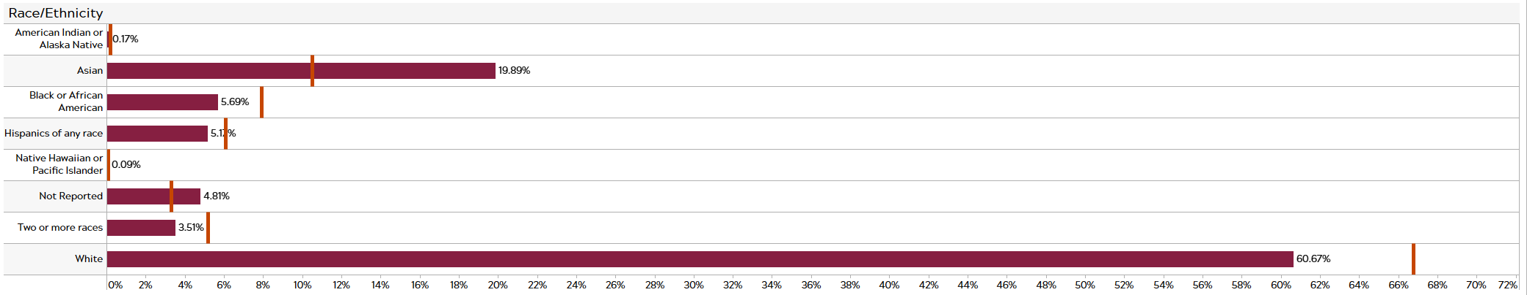
Gender and Race?

Slide 14
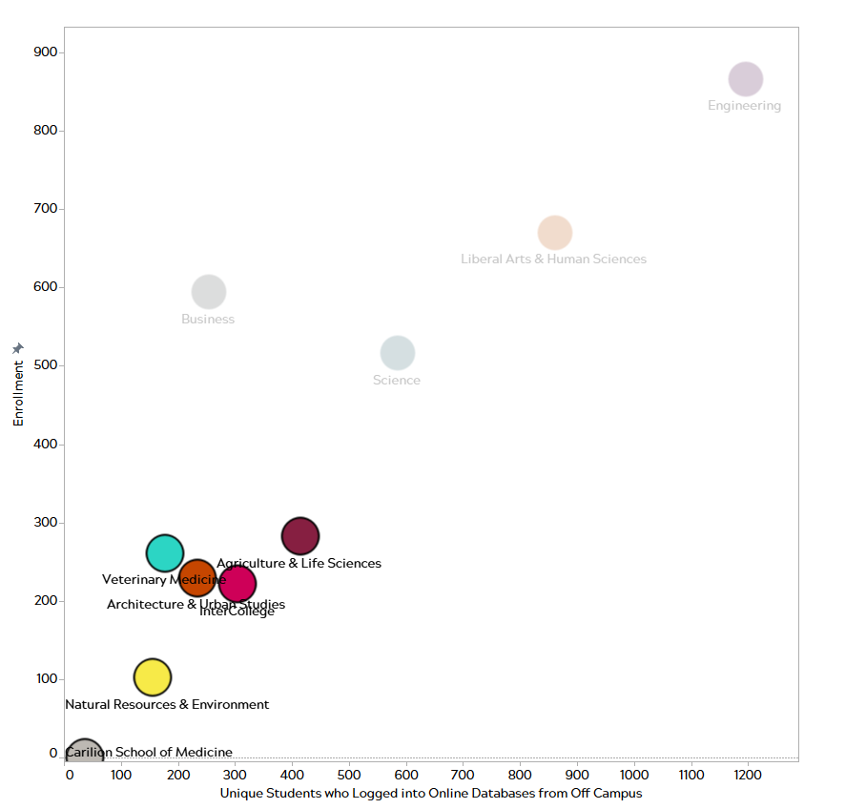
By college?
Notes:
When looking at a scatterplot, the items in the lower left quadrant indicate a close enrollment to unique student ratio in these colleges.
Also, maybe here it is important to note that:

Slide 15
What about GPA?
 | Graduate | Undergraduate | Total Average
Avg. Overall GPA | 3.74 | 3.24 | 3.49
Avg. Age | 31.98 | 21.61 | 28.23
No Comparison Data from University

Slide 16

So what does this mean?
Image used from: https://www.convergentresults.com/single-post/2016/02/07/Paralysis-by-Perfection
Notes:
It’s complicated! But this does not stop us from understanding how off-campus users (students) are using our resources, or which college is most/least likely to use them. This may not be the collections silver bullet.

Slide 17

Next steps
Fall semester data
Usage workaround
Find awesome insights from the data we have

Slide 18

Thank you!
Ellie Kohler: EllieK@vt.edu
Connie Stovall: CJStova@vt.edu

