Slide 1
Assessing Transformation
Findings from the Measuring Reuse Project
Santi Thompson
Caroline Muglia
Genya O’Gara
Liz Woolcott
Ayla Stein Kenfield
Elizabeth Kelly

Slide 2
Presentation Outline
Project Background
Definitions
Methodology and Results
Prioritized Use Cases
Next Steps

Slide 3
Project Background

Slide 4
#digreuse
Santi Thompson
University of Houston
sathomp3@central.uh.edu | @SantiThompson
Elizabeth J. Kelly
Loyola University, New Orleans
ejkelly@loyno.edu | @ElizabethJelly
Caroline Muglia
University of Southern California
muglia@usc.edu
Genya O’Gara
Virtual Library of Virginia, George Mason University
gogara@gmu.edu | @genyao
Ayla Stein Kenfield
University of Illinois Urbana-Champaign
astein@illinois.edu | @TheStacksCat
Liz Woolcott
Utah State University
liz.woolcott@usu.edu | @lizwoolcott
Project Team
reuse.diglib.org
Notes:
Our research team includes Elizabeth Kelly from Loyola University, New Orleans, Caroline Muglia from University of Southern California, Genya O’Gara from the Virtual Library of Virginia at George Mason University, Ayla Stein from the University of Illinois at Urbana-Champaign, and Liz Woolcott from Utah State University.
I serve as the PI for the project
We are talking about this project on Twitter under the hashtag #digreuse, so please fuse that to tag any Tweets you write about this presentation. You can also find out more about our work on our website at reuse.diglib.org.

Slide 5


Previous Work and Support
Assessment Interest Group (AIG)
Surveying the Landscape: Use and Usability Assessment of Digital Libraries (2015) white paper
2017 National Leadership Grant (LG-73-17-0002-17)
July 01, 2017 – June 30, 2018
Notes:
Back in 2014, the Digital Library Federation’s Assessment Interest Group, or DLF-AIG, began studying current literature on the Use and Usability of Digital Libraries.
We authored a white paper that was released in 2015 summarizing our findings using three umbrella terms: user and usability studies, return on investment, and content reuse.
We found a number of articles written about users and usability of our digital library systems, but very little on how material is actually being used or how to evaluate the impact of digital collections.
This led to a smaller working group splitting off to dive into the topic. We called the project “Developing a Framework for Measuring the Reuse of Digital Objects.”
Last year we were the recipients of an IMLS National Leadership Grant to study current assessment practices and generating use cases for developing a reuse assessment toolkit.
I do want to take this moment to thank the Digital Library Federation who have handled the administration of the grant funding and provided us digital, physical, and organizational space to work on this project.

Slide 6
Definitions

Slide 7
Assessing Use vs. Reuse
Use
Discovering and browsing objects in a digital repository, often described as “downloads” or “clicks,” without knowing the specific context for the use.
Ex. Web analytics; CMS supplied analytics
Reuse
How often and in what ways digital repository materials are utilized and/or repurposed, knowing the context of the use.
Ex. Social media use; reverse image lookup
Notes:
Before we can understand how to assess, we have to understand what reuse is.
The project team has attempted to articulate reuse by comparing and contrasting with the idea of use.
It's important to note that the definitions provided are very much in flux--part of what we’re trying to accomplish with this research is a clearer definition of reuse and how it differs from just use of digital library materials, and I’d welcome your feedback or thoughts on these definitions.
We define “use” as discovering and browsing objects in a digital repository, often assessed as “clicks” or “downloads,” without knowing the specific context for the use.
Some examples are web analytics that capture metrics on initial access like Google Analytics or the metrics that are supplied by your digital library systems.
We contrast that with our definition of reuse which we interpret as how often and in what ways digital repository materials are utilized and repurposed, knowing the context of the use.
Examples would include the metrics of what and how often your digital content is shared on social media, or analysis of image reuse using reverse image lookup technologies.

Slide 8
Methodology and Results

Slide 9
Prioritized
Reuse Assessment
Use Cases
Our Process
UC
Initial Survey Results
Focus Group
Coded Data
Data Collection
And Analysis
S
FG
Notes:
Our ultimate goal is to develop the reuse toolkit, but that’s actually a future project.
The point of this grant is to gather all of the information we need in order to begin tackling that objective.
To do that we have to find out what digital library practitioners are already assessing, how they’re doing it, what’s working and not working for them, and what would aid them in reuse assessment.
To learn the answers to these questions, we have been conducting research with digital library practitioners and stakeholders.
We began with a foundational survey to start narrowing down our definitions of use and reuse and to point us in the right direction with some possible topics to delve into further.
We took that data and used it to develop themes for a series of both in-person and virtual focus groups.
We’ll then conducted a follow-up survey in which we synthesized all of the the data we’ve collected to develop potential use cases for the reuse toolkit. We asked survey respondents to prioritize the set of use cases.

Slide 10
Data Collection
Initial Survey
Focus Group sessions
Follow Up Survey
Notes:
As outlined in the project grant proposal, the purpose of this research study was to “conduct a robust digital cultural heritage community needs assessment focused on developing use cases and functional requirements for a future digital content reuse assessment toolkit.”
The project team’s approach for assessing the community’s needs for a toolkit was constructed around two surveys (a pre- and post-survey) and a series of focus groups.
The initial survey, administered in September through October of 2017, queried the community about their use and reuse assessment practices as well as investigated barriers and complications for conducting assessment of digital repository content.
The results of this survey fed into the structure and questions for ten focus groups, which were designed around three primary topics: exploratory information gathering, technology and standards, and cultural issues and privacy.
Focus groups were conducted from December 2017 through June 2018.
Also during June of 2018, the final follow-up survey was conducted.
This survey pulled together use cases identified from the focus groups and asked the CHKO community to prioritize both the use cases and also the functional requirements of a reuse assessment toolkit.

Slide 11
Focus Group Analysis
Document
Code
Generate Use Cases
Notes:
We recorded the focus groups in order to verify the accuracy of our notes. We intentionally decided not to create transcripts because we did not want to complicate our IRB review.
We regretted this a little after the fact because it kept us from analyzing our data via grounded theory, but we were able to use a similar analysis method called **WHAT WAS THIS CALLED???** with guidance from our advisory board.
We coded our notes using the Dedoose software for initial coding and then grouped excerpts from our notes into categories as focused coding.
From this focused coding we drew out specific use cases which would ultimately be distilled into high level cases for inclusion in the final survey.

Slide 12
Examples of Reuse (so far…)
metadata aggregators
digital exhibits
archiving websites
social media
commercializing content
blogs/other online publishing
scholarly citations
support cultural or political statements
games
commentary/ annotation
remixes
presentations
digital humanities project/research
virtual reality environment
genealogical research
institutional history
educational lesson plans/instruction
research for historic preservation
Wikipedia citations
documentary footage and/or research
workshop and training sessions
marketing materials
Notes:
This is a list of some of the use cases that participants suggested or specified in the focus groups.
Not all of these will be considered “reuse” in the long-run but they were what our focus group participants identified as potential instances of reuse.

Slide 13
Use Cases
Data Collection, Analysis, and Reporting
Use cases that address how reuse data is being assembled, interpreted, and communicated to various audiences and stakeholders.
Privacy, Rights Management, and Ethics
Use cases that address the assessment of reuse through legal, ethical, and culturally-aware perspectives
Collection Development
Use cases that address how to assess aspects of a digital collection based on reuse data.
Notes:
When we first began identifying use cases, we had a lot of very specific use cases, some of which you just saw.
The amount was overwhelming and they were often repetitive, so we decided to condense them down to their “essence”
We didn’t start of with using a particular existing format of writing these use cases, but we ended up falling into like language organically
The generalized use cases that we derived fell into three broad categories:
Data Collection, Analysis, and Reporting:
Privacy, Rights Management, and Ethics
Collection Development
Unfortunately, due to time constraints I won’t be going into more detail

Slide 14
Prioritized
Use Cases
Notes:
In our follow-up survey, we asked the digital repository community to identify and rank the most salient of the high-level use cases
The following are some of our results

Slide 15
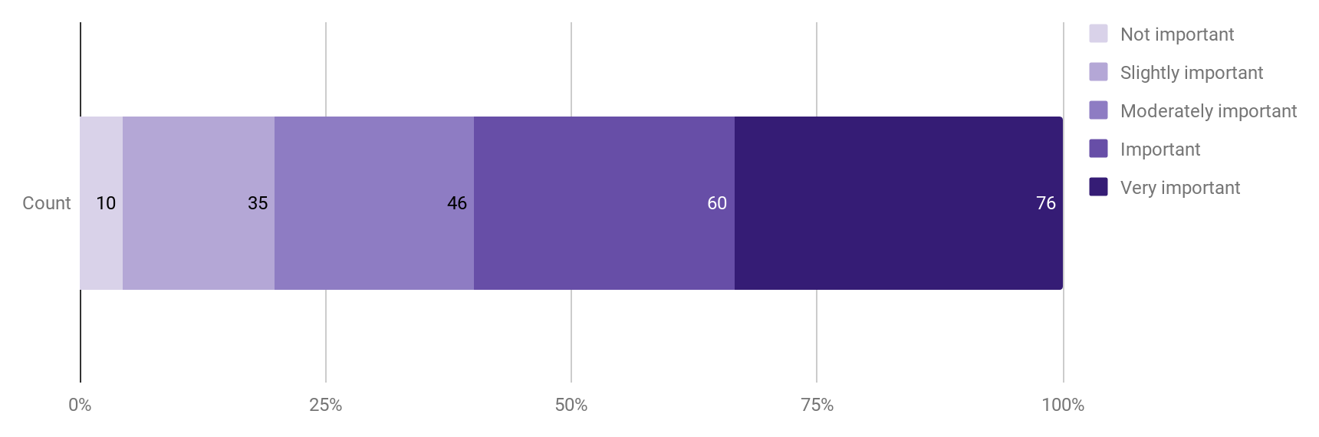
Importance of measuring reuse for the institution
(n=227)
Notes:
This chart shows the importance of measuring reuse for responding institutions.
The majority of whom say it is either ‘Important’ or ‘Very important’.
Could be due people who take this survey are more likely to prioritize this type of work at their institutions, but still, not bad, especially when ‘Moderately Important’ is included
Darker purple is higher importance and lighter purple is of less importance.

Slide 16
Prioritized Use Cases
(1 of 2)
Understanding how content is being reused in a variety of contexts by various audiences (social media, classrooms, scholarly works, genealogy, digital humanities, etc.)
Tell stories of impact with the reuse data that has been captured and tailor it to specific audiences/stakeholders
Assesses quality and quantity of items reused to inform digitization projects and priorities
Notes:
In the final survey, we gave participants three use case questions, one for each category:
1) Data Collection, Analysis, and Reporting
2) Collection Development,
and 3) Privacy, Rights Management, and Ethics.
For each category, respondents were asked to rank the given use cases in order for our research team to tell which were the most important of those use cases - and what we should address first in a future toolkit.
In the survey, these choices were randomized to help prevent presentation bias.
From these survey results, we weighted each use case by the order in which it was ranked and then averaged that by the number of responses.
Our results showed that understanding how content is used was the most highly rated use case closely followed by wanting to tell stories about the impact for their stakeholders

Slide 17
Prioritized Use Cases
(2 of 2)
Enable/encourage attribution of materials from collection in various reuse contexts, including through sharing and reposting on social media, integration into classroom instruction, citing in scholarly works, or through non-academic avenues
Know and understand digital repository users without violating user privacy
Notes:
Additional results can be found in the groups’ white paper, which I will reference at the end of this presentation

Slide 18
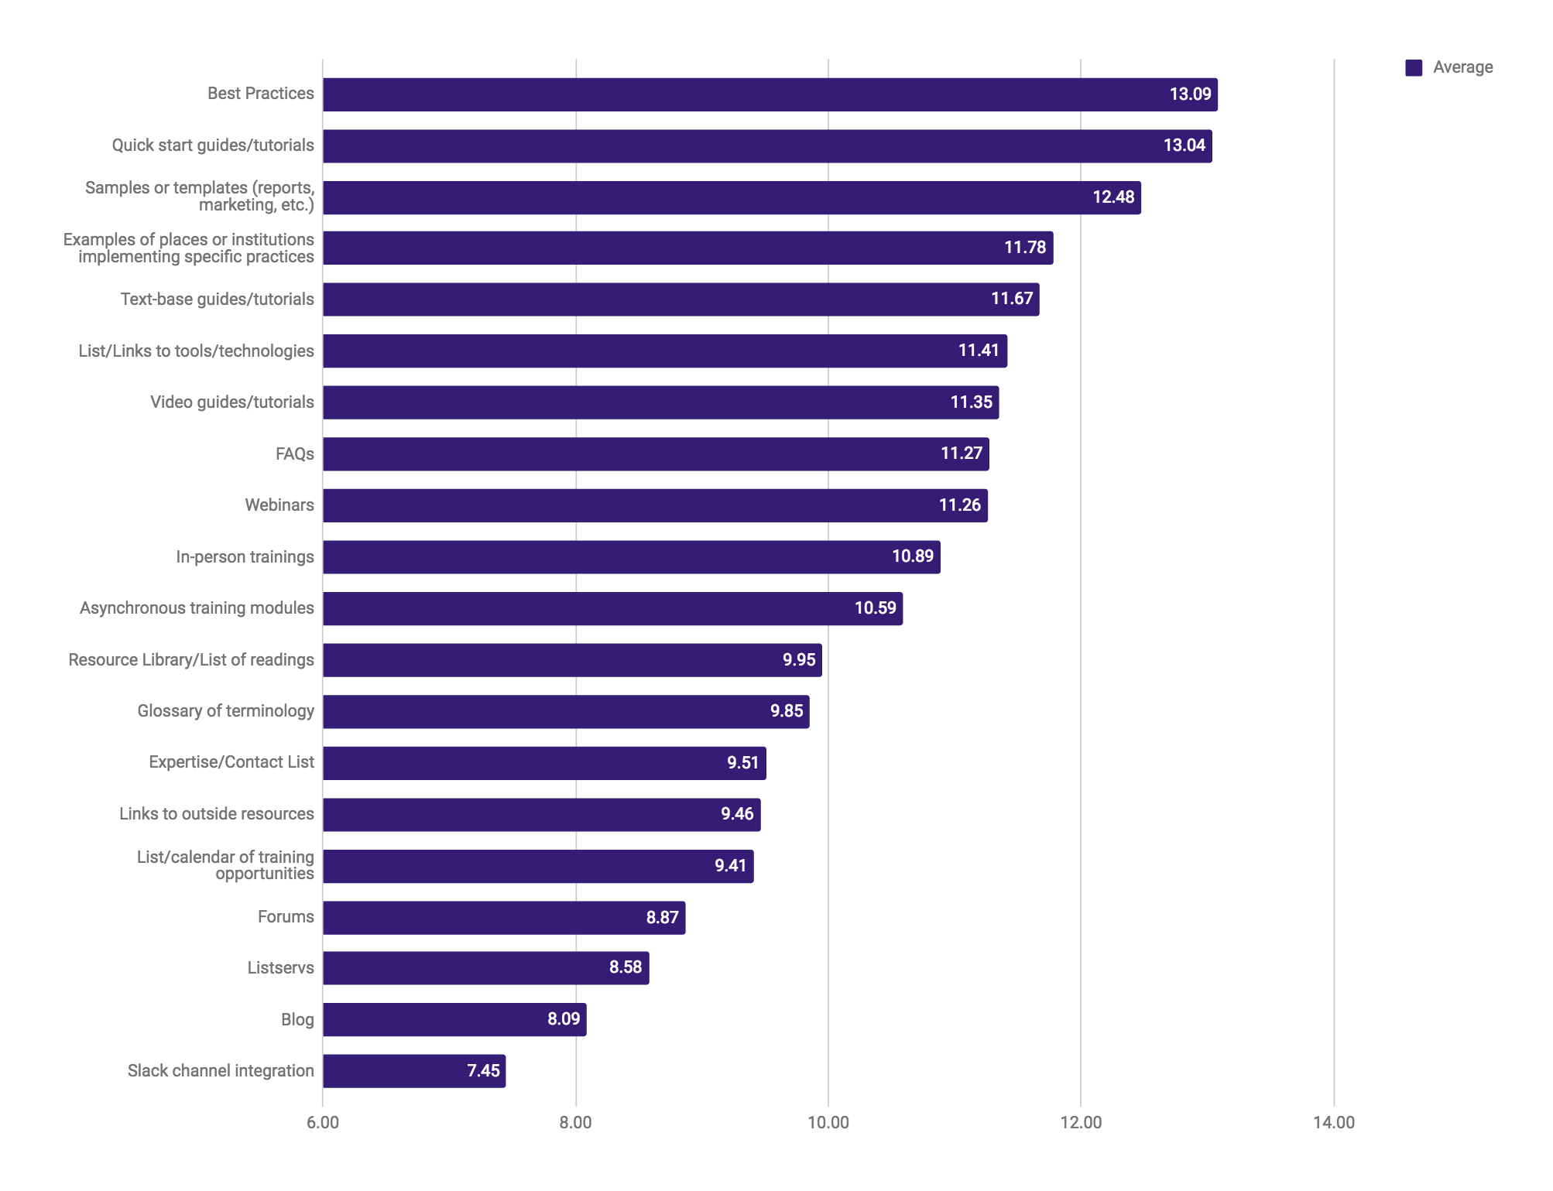
Functionalities for a Reuse Assessment Toolkit
weighted and averaged
(n=223, range 7.45-13.09)
Notes:
Finally, the survey looked at what functionalities a possible toolkit should include.
Respondents were in favor of Best Practices and also quick start guides and tutorials.
They were also interested in seeing samples or templates of reports or marketing material, examples of institutions implementing specific practices, and text based guides and tutorials.
They were least interested in Slack channel integrations, blogs, listservs, or forums.

Slide 19
Next Steps

Slide 20
Spread the word
Setting a Foundation for Assessing Content Reuse: A White Paper From the Developing a Framework for Measuring Reuse of Digital Objects project.
Performance Measurements & Metrics,
“Barriers and Solutions to Assessing Digital Library Reuse: Preliminary Findings”
Upcoming conferences:
  GL20 Conference
  CNI Fall 2018 Meeting
Notes:
Next, we will continue to spread the word about our findings in this project.
For all results, and project data, see the project’s white paper “Setting a Foundation for Assessing Content Reuse,” which is found in the team’s OSF repository. Visit our home page for more information.
Our first journal article just came out in Performance Measurements and Metrics called “Barriers and Solutions to Assessing Digital Library Reuse: Prelim Findings.”
The article has been published OA and can be found in our OSF repository (again, linked from our home page)
We have participated in a lot of conferences over the last two years, but we will be presenting in two more upcoming conferences, which are: the GL20 Conference focused on grey literature and the CNI 2018 Fall Meeting.
These touch points are really helpful for us to connect with all of you, our colleagues, and to force us to articulate some of our findings which is always helpful on a long-term project like this one.

Slide 21
Applying for another grant
Second grant to build the toolkit based on use cases and functional requirements
Notes:
And finally, we have submitted our preliminary proposal for an IMLS Project Grant so we can actually create the tooklit based on the use cases and functional requirements we gathered during this project.

Slide 22

THANKS!
Any questions?
reuse.diglib.org
Notes:
Feel free to send us questions on twitter too, which we will do our best to follow-up on if we run out of time.

