Slide 1


Bringing IRUS to the USA: International Collaborations
Santi Thompson, Jo Lambert, Joy Perrin, Sara Rubinow, Katherine Kim, Ross Macintrye, David Chaplin, Paul Needham, Hilary Jones, Laura Wong, Bethany Nowviskie, Christa Williford, and Wayne Graham

Slide 2
Background and Overview
IRUS-UK and IRUS-USA Pilot
DLF Assessment Interest Group (DLF AIG) connections and interests
Pilot recruitment, configuration, and assessment
Findings
Notes:
In March 2017, Jisc, DLF, and the Council on Library and Information Resources (CLIR), DLF’s parent organization, announced an intent to collaborate around a number of issues of mutual interest.
Stakeholders in the Jisc and CLIR/DLF community selected IRUS as the first collaborative effort between the two organizations.
In a press release (?), Chuck Henry, President of CLIR, articulated some of the potential benefits to such a collaboration, including:
Giving participating institutions the ability to plan and make strategic decisions based on their, and other institutions’, data
building a user community of shared standards
the inherent, collateral goal of national and international coherence at scale in support of higher and continuing education
and the promotion of OA.
To facilitate this collaboration, the two groups developed a pilot project to bring IRUS-UK to the United States (branded as IRUS-USA).
The group was comprised of individuals from both organizations, including representatives from DLF’s Assessment Interest Group (AIG).
Together, the pilot project organizers devised a three-phased approach to the project, including pilot recruitment and platform configuration, information sharing on IRUS-USA, and pilot assessment.

Slide 3
IRUS
A national aggregation service, enabling IRs to share/expose usage statistics at the individual item level, based on a global standard—COUNTER
Collect raw download data from IRs for all item types within repositories
Process those raw data into COUNTER-conformant statistics
Notes:
What is IRUS?
Institutional Repository Usage Statistics

Slide 4
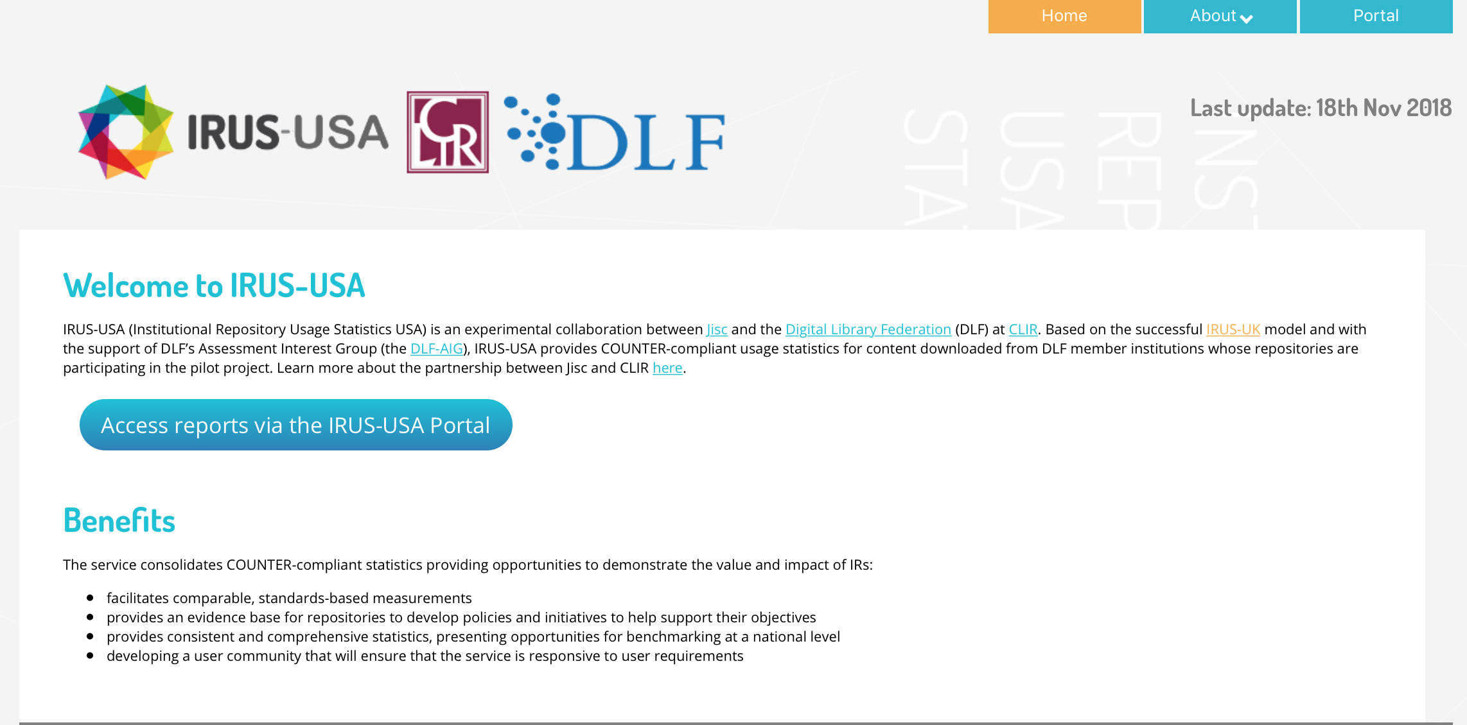
Notes:
Home page introduces the project and highlights benefits of service
A survey of UK institutions indicates that IRUS-UK primarily offers value by improving statistical reporting, enabling new forms of reporting, saving time collecting statistics, and increasing knowledge to support better decision making.

Slide 5
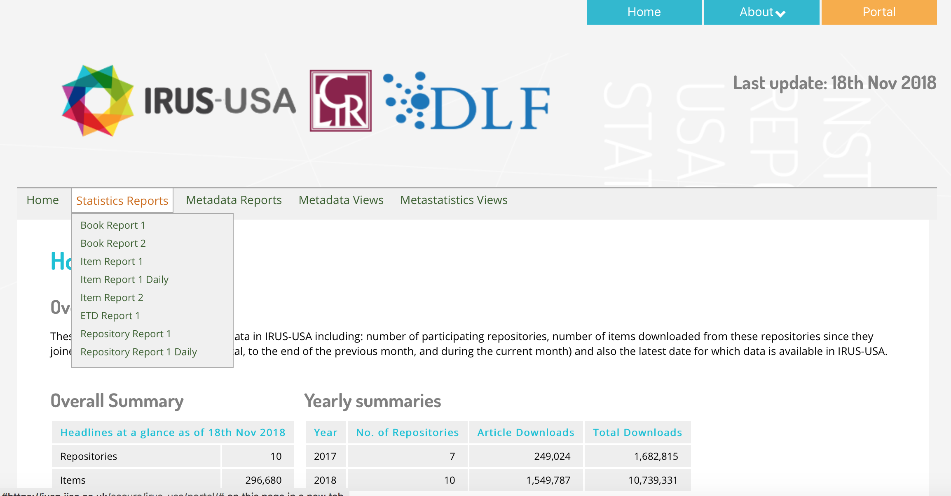
Notes:
IRUS-UK presents statistics through a portal via a series of charts and data visualisations that enable users to easily understand, interpret, and communicate data.
The IRUS-USA pilot replicated the UK approach but provided a limited subset of reports and, therefore, functionality.
These reports provided a general indication of features available in the production service and enabled the pilot group to assess value.
Some of the reports include:
Summary of all data in IRUS-USA
Provides summaries of data in IRUS-USA including: number of participating repositories, number of items downloaded from these repositories since they joined, numbers of downloads (in total, to the end of the previous month, and during the current month).
ETD (electronic thesis or dissertation) Report 1
Indicates the number of successful thesis or dissertation download requests by month and repository identifier for a selected repository.
Repository Report 1
Indicates the number of successful item downloads by month for all participating repositories.

Slide 6
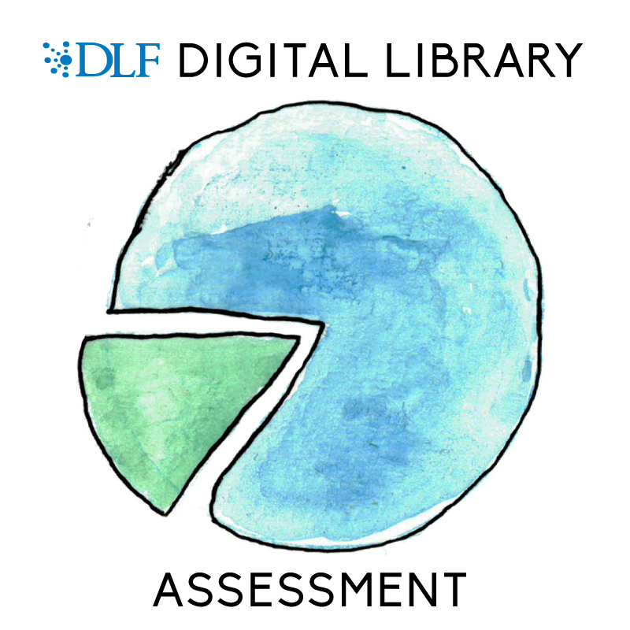
Notes:
The DLF Assessment Interest Group (AIG) seeks to engage the community in developing best practices and guidelines for various kinds of digital library assessment.
Since 2014, the DLF AIG has been concerned with:
determining how to measure the impact of digital collections through qualitative and quantitative metrics;
developing areas of commonality and benchmarks in how we measure collections across various platforms;
understanding the costs and benefits of digital collections;
and exploring how can we best collect, analyze, communicate, and share such information effectively across our various stakeholders
Three individuals from the AIG joined the IRUS-USA pilot to assist with the assessment of the project.

Slide 7
Research Questions
What are the primary repository usage assessment needs, barriers, and opportunities for IRUS-USA pilot participants?
What is the perceived value of international measurement and benchmarking among IRUS-USA pilot participants?

Slide 8
Participants
Caltech
Indiana University
Montana State University
Smithsonian Institution
Swarthmore
University of Arizona
University of Houston
University of Maryland
University of Michigan
University of Pittsburgh
University of Virginia
Notes:
With a note that some of these institutions were unable to participate because of platform barriers

Slide 9
Methodology
Survey
Focus group
Notes:
Two methodologies were used to assess the IRUS-USA pilot: a survey and a focus group.
The assessment group developed survey questions by modifying a previous IRUS-UK assessment survey
The survey was sent to the 11 institutions that were participants
(Caltech, Indiana University, Montana State University, Smithsonian Institution, Swarthmore, University of Arizona, University of Houston, University of Maryland, University of Michigan, University of Pittsburgh, and University of Virginia) with a response rate of 72% (ten starting the survey and eight finishing).
Survey questions appear in Appendix A of our proceeding.
In the survey, participants were asked if they would be willing to participate in a focus group. This pool of self-selected individuals were used for the focus group.
Four of the survey participants agreed to be a part of the focus group and three participated in the focus group.
The prompts for the focus group are included in Appendix B.

Slide 10
Selected Survey Findings
Usefulness of reports
Benefits of repository statistics
Value of IRUS-USA
Improved decision making
Notes:
Usefulness of reports
The reports that scored the highest on usefulness are the “Item Report 2,” “ETD (electronic thesis or dissertation) Report 1,” and “Item Report 1.”
Many of the reports received “Do not use” from 4-6 institutions.
These results were further investigated in the focus group.
Benefits of repository statistics
The responses indicated that most participants use IRUS-USA to “identify trends and patterns in usage” a “to contribute to statistics,”
Other popular benefits included “regular reporting to management,” “to provide evidence related to the impact of institutional outputs,” and “advocacy with researchers.”
Value of IRUS-USA
Participants found that IRUS-USA is best at saving them time in collecting statistics and enabling reporting previously unavailable.
To a lesser extent, they found that it improved statistical reporting and increased knowledge to support better decision making.
Improve decision making
The majority of participants noted that IRUS-USA was useful for supporting better decision making.
Participants noted the benefits of being able to see other institutions’ statistics and would desire more functionality to compare across institutions
Also would like to be able to compare across disciplines/domains

Slide 11
Selected Focus Group Findings
Reports and features
Continuing education
Membership model
Notes:
Reports and Features
Regarding why some of the built-in reports were not used, all participants agreed that it was not always clear how the reports worked or what they were trying to show.
They agreed that there is a need for more documentation and more education regarding how the statistics are gathered and displayed.
One reported inconsistencies between their expectations and what the reports showed, which indicated a need to investigate more deeply to see if the anomalies are a problem on the repository end or a problem interpreting the report.
Continuing Education
Regarding continuing education, all three participants said that documentation explaining how IRUS-USA works is most needed.
They also noted that working with a group interested in developing policies and standards would be very valuable.
It should be noted that many of the feature requests and enhancements suggested during the focus group are already provided through IRUS-UK and its program of services. Resource constraints, however, necessitated that IRUS-USA offered reduced functionality for the purposes of the pilot.
Membership Model

Slide 12
Challenges and Barriers
Unclear pilot system features
Lack of pilot documentation
Lack of graphical representations/visualizations
Notes:
Unclear pilot system features
When asked if the current functionality of the system was easy to understand, four said “Yes,” three said “Maybe/unsure,” and one said “No.” This suggests that the functionality of the system could be made clearer.
The participants offered suggestions for enhancements such as:
making the tool faster,
showing top downloads/views,
sorting reports by academic departments,
viewing statistics in the browser, including date as a filter, providing author-level download reports,
breaking downloads down by country by institution,
and running special reports like the ETD Report across all institutions.
The authors anticipate that many of the functionality and documentation barriers identified during the assessment will be mitigated by an expanded service, comparable to the increased functionality found in the full-scale IRUS-UK platform.
Focus group participants also expressed a desire to have better graphical representations and visualizations available to supplement the hard numbers aggregated by the service.

Slide 13
Broad Implications
Desire for a larger community that works with defined usage statistics assessment criteria
Curiosity in international benchmarking capabilities
Notes:
Beyond the research questions, the results of the IRUS-USA pilot project speak to broader implications for IR usage statistic assessment.
The pilot project serves as an important use case for a full-scale IRUS-USA service.
According to this survey and focus group, it is likely that most institutions in the US would find the service valuable and would support a fee-based model.
A few institutions will find more value in the service when it is more-widely adopted nationally.
There was additional interest and curiosity among pilot participants in IRUS-USA’s international benchmarking capabilities.
Based on this assessment, however, the international collaboration opportunities are secondary to reliable intraorganizational statistics at this point in time.
As a result, the authors of this paper recommend that the project first focus on widespread US adoption, which will provide institutions with the means, over time, to benchmark against local peers.

Slide 14
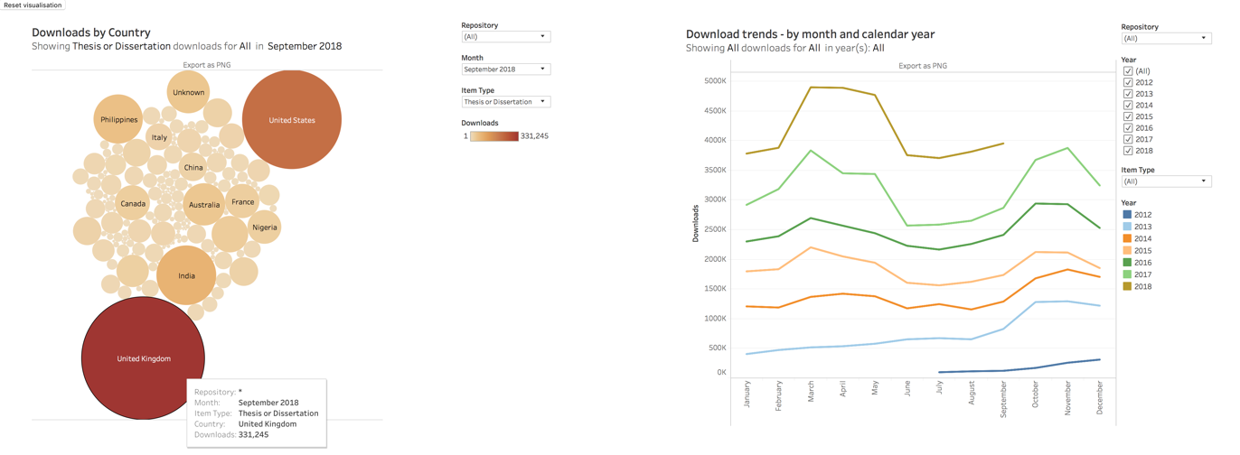
Next Steps
Notes:
The IRUS-USA pilot will consider these assessment results as it aims to identify next steps and, ultimately, expand the scope to a full-fledged usage statistic platform.
As a first step, we have drafted recommendations for Jisc and CLIR/DLF, focused on:
enhancing functionality through access to the production service,
increasing awareness and an understanding of IRUS-USA benefits,
and sharing potential collaborative models for community support.
Some of the earliest feedback has already begun to be addressed.
Three new data visualisations introduced post pilot feedback.
Visualisations are currently available for ‘Download Trends – by month and calendar year’;
‘Downloads by Item Type’;
and ‘Downloads by Country’.
These ban be viewed across all repositories or individually.
These recommendations, in conjunction with the cooperative spirit established by multiple parties who make up the pilot project, will fuel this much needed assessment resource moving forward.
At this current time CLIF/DLF and Jisc are developing a formal business plan for a full IRUS-USA service.
There will be additional updates and information shared out to the community in the early months of 2019.

Slide 15


Thank you! Questions?
sathomp3@central.uh.edu info@diglib.org irus@jisc.ac.uk

