Slide 1
Creating, Assessing & Communicating Social Value
A Legitimacy Based Framework

Slide 2
Assessing Social Value
Three Interrelated Questions
What services create social value?
How is that social value assessed?
How is the assessed value communicated?
Notes:
We realized it was a 3 part problem

Slide 3
“Interrelatedness” & Legitimacy
Interrelatedness = Resources to sustain the library as a durable social institution
Legitimacy = Community perception that the library’s actions are desirable & appropriate

Slide 4
Legitimacy Framework
Regulative
Cultural Cognitive
Normative
(External
Sub-Community)
(Community)
(Library)
Ideals
Values
Principles
Beliefs
Practices
Standards
Communication
Service
Assessment

Slide 5

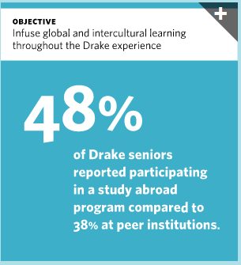

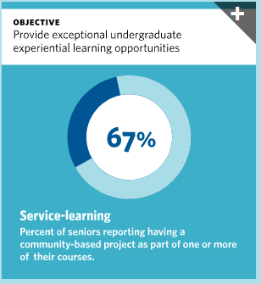
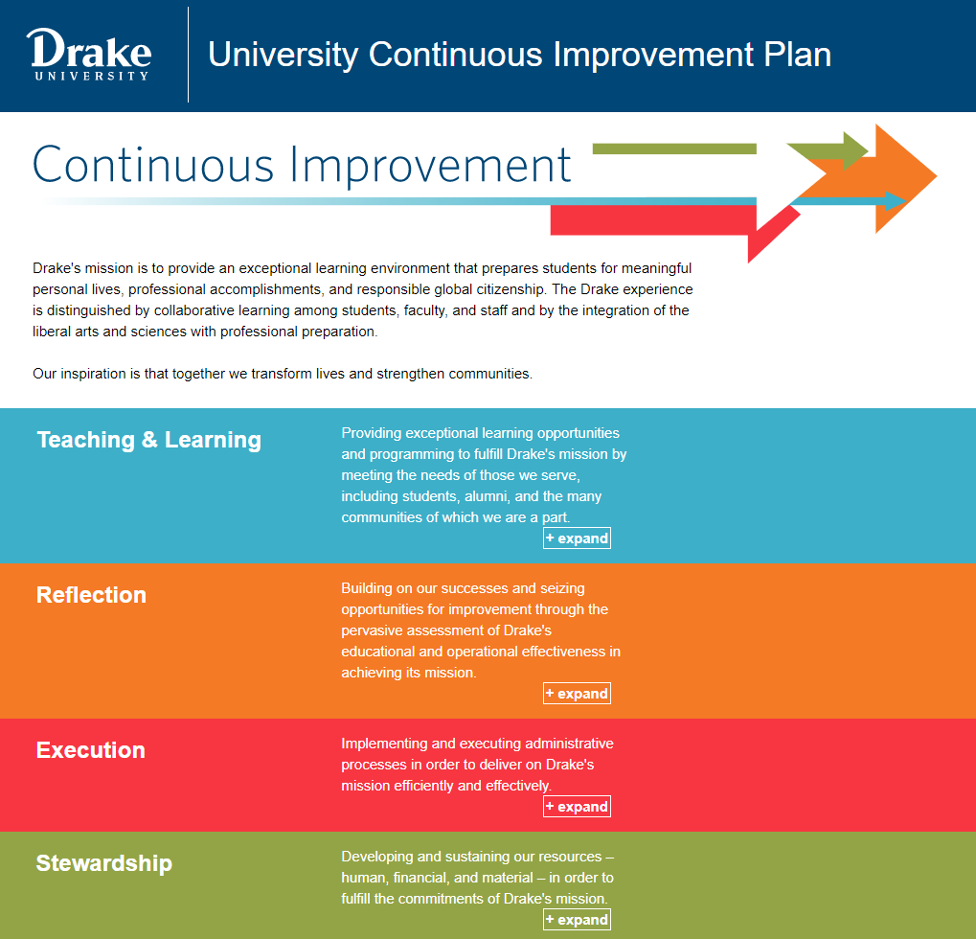

Element: Cultural-Cognitive
Ideals: Social justice ideals of the organization
Beliefs: Belief in how they will be realized
“Global & Intercultural Learning”
“Community Engagement”
“Diversity & Inclusion”

Slide 6
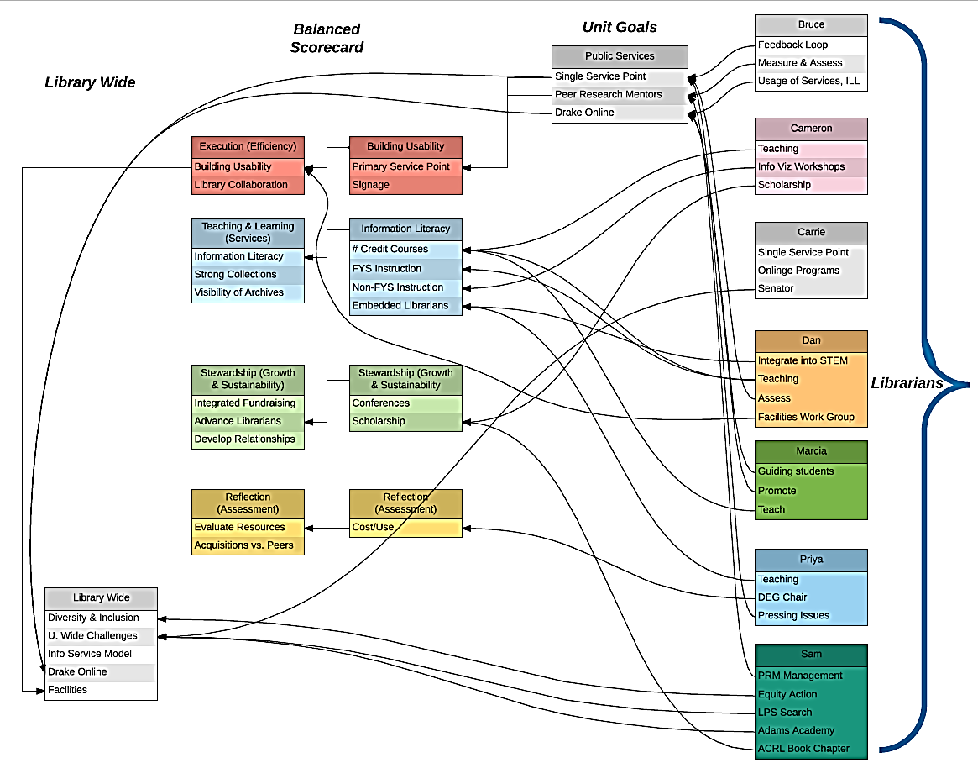
Element: Normative or Moral
Values: What are your professional values?
Practices: What practices realize those values?
ALA Code of Ethics “… ensure the free flow of information and ideas”
Multicultural Collections
Instruction: CREW Scholars
ACRL Framework for Information Literacy “Authority is Constructed and Contextual”

Slide 7

Element: Regulative
Principles: Principles that guide behavior?
Standards: Standards for evaluating behavior?
“Recognizing & nurturing differences and identities”
“Increase diverse cases in case-based courses”

Slide 8
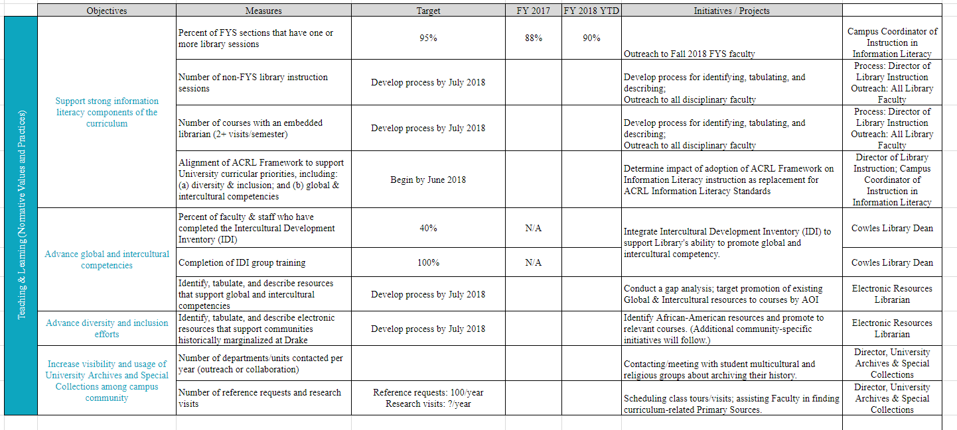
Assessing the Social Value of Library Services
Inflow of Resources
Influence on Resource Allocation Decisions
Ability to Define Beliefs

