Slide 1
LibQUAL+ Results Bring
More Questions
than Answers
Kimberly Vardeman
Jingjing Wu
Texas Tech University
Notes:
Kimberly Vardeman, User Experience Librarian
Jingjing Wu, Web Librarian

Slide 2
BACKGROUND & OUTLINE
Introduction
X/O tests
Card sorting
A/B tests
Unmoderated usability testing
Heuristic evaluations
All-student survey
Conclusion
Notes:
We’ll begin with some background and an outline. The Texas Tech University Libraries conducted the LibQUAL+ survey in 2017. After receiving our survey results from LibQUAL, we had many unanswered questions—What is the next step? How should the results be shared? What are the problem areas? Which problems should be addressed first?
As an initial step, LibQUAL+ didn’t offer us specific answers, but it suggested potential directions for further study. We identified the website as a potential problem area that merited additional study. We collaborated to gather more evidence to guide our action.
In our presentation, we’ll talk about the variety of research methods we used to iteratively test the website over subsequent months, with Jingjing making adjustments to the website along the way. In the short time we have, we’re going to focus on the lessons we learned from each of these methods. We thought that would be the most useful takeaway for you. Our paper will go into more detail about the results and subsequent changes we made on our website.

Slide 3
RE-VISUALIZATION AND CODING DATA
The LibQUAL+ report included complex graphics. We created infographics and charts to highlight key findings for stakeholders.
We coded over 1,400 open-ended comments into topics and sub-topics.
Notes:
So continuing with some background information, the survey results report generated by ARL included graphics that were not easily understood—including complicated, multi-color radar charts and high-low charts with interior and exterior bars. Those graphics communicated a great deal of information, but they weren’t effective at showing “at a glance” what results were most significant and actionable. The re-visualization and reorganization of the data made relevant information more understandable to stakeholders.
Additionally, the UX unit coded over 1,400 open-ended responses into topics and sub-topics, making it easier for different departments to locate the qualitative data that was relevant for their areas.

Slide 4
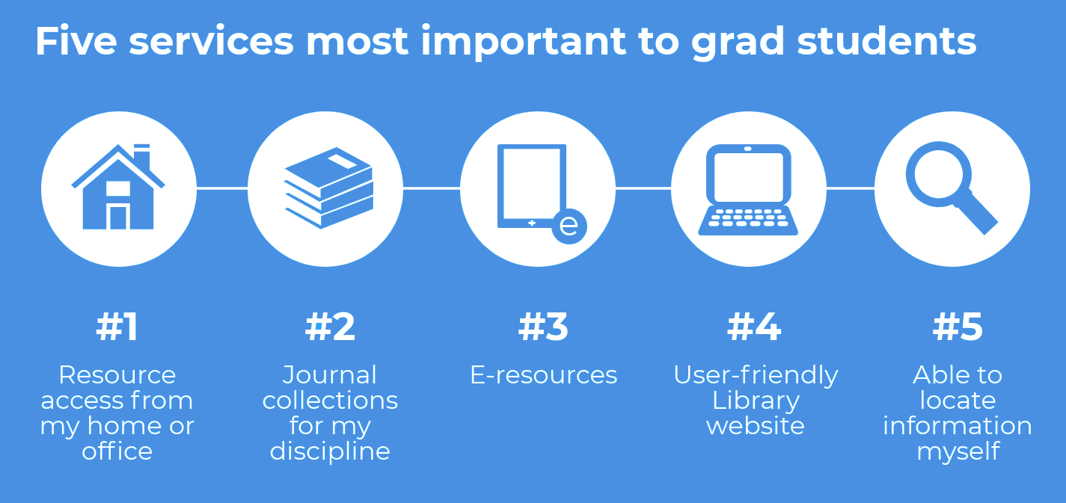
created using Piktochart PRO
Notes:
Here’s one example of an infographic created by the UX department to highlight key findings. It shows the most desired, or most important, library services for our graduate students.

Slide 5
WEBSITE RESULTS
Two LibQUAL questions about the website:
Enables me to locate information on my own
Ability to navigate library Web pages easily
Notes:
LibQUAL survey has 1 core question related to the website: A library web site enabling me to locate information on my own. We added a local question: ability to navigate library web pages easily.
This chart shows the results of these two questions: the gray bars show the range between the minimum and the desired, light gray for locating information, dark gray for navigation; the orange dots are perceived means.
So, generally speaking, the perceived means fall into the minimum-desired range. When taking a closer look, we can find faculty and graduates had higher expectations but lower satisfaction; while undergraduates had lower expectations and were happier with the site.
We also received 18 comments, where16 specified issues they met. We took actions on 5 suggestions and started further studies on others.

Slide 6
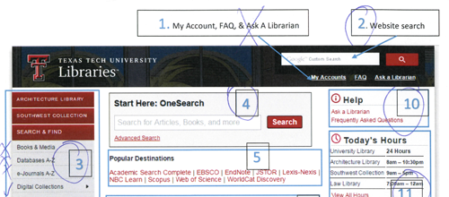
X/O TESTS
Conflicts between pre-survey and X/O results.
Low representativeness of graduates & faculty.
Final decisions depend on more factors.
Notes:
X/O test is a quick survey, where attendees are asked to circle items they use or like and crossed out those they don’t.
We ran X/O tests, for the library homepage. A complete test includes a pre-survey of demographic information and services they used before, plus the X/O session.
The results showed, some users circled several areas but reported they barely used the site, and vice versa.
The tests were mainly ran in the library building, we had around 80% undergraduate attendees, while the LibQUAL results told us graduates and faculty were heavier users of the website.
When making decisions, we referred to web analytics and the importance of content, to balance the bias of non-representativeness and self-report.

Slide 7
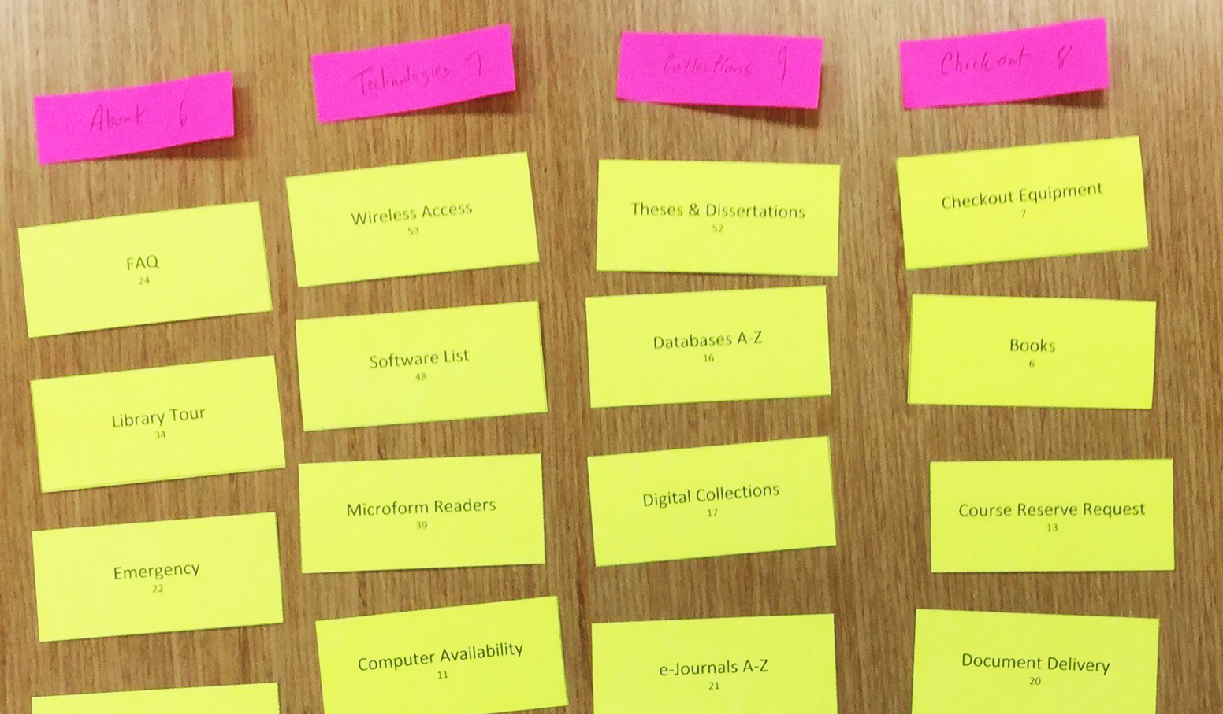
CARD SORTING EXERCISE
Pilot tests optimized terms and descriptions.
Combined results of pilot and official tests.
Pilot tests with library staff obtained buy-in.
Notes:
Card sorting is a method to design or evaluate the information architecture of a website.
We ran 4 rounds of pilot tests with library staff and student assistants. Pilot tests were helpful in determining cards, and optimizing procedures.
In pilot tests, attendees developed meaningful category labels. While, in official tests, students used vague terms, like resources or services, and it was difficult to see a clear pattern, because too many categories were suggested. If the official tests were changed to closed card sorting, using labels from pilot tests, the results could be more controllable and useful.
A bonus of pilot tests, was to get buy-in among colleagues. Several librarians told us, they did not expect such difficulties, organizing web content into categories, which make sense to students as well as to themselves.

Slide 8
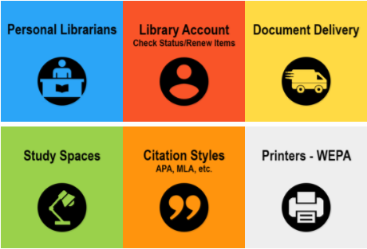
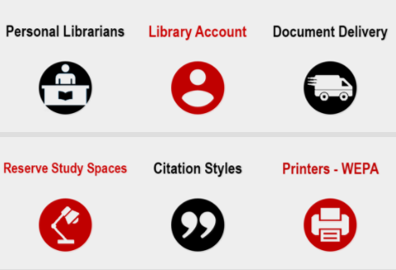
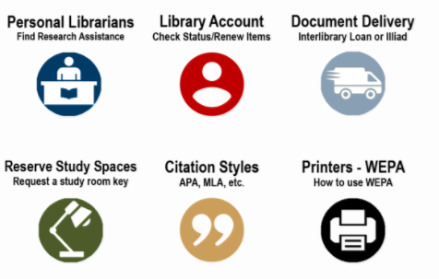
A/B TESTS
Changed plan during the onsite testing from usability testing to survey.
A/B tests for e-commerce sites vs. Library sites
Design A Design B Design C
Notes:
A/B tests are usually used to determine which of the two designs is better by the target audience.
In our A/B tests, we created 3 designs A, B, and C, and planned usability testing, where we gather the time to finish tasks on each design, as well as participants’ preferences.
After running a few tests, we switched to more of a survey, where we asked participants’ likings.
An authentic A/B test would randomly show different designs to visitors. According to Jacob Nielsen, “A/B testing can only be used for projects that have one clear and all-important goal” which is measurable, such as sales, or new subscriptions. Libraries probably cannot give an authentic A/B test, for the following reasons:
We are hesitant to create control and test groups, where one group might receive less-preferable designs.
Library websites, especially home pages, may not have outcomes that can be widely and usefully measured.
Less technical expertise or system capabilities may prevent us from displaying different designs randomly.

Slide 9
UNMODERATED USABILITY TESTING
Run multiple pilots to ensure testers understand instructions.
Tests don’t require as much staff involvement during testing.
There isn’t a chance to follow up on unexpected behaviors and post-survey comments.
Notes:
We recruited students to participate in unmoderated usability tests to evaluate whether common tasks could be performed easily. Participants were asked to complete 4 simple tasks on the Library website and then complete a short questionnaire comprised of open-ended questions about their overall experience using the website and the System Usability Scale (SUS). 28 students participated in the tests.
It’s critical to run multiple pilot tests before you begin testing. If testers do not understand the instructions or there are other problems with the testing design, you may not know it until after tests are completed and you’re watching the recordings.
Unmoderated usability tests did not require as much staff involvement during the testing, allowing us to conduct 28 tests within a couple of hours.
When we watched the recordings of the tests, we felt frustrated that we couldn’t be present to follow up on unexpected behaviors and post-survey comments—unlike with moderated testing.

Slide 10
HEURISTIC EVALUATIONS
Do not require evaluators to have expertise.
Identified areas of the website that were problematic for users.
Partnering with a course instructor presented many benefits and some drawbacks.
Notes:
We collaborated with a Texas Tech University faculty member in Technical Communication who instructed the undergraduate usability testing course. Students were randomly assigned to review one of three frequently used webpages and evaluate them using Jakob Nielsen's 10 Usability Heuristics for User Interface Design. After we received and reviewed their recommendations, we made changes on our home page such as removing an Advanced Search button that was causing users to commit errors. Some of the issues evaluators mentioned in their reports were built in to the university-level website template. We couldn’t resolve these.
It doesn’t require a high level of expertise to conduct a heuristic evaluation.
Having multiple evaluators review the websites helped us to see patterns and find areas that were repeatedly identified as problematic.
The partnership with a class instructor and students presented many benefits—the Libraries received detailed feedback from students and students had an opportunity to do relevant "fieldwork" that supported their curriculum. A drawback from receiving written reports via the professor and not communicating directly with the students was that we couldn’t always replicate problems they listed, or we didn’t have enough information. We didn’t have a process to follow-up with individual students.

Slide 11
ALL-STUDENT SURVEY
Notes:
We mirrored our annual all-student survey to complement LibQUAL+ in the Fall of 2017, about six months after LibQUAL. While we could only include 5 local questions on the LibQUAL survey, and the questions had to be selected from a question bank, this survey could be much more tailored and specific to our current needs. Because the website had been a major focus for us, we asked questions about it on our annual survey, including asking students to agree or disagree with the following statements:
The information I need is easy to locate.
The site allows me to complete the tasks I need to.
The overall design is appealing.
The percentage of students who agreed with each of these was 81-84%, indicating good progress on our goals for the redesign.
Two issues that remained were first, the relatively high number of “not sure” responses. Second, this was a student survey and didn’t include faculty responses. We need to find other ways to reach faculty, specifically because they were less-satisfied with the website than students.

Slide 12
OUR CONCLUSION
LibQUAL+ results generated research questions in specific areas.
We collaborated to test the website using various complementary methods.
Each method had its own advantages and disadvantages.
Notes:
To conclude, our LibQUAL+ survey results provided a foundation that generated research questions related to specific areas. We started by making the data more understandable to stakeholders and involving them in the process of reviewing and analyzing the data.
Then we collaborated to investigate the problems and potential issues and implement changes.
We described how to iteratively test the UX of a website using several complementary methods. We made quick changes during testing so that we could gather more feedback.
This shows the different ways to research a problem. We came at it from multiple angles to triangulate several data sources. Each method helped us evaluate different aspects of the website. In the process, we learned about the strengths and drawbacks of these methods and obtained experience using each one.

Slide 13
OUR CONCLUSION
We moved “from data to action” by
Involving stakeholders
Conducting further study using various methods
Making changes
Re-assessing.
kimberly.vardeman@ttu.edu
jingjing.wu@ttu.edu
Notes:
We were able to move "from data to action" through collaborating on further studies, making changes, and then re-assessing.
We believe these strategies extend the value of survey results and make assessments more effective and practical. This pattern can be used not only for a website but for evaluating other services and spaces.
Please contact us with questions.

