Slide 1
Library Return-on-Investment: Collaborating with Research Administration to develop a model for Health Sciences Library in support of research
Douglas L. Varner, MS, MLS, AHIP – Assistant Dean for Information Management / Chief Biomedical Informationist, Dahlgren Memorial Library, Georgetown University Medical Center.
Jennifer C. Kluge, MSM – Chief of Staff, Office of the Dean for Research, Georgetown University Medical Center.
Nancy N. Woelfl, PhD – Professor Emeritus, McGoogan Library of Medicine, University of Nebraska Medical Center.
Jett McCann, MLS, CKM, DM/AHIP – Senior Associate Dean for Knowledge Management; Director, Dahlgren Memorial Library, Georgetown University Medical Center.
Notes:
Good morning.
My name is Doug Varner. I am the Assistant Dean for Information Management and Chief Biomedical Informationist at Dahlgren Memorial Library at Georgetown University Medical Center
I am part of a multi-disciplinary and cross-institutional team conducting a research project assessing the value of the library to the research enterprise of an academic health center. Our team derived a quantitative measure of the impact of institutional investment in library resources on extramural grant income.

Slide 2

Notes:
I would like to start off this talk by discussing
What is the state of library return on investment algorithms? Specifically what is the institutional return on investment for providing resources to their respective libraries.
First start with a brief discussion of ROI and it’s application in library settings, giving some examples of it’s use.
Transition into a model that has been developed to correlate institutional investment with grant income, how that model has evolved into usage in an academic health sciences library and finally how the assessment team at Georgetown adapted this model for use in our setting.

Slide 3
Health Sciences Library at Georgetown University
Health Sciences Library at Georgetown University established in 1912
Dahlgren Memorial Library (DML) facility built in 1970
Georgetown University Medical Center (GUMC) – primary user groups
Georgetown University School of Medicine (SOM)
Georgetown University School of Nursing and Health Studies (SNHS)
Lombardi Comprehensive Cancer Center (LCCC)
Biomedical Graduate Research Organization (BGRO)
MedStar Georgetown University Hospital (MGUH)
Print repository through 2004
30,000 books
42,000 Bound journals
Migration to electronic/digital library beginning in 2004
6,000 electronic journals
4,600 electronic textbooks
3,000 print books
150 databases
19 clinical point-of-care tools
Notes:
DML – consolidated library merging several cross-campus health sciences libraries.
2004 – major initiative to migrate to a digital collection

Slide 4
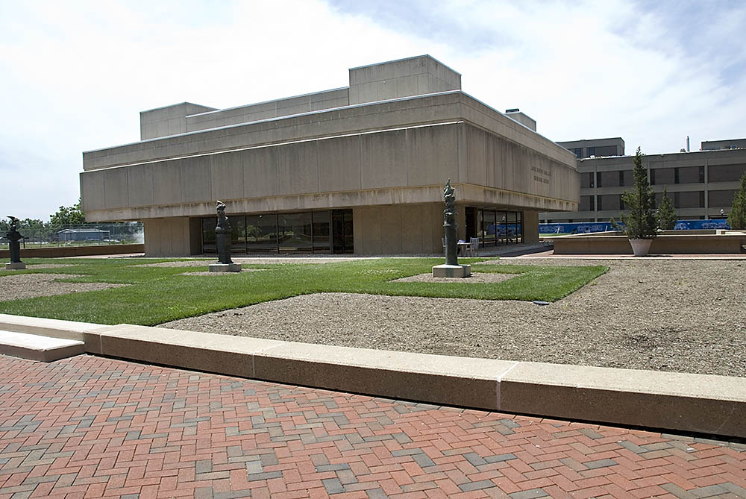
DML TODAY! [1970-present]
Notes:
DML of today….[1970-present]

Slide 5
Research at Georgetown University Medical Center
400 scientists working on basic and clinical research projects.
300 active clinical trials.
2017 research funding
$105 million in sponsored research
NIH funding
2017: $50 million
2018 YTD: $25.5 million
Areas of specialization
Cancer
Neuroscience
Child health and development
Global health
Carnegie Classification System R1: Doctoral Universities – “Highest Research Activity”.
Notes:
Since this presentation will focus on the library’s contribution to the institutional research enterprise I thought I would provide a snapshot of research endeavors at GUMC.
Georgetown has an Carnegie R1 designation which corresponds to the “Highest Research Activity”.

Slide 6
Return-on-investment and it’s application in libraries
Trends in the literature describing return-on-investment in the library setting
Cost savings
Use of library facilities / resources / services results in measurable savings to individuals, groups or institutions.
Revenue generation
Use of library facilities / resources / services enhances or provides a revenue stream primarily for the institution.
Notes:
ROIs described in the literature seemed to fall two different categories described.

Slide 7
Library return on investment
Qualitative ROI measures
Survey end-users for rating of satisfaction with library services/resources.
Marshall, J. G. (1992). The impact of the hospital library on clinical decision making: The Rochester study. Bulletin of the Medical Library Association, 80(2), 169-178. Retrieved from http://www.ncbi.nlm.nih.gov/pmc/articles/PMC225641/
Quantitative measures of library impact
Association of Research Libraries Statistics & Assessment program http://www.arl.org/focus-areas/statistics-assessment#.VVE0Uo5Viko
Steffen, N., Lietzau, Z., Lance, K. C., Rybin, A., & Molliconi, C. (2009). Public Libraries-a Wise Investment: A Return on Investment Study of Colorado Libraries.
Graves, Hamasu, Millsap, & Simmons, Medical Library Association Conference 2014
Library calculator
American Library Association
http://www.ala.org/advocacy/advleg/advocacyuniversity/toolkit/makingthecase/library_calculator
Midcontinent Region of the National Network of Libraries of Medicine
https://nnlm.gov/mcr/training/program-evaluation/cost-benefit-and-roi-calculator
Library contribution to institutional research endeavors:
Model developed by Luther & Tenopir and adapted for academic medical libraries by Woelfl
Notes:
In the past primarily qualitative ROI measures where gathered and analyzed commonly surveying end-users for ratings of satisfaction with library services/resources.
In Health Sciences Librarianship the Rochester Study by Marshall published in 1992 demonstrated by qualitative means that physicians judged information provided by the library as having a significant impact on clinical decision-making, patient care and saved the physician time. This is an important study but did not quantify any of the study findings.
There is now well established protocols and methodologies developed for quantitative measures of library impact
Association of Research Libraries Statistics & Assessment program has created a community of practice around the generation and use of quantitative data with tools such as LibQUAL ClimateQUAL LibValue
An example of a revenue-generating ROI study was a 2009 survey of approximately 5,000 Colorado residents. The survey collected data on library use and estimation of dollar amount for services if the respondent was not able to access their local public library. The return on investment (ROI) data generated was approximately five to one---that is, for every $1.00 spent on public libraries, $5.00 of value was
realized by taxpayers.
An example of a cost saving model was a University of Utah study presented at a recent Medical Library Association Annual Meeting section program titled: “Leading the
Way in Assessing Our Value” devoted to development of quantitative tools for library assessment. Researchers from the University of Utah described how librarian
participation in patient rounding allowed for the calculation of specific reduction in physician salary and benefits due to the librarians conducting literature searches relating to patient care instead of the
physician devoting time to this endeavor.
The American Library Association and The Midcontinent Region of the National Network of Libraries of Medicine have developed “Library Value Calculators” which compiles a benefits/cost ratio and return-on-investment calculation based resources, services and staffing.
The Dahlgren Assessment team used a model developed by Luther and Tenopir and adapted for use in academic medical libraries by Dr. Nancy Woelfl to quantify library contributions to research.

Slide 8
Quantitative Return-on-investment Model Development for Research Support: Luther 2008
University investment in the library: What’s the return? A case study at the University of Illinois Urbana-Champaign by Judy A. Luther [2008]
Origins of study
Research performance measurement
Cost justification
Return-on-investment
Carol Tenopir – research demonstrating positive impact of electronic access on productivity
Carol Tenopir and Donald W. King. “Perceptions of Value and Value Beyond Perceptions: Measuring the Quality and Value of Journal Article Readings.” Serials 20 (3) November 2007: 199-207.
UIUC developed the model & calculated $4.38 in grant income earned for every dollar invested in the library budget
Model adopted from corporate library:
Revenue generated from library support
Strouse, R. (2003, March). Demonstrating value and return on investment: The ongoing imperative. Information Outlook, 14–19.
Notes:
The ROI model used by the Dahlgren assessment team was developed by Judy Luther in 2008 working with the Dean of Libraries and faculty from University of Illinois Urbana Champaign.
The development of this model was based on the need for libraries to demonstrate to their administrators metrics measuring research performance, cost justification and return on investment figures and the application of research conducted by Carol Tenopir correlating electronic access to journals with faculty productivity
The model and results, published in a white paper referenced here show that at UIUC for every dollar the institution invested in the library budget, the institution could expect to earn $4.38 in grant income.
The model was derived from research conducted by Roger Strouse, formerly with Outsell Inc., who described the contribution of corporate and government libraries to their institutions
based on the time and costs saved by users and the income generated when using library resources. The research was published in a 2003 issue of Information Outlook.
At our North American Library Advisory Board (NALAB) in the 2006 Fall, we proposed the idea of conducting a case study with an academic institution. Paula Kaufman immediately and boldly raised her hand to volunteer the University of Illinois at Urbana–Champaign, providing access to their records, data, and wonderfully brilliant staff. Since then, we’ve assembled an esteemed team, including Carol Tenopir, Judy Luther, and Kira Cooper from Elsevier. Chrysanne Lowe; Vice President, Global Customer Marketing, Elsevier

Slide 9
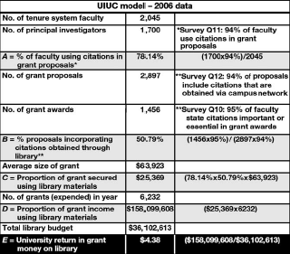
Notes:
This is the UIUC model with data coming from:
Internal institutional sources
Publically available databases
faculty surveys
Key data points:
From faculty surveys: 78.14% of faculty report using citations in grant proposals.
Number of proposals incorporating citations obtained through library collections: 50.79%
Again the ROI is $4.38 in grant income earned for every dollar invested in the library budget

Slide 10
Quantitative Return-on-investment Model Development for Research Support: Tenopir, et al; 2010
Tenopir, C., Love, A., Park, J., Wu, L., Baer, A., & Mays, R. (2010). University Investment in the Library, Phase II: An International Study of the Library's Value to the Grants Process. (B. Kingma & King, D. W., Eds.)Library Connect White Paper. San Diego, CA: Elsevier.
For every monetary unit invested in academic libraries, the parent institutions received a return on investment of between 15.54:1 to 0.64:1 in research grant income. In 6 of the 8 countries, the ROI for grants is more than 1:1.
Notes:
Carol Tenopir from University of Tennessee expands and tests the Luther model in this 2010 study by surveying libraries in 8 countries This study reported a positive correction between monetary investment in library resources and an increase in grant income for the majority of institutions reporting results.

Slide 11
University of Nebraska Medical Center
University of Nebraska Medical Center adaption of UIUC model
Number of principle investigators. | 97 | NIH Database Research Project Detail
a= percentage of proposals using citations. | 94% | a = NIH Research Awards/NIH Total Awards [where Research awards/Total awards reflects % of proposals using citations]
A4 = Number of grant proposals. | 575 | Number of grant proposals presumes a success rate of 20%
A5 = Number of grant awards. | 115 | Number of grant awards from NIH Database
b= Factor for citations obtained via library networks. | 80% | b=average response between UIUC and UNMC for citations obtained via campus library
B = Percentage of proposals incorporating citations obtained through library | 17.5% | B = % proposals incorporating citations obtained through library B = (A5 *b)/(A4 * a)
A8 = Total NIH Awards [2007]. | $41,100,105 | Dollars from NIH database
C = Proportion of grant secured using library materials | $6,567,797 | C = Proportion of grant secured using library materials C = (a * B* A8)
A10 = Total library budget | $3,117,530 | provided by library staff
D = University ROI for library | $2.11 | D = C/A10
Notes:
Nancy Woelfl at the University of Nebraska Medical Center adapted, for use in a health sciences library, the return-on-investment model developed by Judy Luther from work Ms. Luther conducted at the University of Illinois Urbana- Champaign.
The UNMC model demonstrates that for every dollar the institution invests in library resources the institution can expect to earn $2.11 in extramural grant income.
Now I will quickly walk you through how this calculation was derived.
The data in this model were gathered from institutional sources, public databases such as the NIH Reporter, faculty surveys and research administration. Only data from NIH grants submitted in 2007 were reported.
94% of faculty reported using citations in their grant proposals.
The total number of proposals and total number of awards were obtained from Research Administration.
80% of citations in the funded grant proposal reference section were reported to have been obtained from library collections – again from a library survey of faculty.
The figure 17.5 % is the ratio of the number of grant awards using citations from library collections to the percentage of proposals using citations.
This percentage was multiplied by the total NIH grant award dollar amount to arrive at the figure of 6.5 million dollars in grant money directly attributed to content in library collections.
The calculation was divided by the library budget to come up with a return-on-investment of $2.11.

Slide 12
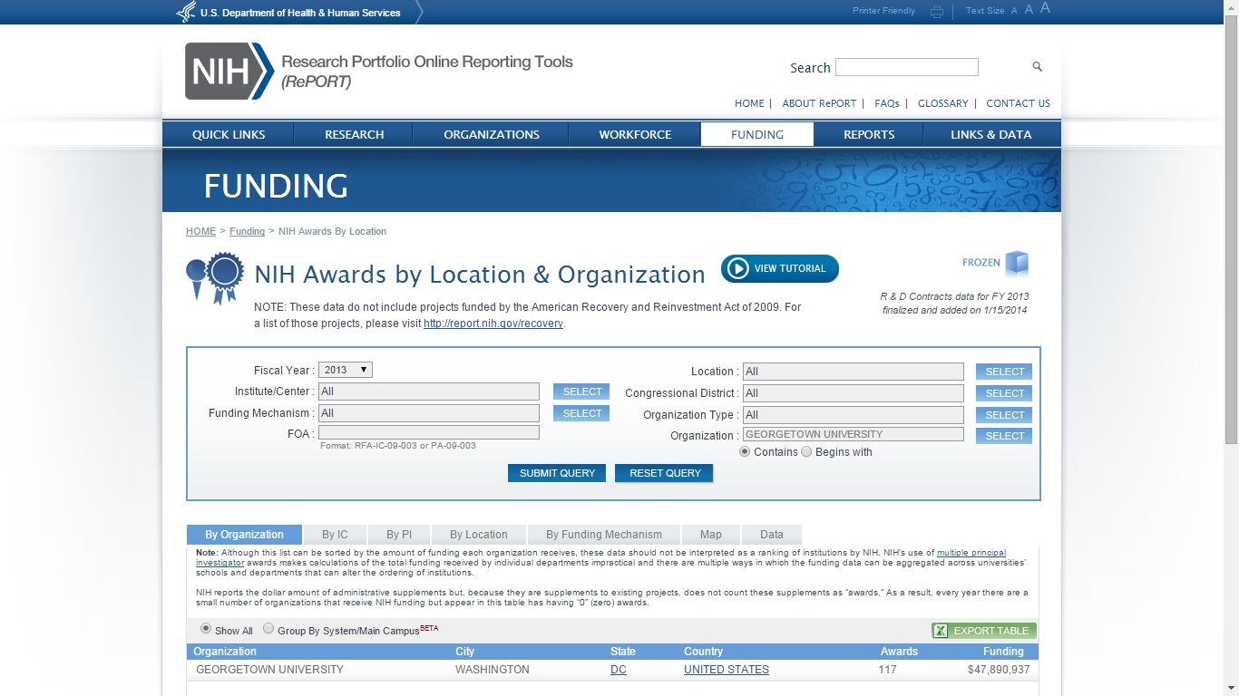
Notes:
The NIH Reporter was an excellent source to find information for our institution.
The “Funding” tab provided us with total NIH grant income and we focused on FY 2013
http://report.nih.gov/award/index.cfm?ot=&fy=2013&state=&ic=&fm=&orgid=2869001&distr=&rfa=&om=n&pid=&view=state

Slide 13
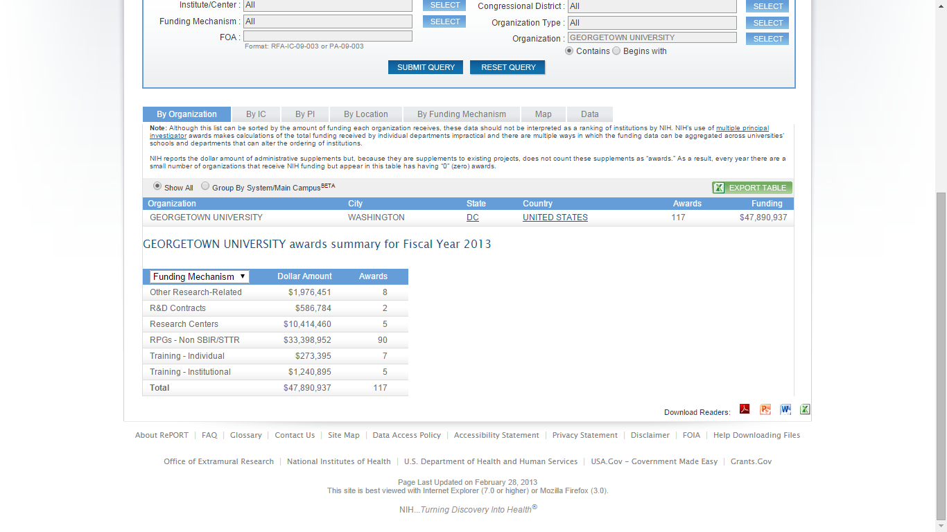
Notes:
Show $47 million in NIH grant income

Slide 14
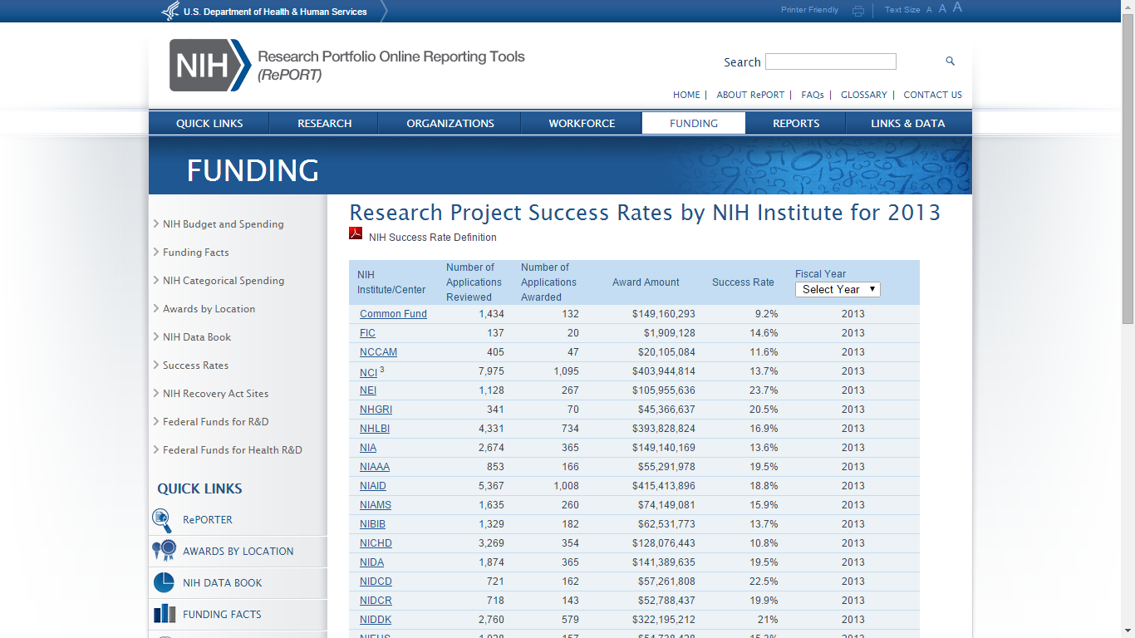
Notes:
Again from NIH Reporter
NIH institute proposal success rates for each institute for 2013.
http://report.nih.gov/success_rates/Success_ByIC.cfm

Slide 15
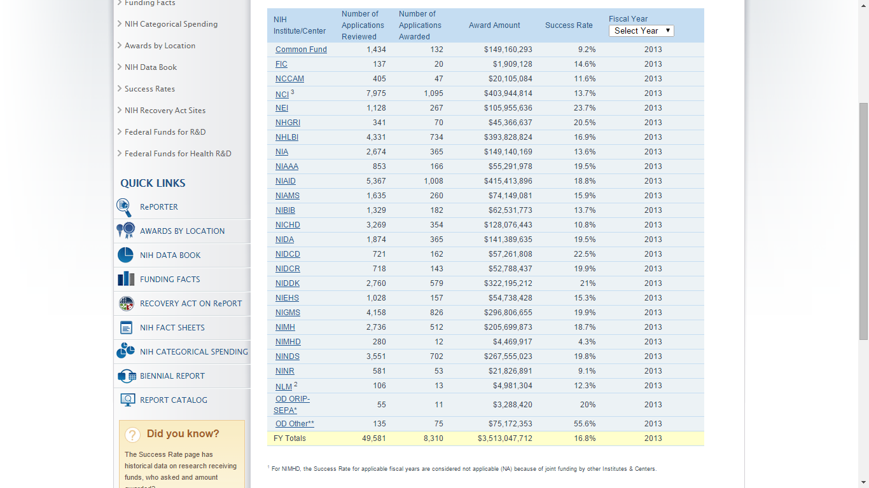
Notes:
Overall success rate is at 16.8% for 2013
FY13 NIH awards: 61
FY13 NIH proposals: 292
TOTAL: 353
61/353 = 0.173
Success rate for 2017 is 18.7%
54,005 applications reviewed
10,123 awarded

Slide 16
Dahlgren/Georgetown Citation Analysis Data
Proposals | Journals (Electronic) | Journals (Print) | Books (Print) | Open Access | Not in collections | TOTAL
Proposal 1 | 44 | 0 | 0 | 0 | 1 | 45
Proposal 2 | 79 | 0 | 3 | 1 | 14 | 97
Proposal 3 | 48 | 1 | 1 | 16 | 42 | 108
Proposal 4 | 32 | 0 | 0 | 1 | 7 | 40
Proposal 5 | 56 | 5 | 0 | 4 | 2 | 67
Proposal 6 | 23 | 0 | 9 | 3 | 21 | 56
Proposal 7 | 62 | 0 | 0 | 5 | 15 | 82
Proposal 8 | 12 | 0 | 0 | 4 | 3 | 19
Proposal 9 | 46 | 0 | 0 | 5 | 6 | 57
Proposal 10 | 57 | 0 | 0 | 3 | 17 | 77
Proposal 11 | 60 | 1 | 0 | 1 | 41 | 103
Proposal 12 | 5 | 0 | 0 | 1 | 0 | 6
Proposal 13 | 130 | 0 | 0 | 8 | 14 | 152
Proposal 14 | 0 | 0 | 0 | 0 | 0 | 0
Proposal 15 | 63 | 0 | 0 | 21 | 21 | 105
Proposal 16 | 25 | 0 | 0 | 3 | 9 | 37
Proposal 17 | 0 | 0 | 0 | 0 | 0 | 0
Proposal 18 | 35 | 0 | 0 | 4 | 1 | 40
TOTAL | 742 | 7 | 13 | 76 | 213 | 1051
% | 70.60% | 0.67% | 1.24% | 7.23% | 20.27% | 100.00%
AGGREGATED % | 79.73% |  |  |  | 20.27% | 100.00%
Notes:
For the Georgetown implementation of the return-on-investment model we decided to review each reference section from the grant proposals to determine the percentage of citations obtained via library collections.
The data gathering and analysis I am describing here is a pilot project in which we analyzed 18 proposals.
We derived five categories for the grant reference section analysis:
Journal articles in electronic format.
Journal articles in print format.
Print books.
Open access titles.
Items not in the collection.
The grant proposals were from 2013 NIH awards and provided to us by our Research Administration office or provided by the PI
As you can see we aggregated the first four columns in the table to represent the content available to faculty to support their grant submission work.
Our analysis shows that approximately 79% of articles were obtained from library collections.

Slide 17
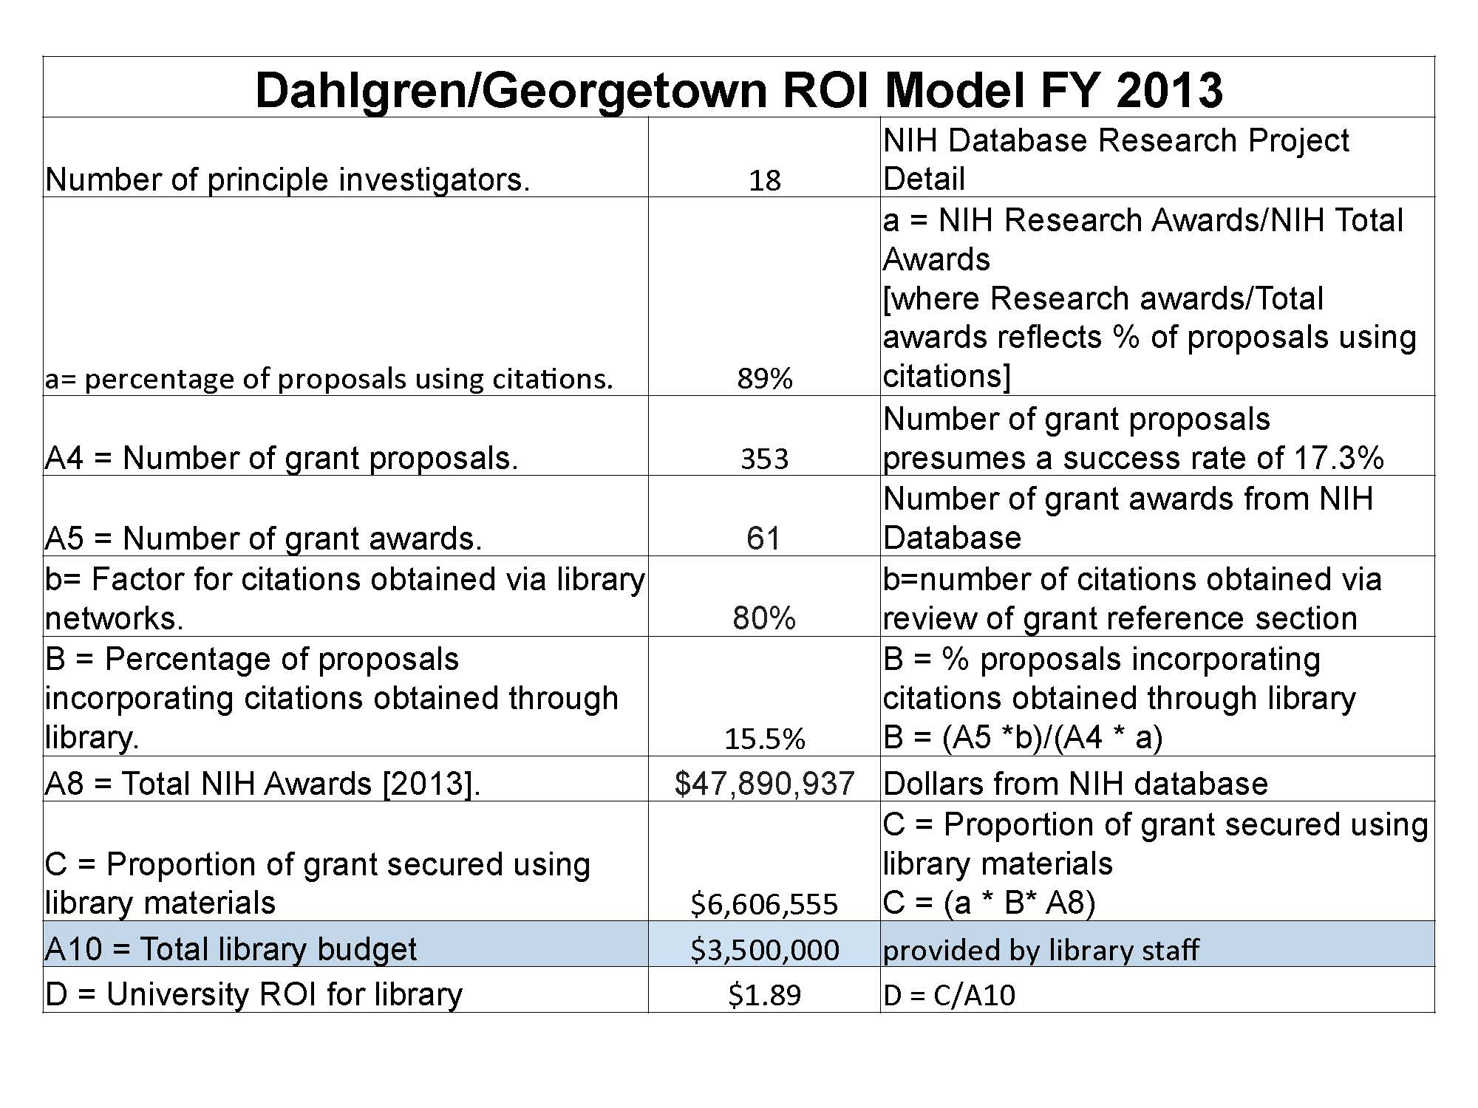
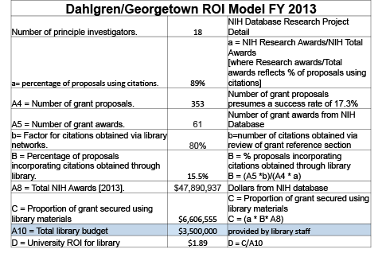
University of Nebraska Medical Center
Notes:
Here is our data using Dr. Woelfl’s model with the modification that we did not use faculty survey data
Our ROI is $1.89 in grant income generated for every dollar the institution invested in library resources.
$4,000,000 = $1.68
50% = 1.16
45% = approximated 1.06
Pivot point is library investment as it correlates with grant income.

Slide 18
Current challenges / future exploration
Pilot study
18 proposals from 2013 (will reanalyze since print volumes are no longer in collection).
7 proposals each from 2014 and 2015
Effect of combining years?
Modeling/forecasting to provide real-time dashboard of effects of library budget on grant income
EX: budget reduction will have $X.XX effect on grant income
Replication at other institutions
Model validation from statistician
Use to establish peer groups for benchmarking / budget justification
Notes:
Yearly allocations for multi-year grants
Modeling/forecasting – trend various parameters up or down – how will this affect ROI figure?
If this model is replication – could it be validated for widespread use?
If the model is adopted at other institutions we could potentially establish peer groups or benchmarking

Slide 19


QUESTIONS?

