Slide 1

Data modelling and why it matters
Frankie Wilson
Head of Assessment & Secretariat

Slide 2
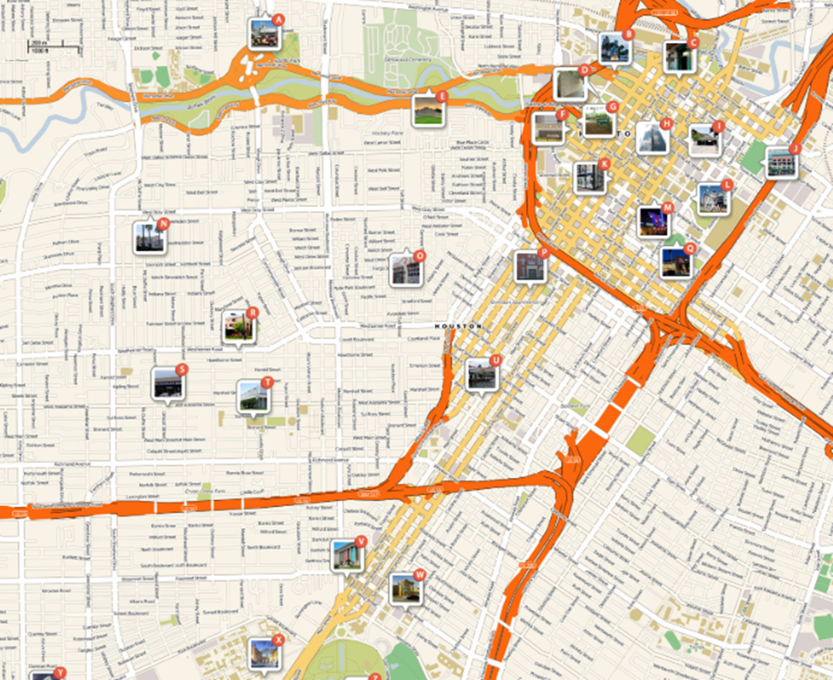
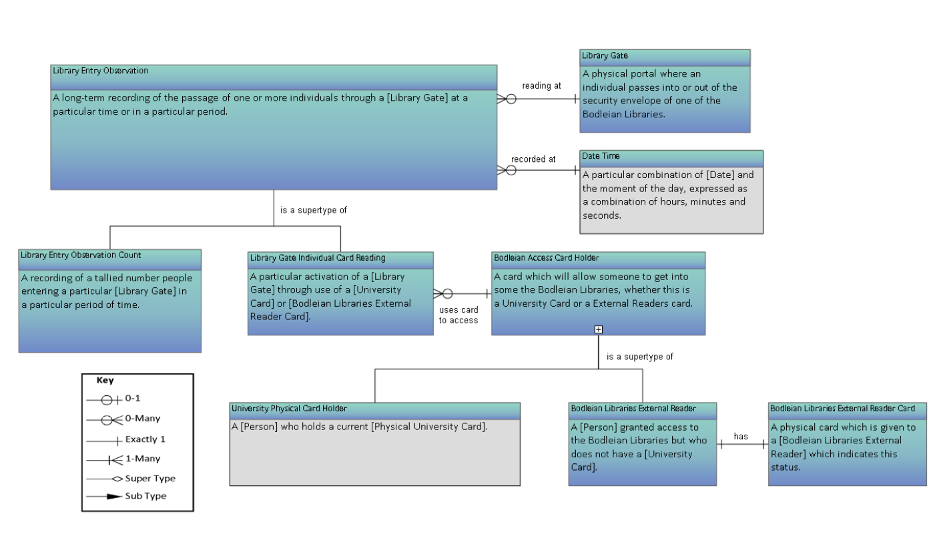
What is a data model?

Slide 3



Why are data models useful?
Every person in the library, for every day in a specific week, keeps a tally of the number of enquiries they receive. They report the daily number to a team ‘rep’ who sums them to get a team daily total. The rep then enters this figure into the form. Some libraries have more than one team; some teams cover more than one library; and some teams are not in any library.
700+ staff;
28 libraries; broadly subject focussed; back office & administration buildings; book storage facility

Slide 4
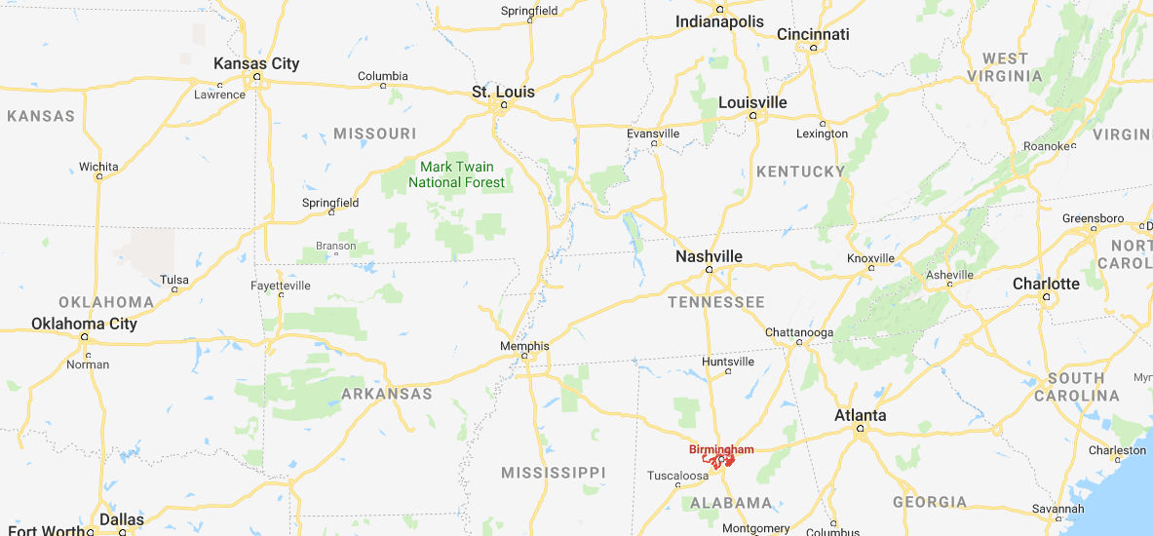



Implicit knowledge - context

Slide 5
Data model
A conceptual framework that represents the world as accurately as possible.
Defines the actors, actions and rules that govern the ways that processes work, representing them in a standard syntax.

Slide 6
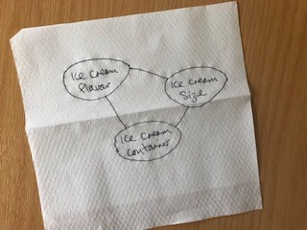
Ice cream
Ice cream flavour
Ice cream size
Ice cream container

Slide 7
All about the process
Time consuming
Challenging
Trial and error
Making implicit explicit
Thinking about how aspects of data relate to each other
Documenting constraints

Slide 8
Entities
Things that are important to the organization
Who; What; Where; When; Why; How
3 levels of abstraction: Subject; Logic; Physical
Student
Attainment Retention Satisfaction
Survey score

Slide 9
Elements
Property of entity that is important to organisation
AKA attribute; label; field
3 levels of abstraction
Programme of study
Department Status Level Mode
Course code

Slide 10
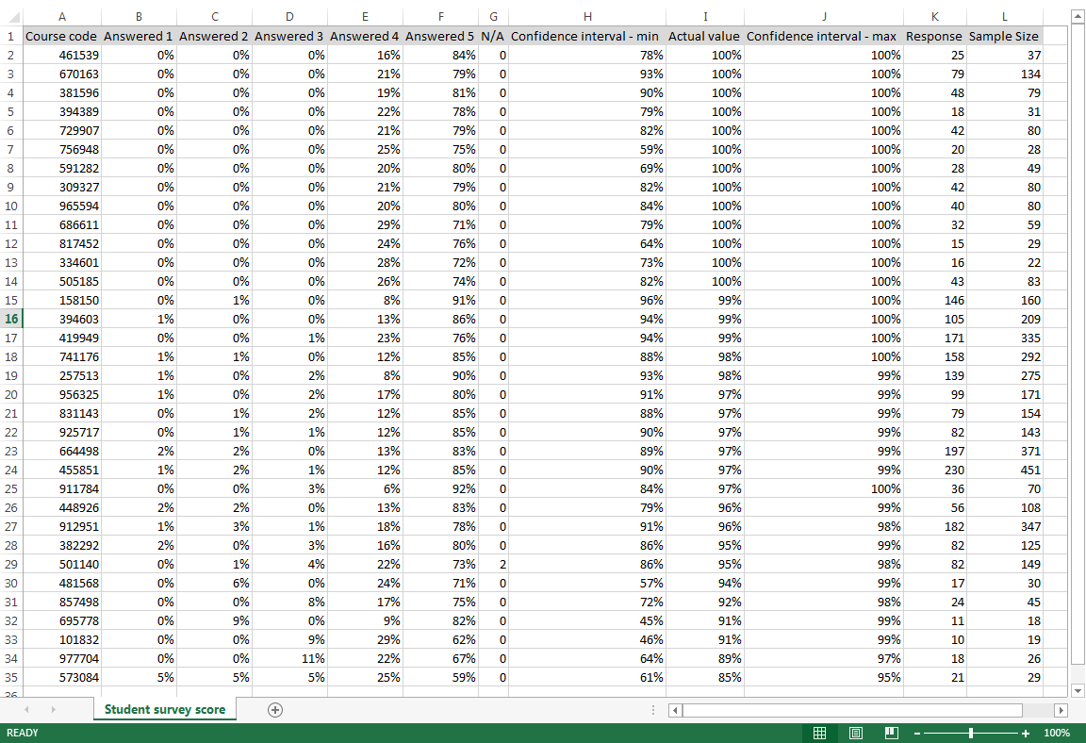

Slide 11
Relationships
Rules
Structural
Number participating in relationship
0; 1; many
Integrity
Ensure valid values
E.g. Library must be on prescribed list.

Slide 13
Learn from my mistakes
Build a subject area model before you start to collect, link, process, analyse, or visualise data.

Slide 14

Questions?
frankie.wilson@bodleian.ox.ac.uk
@qualitydog
Data modeling made simple by Steve Hoberman.

