Slide 1
Discovering Access: Uncovering the Connection Between Office Spaces and the User Experience
Sara E. Wright, Head of Learning, Spaces & Technology
Tobi Hines, Head of Operations & Outreach
Mann Library, Cornell University
Notes:
Albert R. Mann Library is part of Cornell University Library, one of many unit libraries on campus and serves the College of Agriculture and Life Sciences and the College of Human Ecology

Slide 2
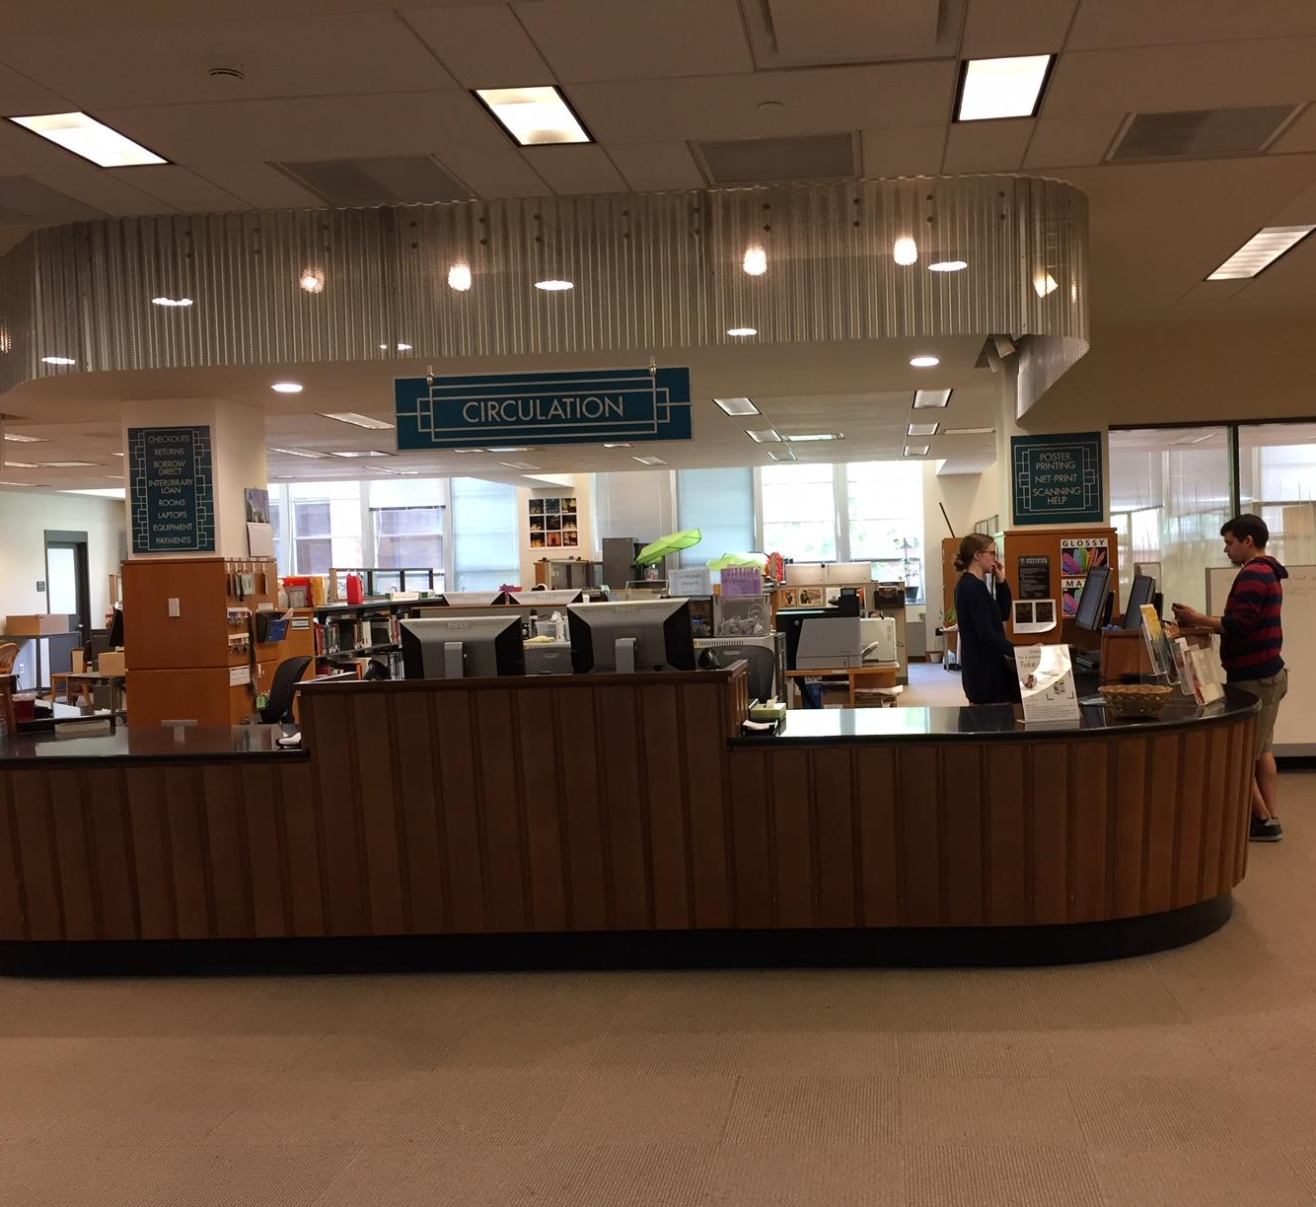
The way we were…
Notes:
At Mann library we've recently renovated many of our public spaces, and Tobi and I have both been involved in designing and assessing these spaces for our users. While changes to our patron spaces are often informed by assessment data, when it comes to office space, we tend to just let the facilities department handle it using whatever furniture is lying around. When the time came to renovate our Access Services staff offices, we were excited for the opportunity to apply many of the same user experience techniques as we had to our public spaces.
The changing nature of library work is no surprise and Access Services functions have not been immune to these changes. Like many of you, our circulation desk supports more and more services, many of which have pushed staff positions to become much more technical in nature. In addition to changing what we do, who does it and how we do it has also been revamped – it seems like we are constantly restructuring and reevaluating positions.
As work demands shift, we've been negligent in updating our office environments. We were hearing frustrations from staff that the current offices were not meeting their needs and they were eager to share their ideas and suggestions with us. But as anyone who has talked to users knows, they don't always know what they need, and we suspected that there were some larger issues that needed to be addressed.

Slide 3
Discovery Methods
Staff survey
Follow-up interviews with each staff member
Card sort ranking
Preliminary designs and solicited staff feedback
Notes:
We had some assumptions on what needed to change about the office environment based on regular conversations with our staff and our own observations/experiences working in Access Services but we were ready to test those assumptions and see what was really needed. So to figure this out we:
Distributed survey to staff – we asked questions like, “which of your work duties requires the most concentration/focus?” “On average, how many hours a day do you spend in your office?” “Is there anything you wanted/needed to work on in your office but space or furniture was too limited?”
Conducted follow-up interviews – to ask more probing questions
Finished those interviews by asking staff to do a Card sort ranking – showed different office environments/designs to staff and asked them to rank in order of preference
With all that information, we then met with an interior designer to develop Preliminary designs on which we solicited feedback in formal way (meeting) and also informally (leaving design out with post-it notes for anonymous feedback/suggestions)
From these methods clear themes emerged on what would create an ideal office space.

Slide 4
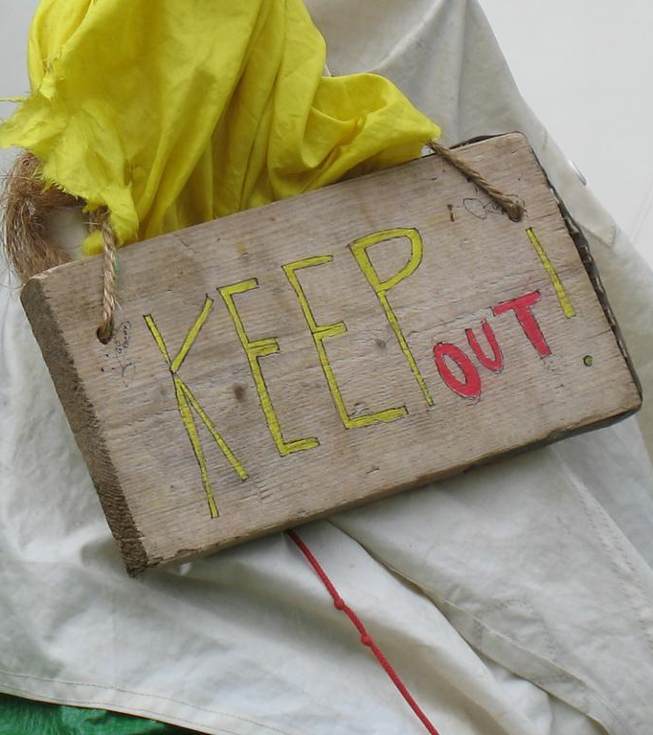
Office size could be reduced but it was important to have dedicated space
Photo by fodwyer - Creative Commons Attribution-ShareAlike License https://www.flickr.com/photos/57412091@N00
Notes:
Many of our staff had offices that were twice the size of offices elsewhere in the library and they all felt that they didn’t need that much space
While staff were willing to reduce the size of their office, it was still important to them to have their own dedicated space with walls. The open office environment that we actually thought might be a perfect fit, was universally disliked.
For staff, having their own private office space gave them a sense of ownership and made them feel valued by the organization.

Slide 5
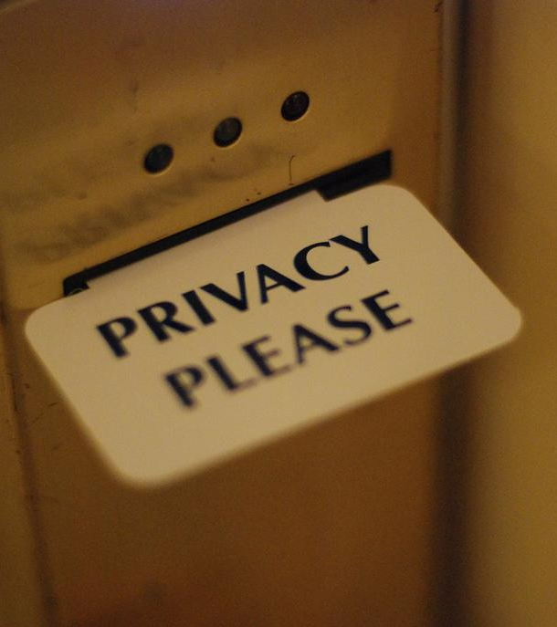
Visual & acoustic privacy needed
Photo by hyku - Creative Commons Attribution License https://www.flickr.com/photos/12734746@N00
Notes:
Our circulation desk is very busy place and there are many distractions for staff who work nearby. For that reason, visual privacy was crucial to helping staff disconnect from the service point without the expectation that they would have to provide service to patrons when they were engaged in other tasks.
Many of the staff also responded that they often put on headphones and listened to music in order to tune out what was happening around them.

Slide 6
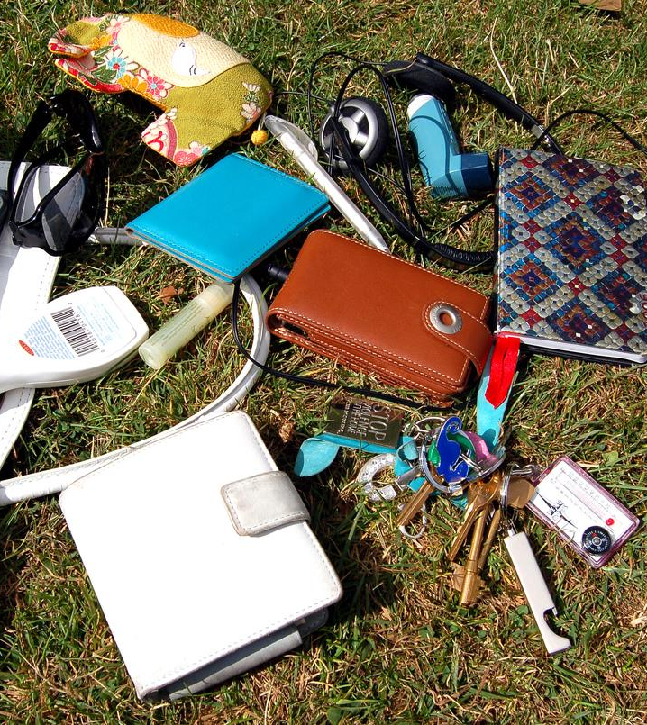
Space for student employees and their belongings
Photo by Zemlinki! - Creative Commons Attribution License https://www.flickr.com/photos/78199898@N00
Notes:
We have a team of 30+ student assistants during any given semester and they constantly use the staff conference table to store their personal belongings, do school work before/after their shift, eat their meals, and socialize with each other
Staff wanted to create a distinct space for the students to do all of those things that would help separate them from the staff offices and meeting area, thereby minimizing noise and visual distractions

Slide 7
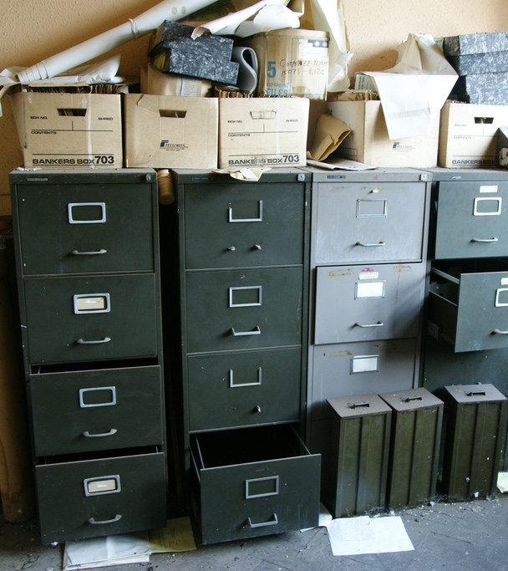
Unused furniture occupying office space
Photo by Tim Ellis - Creative Commons Attribution License https://www.flickr.com/photos/tim_ellis/3815589201
Notes:
The staff offices were built from a lot of leftover pieces, they were a bit of a hodge-podge and there was often additional furniture in there as structural support for work surfaces. So, for example, there might be extra filing cabinets to support a desk surface that didn't really serve any other purpose for the staff member
And let’s face it – a lot of people who work in libraries tend to be pack rats couple that with the large offices our staff had, and there was a lot of accumulated miscellaneous furniture buried in the corners of staff offices

Slide 8
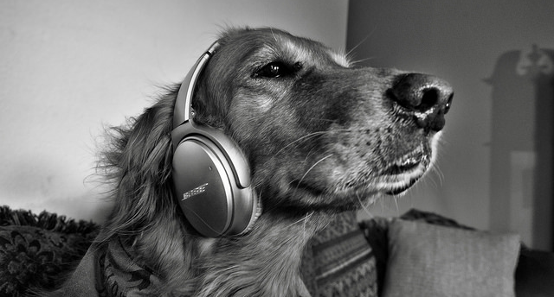
All staff are doing a mix of collaborative and focused, individual work each day
Photo by Mark Stevens - Creative Commons Attribution License https://www.flickr.com/photos/14723335@N05
Photo by Sally9258 - Creative Commons Attribution License https://www.flickr.com/photos/9258photo
Notes:
All staff are doing a mix of collaborative and focused work each day. From needing quiet space to crunch some numbers or outline a lesson plan, to work that is more collaborative in nature like group consultations on how to edit videos or work with fellow committee members on a project

Slide 9
Shared workstations for shared tasks
Photo by ryancr - Creative Commons Attribution-NonCommercial License https://www.flickr.com/photos/33128961@N00
Notes:
Many staff now share responsibility for a particular function, for example processing course reserves
Sharing this work often meant that staff would have to go into each other's office space to do their share of that work or they might move the work back and forth between offices which became quite inefficient
Creating shared space for shared tasks was a unanimous suggestion

Slide 10
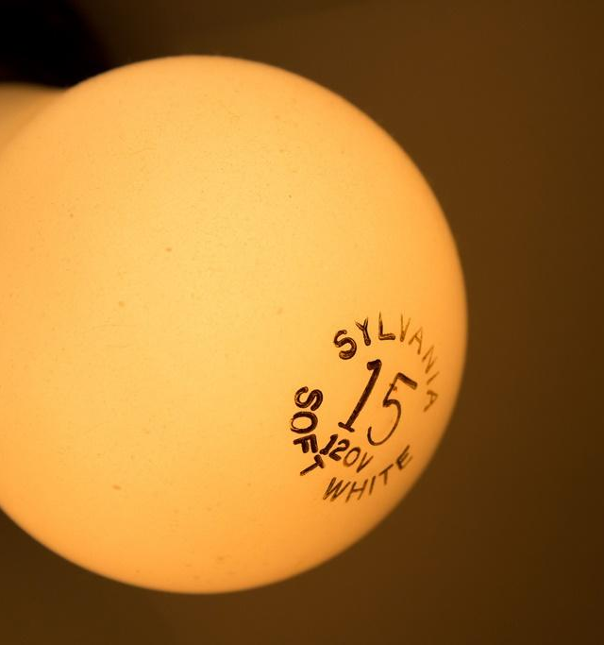
Natural light and/or quality of overhead lighting is important
Photo by hyku - Creative Commons Attribution License https://www.flickr.com/photos/12734746@N00
Notes:
As we all know, task lighting and natural light make an enormous difference in our ability to perform the work we need to do
The quality of light affects how much our eyes have to strain and focus, and poor quality light can lead to eye strain and headaches
Our overhead fluorescent offices lights would often flicker and the lighting is zoned, making it difficult to adjust the lighting for a single office without affecting other areas nearby

Slide 11
Duh!
Notes:
It will perhaps not surprise many of you to learn that in talking to staff, we found that they were unable to separate their comments about their office environment from comments about the circulation desk. It was clear that for an office redesign to function the way that staff would like, the desk needed to change as well, which we had not anticipated at the start of this project...though maybe we should have!
No matter what configuration or redesign we did with the offices, it wouldn’t be effective if we didn’t also address some of the following issues with the desk itself.

Slide 12
Line of sight to the desk is a double-edged sword
Photo by Nine Köpfer - Creative Commons No known copyright restrictions
https://unsplash.com/@enka80?utm_source=haikudeck&utm_medium=referral&utm_campaign=api-credit
Notes:
The Access Services offices were cubicles with low walls that had been designed to provide a direct line of sight to the circulation desk. This line of sight was once thought to be absolutely essential in providing timely and quality customer service.
This meant that staff could always see what’s happening at the desk, but it also created unrealistic expectations of their availability. Staff felt torn between doing the focused work they needed to do and providing good service. Most staff felt pressure to drop whatever they were doing at a moment's notice if help was needed at the desk.

Slide 13
Better solutions for equipment
Photo by frank mckenna - Creative Commons No known copyright restrictions https://unsplash.com/@frankiefoto?utm_source=haikudeck&utm_medium=referral&utm_campaign=api-credit
Notes:
We have a popular equipment lending program that has recently expanded and now includes close to 100 items – everything from short and long term loan laptops, to DSLR cameras and audio recorders
Our circulation desk - built just 11 years ago - was not designed to accommodate this service
Designing a desk that would allow us to circulate this equipment as seamlessly as possible was a high priority. This includes better storage, yes, but also workspace to check, reset, and charge the equipment between uses.

Slide 14
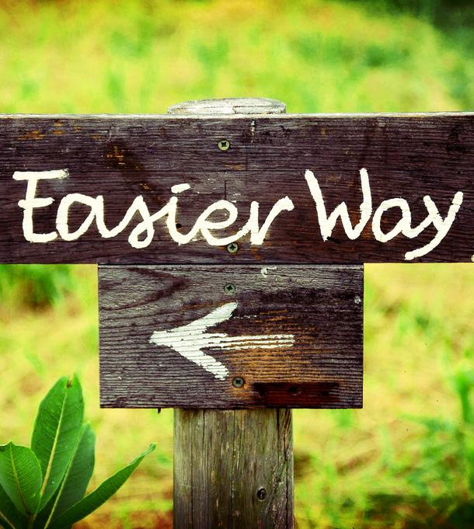
Easier access to high-demand items
Photo by hlkljgk - Creative Commons Attribution-ShareAlike License https://www.flickr.com/photos/52473526@N00
Notes:
Some of our highest circulating items - course reserves and materials that have been requested from other libraries for pickup - were located too far away from the desk
Staff who were assisting patrons would seemingly disappear from view when retrieving these items, leaving confused patrons wondering if someone was still helping them and giving the impression that no one was staffing the desk
These items were also located too close to the staff offices, again raising the issue of service expectation (staff in their offices couldn’t help but see colleagues/student employees looking for items and would be distracted or want to step in and help) – and it was clear we needed to separate these functions from staff office spaces

Slide 15
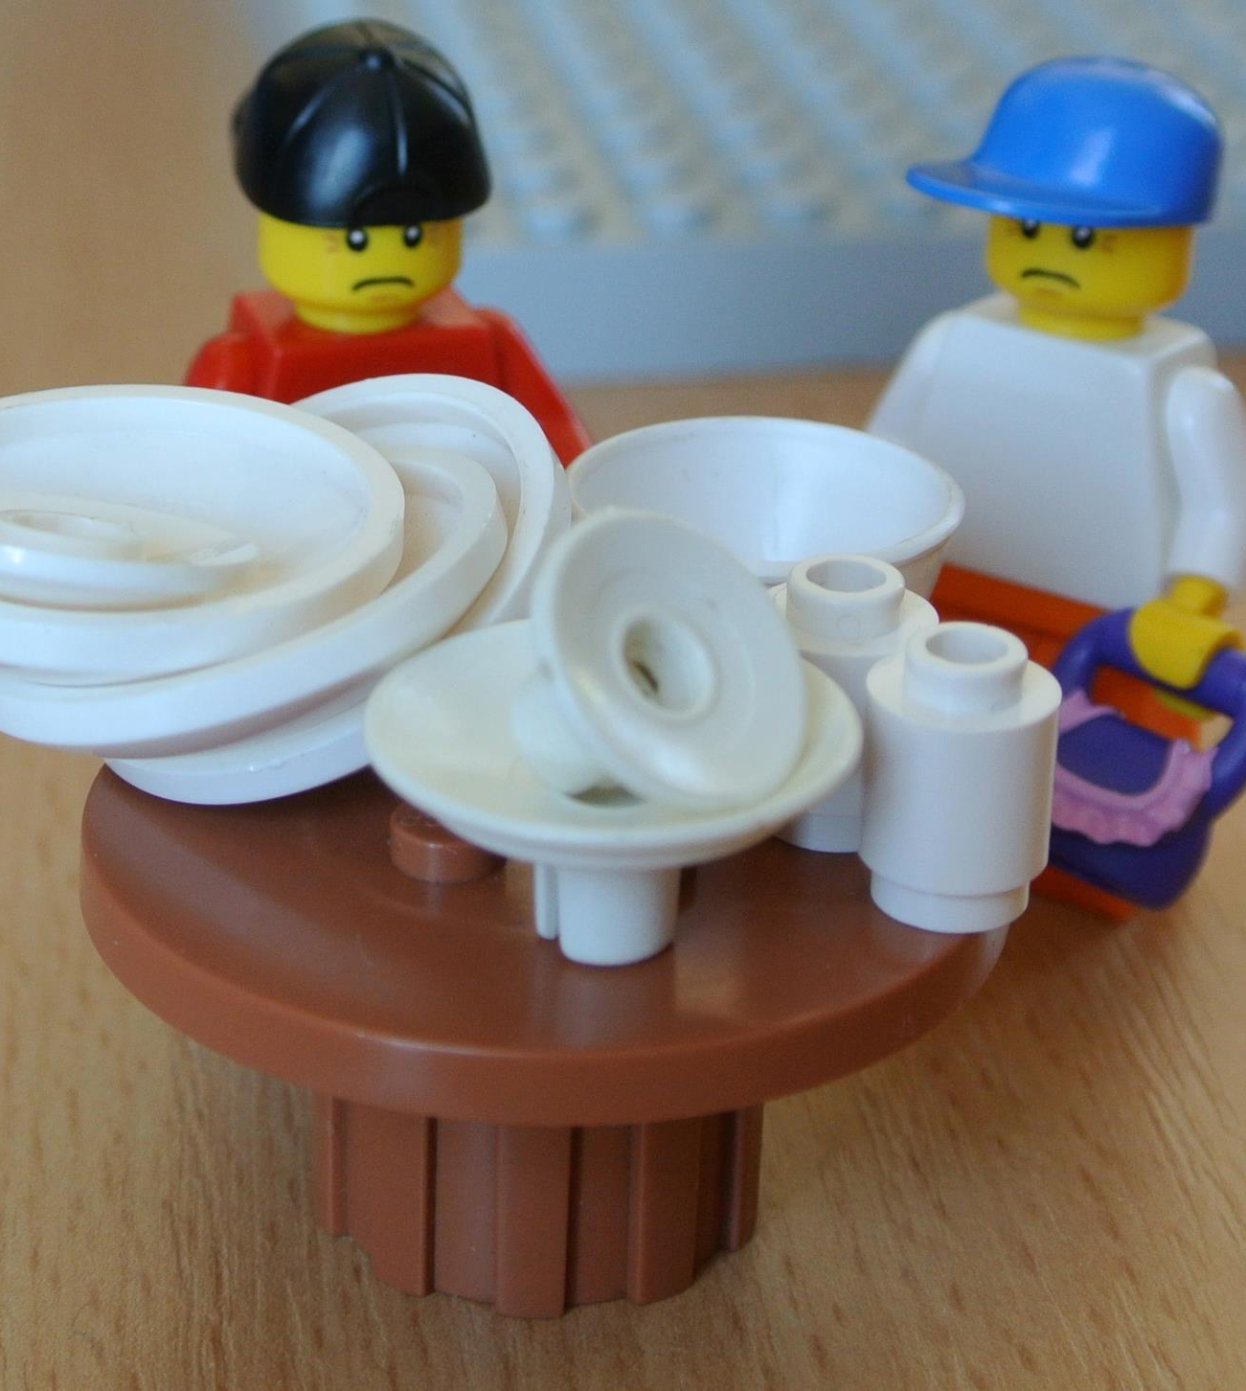
Improved staff workstation
Photo by followthethings.com - Creative Commons Attribution-NonCommercial-ShareAlike License https://www.flickr.com/photos/64914918@N03
Notes:
At our library, the student employees work up front at the desk and the staff member on duty sits at a workstation a little further back from the desk
Again, it was cobbled together with leftover pieces of other office furniture; it was cramped and did not have enough storage or work surfaces for items that needed to be processed
Staff would frequently use whatever other surfaces were nearby (usually our bookshelves) to store items, giving the entire Access Services area a disorganized appearance that was in full view of our patrons

Slide 16
The UX Connection
Notes:
Throughout this process, it became clear to us that there was an obvious connection between the office environment and the user experience.
Staff were feeling stressed, and they were telling us that it was impacting the quality of service at the desk. Just as the line of sight between the offices and the desk was distracting, they were also finding it difficult to leave that work in their offices. They would frequently try to get caught up on other tasks while working their desk shifts, which was distracting them from providing good customer service.
When we design state-of-the-art study spaces and classrooms, what we're saying to our patrons is: We see the value in what you’re doing, so we’re going to create a space that allows you to do it well. This is an important message that should carry over to staff, but it often doesn’t.
We realized we needed to create not only offices but also a service desk that enabled staff to do their work well, and we felt this would be a tangible way of showing staff that the work they do is valued by the organization. And staff who feel valued and supported – and are able to complete their work on time - are going to provide better service to our patrons.

Slide 17
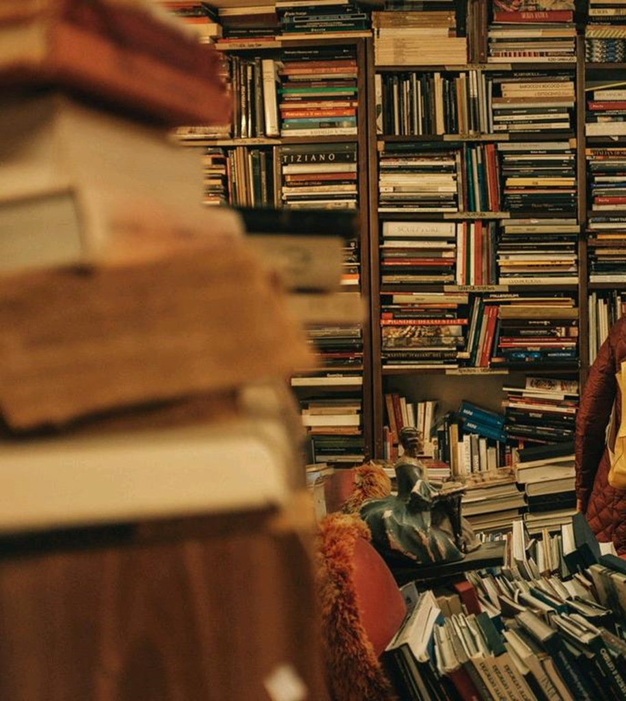
Desk/office configuration is cluttered, creates sense of disorder
Photo by Darwin Vegher - Creative Commons Attribution License https://unsplash.com/@darwiiiin?utm_source=haikudeck&utm_medium=referral&utm_campaign=api-credit
Notes:
A couple other UX connections...
Some of the most interesting conversations we had with staff during the interview process revolved around what message they thought the current desk and office configuration was conveying to our patrons and what message they wanted to convey
Staff felt that our current configuration was sending an implicit message of “clutter”, “chaos”, “disorder” and a sense of “awkward uncertainty” – not exactly what you want at a service point!
Everyone wanted the desk and office space to be welcoming, helpful, efficient, and professional

Slide 18
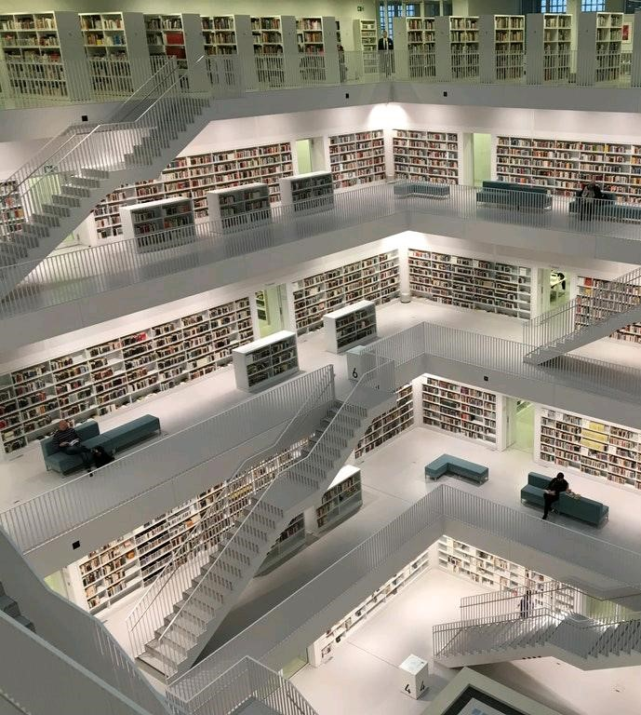
New design should allow for flexibility, change
Photo by Tobias Fischer - https://unsplash.com/@tofi?utm_source=haikudeck&utm_medium=referral&utm_campaign=api-credit
Notes:
We didn't want to focus solely on making current desk functions more efficient – we also wanted to allow for greater flexibility in the future
User needs will continue to evolve and we wanted to design a new desk that would enable us to make iterative changes so we can be more responsive to those needs

Slide 19
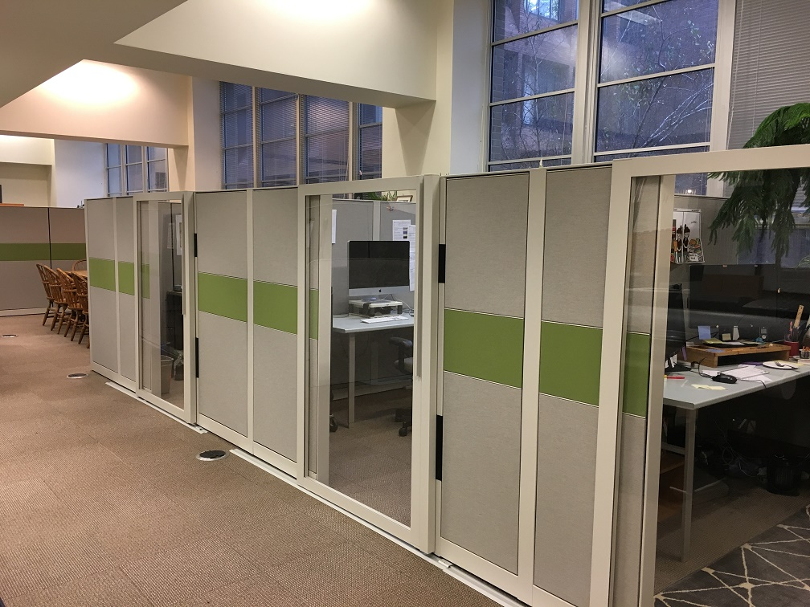
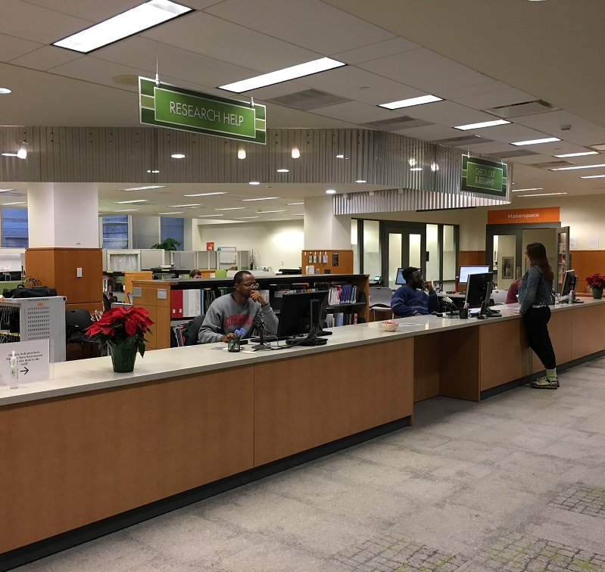
Where we are now…
Notes:
These are pictures of the new staff offices and the new desk that were installed this summer. But we are far from done! We are very much intending for this to be an ongoing design process, particularly since we got thrown a bit of curve ball this summer when we were asked to incorporate reference services into our design. This came up very late in the design process; we were able to make some accommodations but the desk had not been designed with this service in mind so we’re really treating this as a pilot – we'll gather feedback from students and staff, do more observations, and continue to modify the design as we go along.
Immediate next steps
We just completed the first round of desk observations – asked UX colleagues to spend some time observing us in Access Services to assess the layout, workflow and traffic patterns at the desk; and we will be reviewing those findings with them later this month
From there, we hope to identify some changes that can be implemented for the spring semester
And we will continue to cross-train Access Services and Reference staff
Throughout this process we've learned
That it's challenging to try to value both sets of users in this scenario – both staff and patrons. Now that we're switching our focus slightly to try to understand our patrons' experience with this new service desk, staff need to be reminded that the patron feedback is equally important in evaluating the success of our design
Emotional management has been challenging and time-consuming – We have opened the feedback floodgates – we want staff to be engaged in the process, but it has been overwhelming at times
And we should continue to examine our service philosophy, both in light of the changing nature of Access Services work, but also with this new combined service point
Ultimately it was important to create an office environment where staff felt like they could do their best work. The hope is that by giving staff space that allows them to remove themselves from the busy desk and do the work they need to do, they will be more focused and attentive when helping our patrons.

Slide 20
Questions? Sara E. Wright sew268@cornell.edu Tobi Hines eeh53@cornell.edu

