Slide 1

Zero to Sixty Implementing outcomes assessment for an entire organization
Krystal Wyatt-Baxter, Head of Assessment

Slide 2

Starting line
Photo by Tim Gouw on Unsplash
Notes:
Intro:
What the Continuous Improvement Framework is and that we were asked to participate around the same time I was coming on board as Head of Assessment

Slide 3
Planning Phase
Workshop with leadership
Kick-off meetings
Workshop with plan writers
Drop-in work sessions
Feedback rubric
Implementation meetings
Notes:
Process:
- Started w/ leadership team to determine level of organization to implement plans for

Slide 4
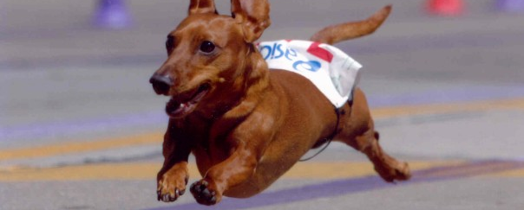
First lap
Photo by Imsupercilious, CC BY-SA 4.0
Notes:
Opportunities/Successes

Slide 5


Successes
Photo by Josh Calabrese on Unsplash
Notes:
Challenges/lessons learned

Slide 6

Challenges
Photo by David Taffet on Unsplash
Notes:
Outstanding questions
What constitutes a program, especially with regards to liaison relationships?
Expectation of continuous improvement with lean staff, budgets that aren’t growing

Slide 7
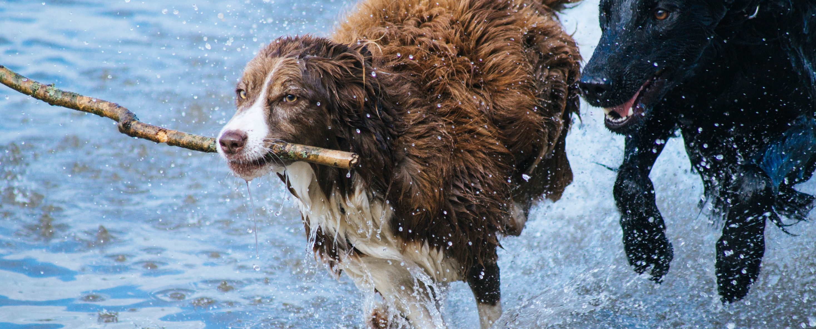
Moving forward
Photo by Matt Jones on Unsplash

Slide 8

Questions?
Photo by Fredrik Öhlander on Unsplash

