Slide 1

Building a ‘Library Cube’ from Scratch
LIBRARIES
Dr. Jesse Klein Kirsten Kinsley Louis Brooks Vijay Sojitra
Social Sciences Research & Data Librarian
Assessment Librarian
Head of Systems
Graduate Researcher
Library Assessment Conference
Association of Research Libraries
Houston, TX, USA
December 6, 2018

Slide 2
Overview
LIBRARIES
Background of Library Cube Concept
Getting Started with a Library Cube
Environmental Scan
Data Security and Privacy Conversations
Creating Community Buy-In
Developing the Concept
Building a LibCube
Identifying Data Sources
Data Processing
Standardizing Data
Technical/Logistical Concerns
End-User Considerations
Data Examples
Discussion

Slide 3
Background of Library Cube Concept
LIBRARIES
Traditional Library Assessment
One or two data sources demonstrate value/impact to stakeholders
Disparate data sources
Library Cube Innovation
Multiple datasets linked with common, unique identifier—Student ID
Reports and statistical analyses generated from all datasets
Benefits of Library Cube for Academic Libraries
Links use of library resources with student success
Improves decision-making about resource allocations
Determines if services are effective and how they can be improved
Notes:
Traditional Library Assessment
One or two data sources demonstrate value/impact to stakeholders
Disparate data sources
Collected inconsistently: different times, methods, management and sharing practices
Lack standard identifier to connect data
Library Cube Innovation
Multiple datasets linked with common, unique identifier—Student ID
Reports and statistical analyses generated from all datasets
Can be combined with institutional data
More comprehensive snapshot for short-term and long-term decision-making
Benefits of Library Cube for Academic Libraries
Links use of library resources with student success
Improves decision-making about resource allocations
Determines if services are effective and how they can be improved

Slide 4
Background of Library Cube Concept
LIBRARIES
University of Wollongong (UOW) Library, Australia
Kennesaw State University (KSU) Library, Georgia, USA
University of Minnesota, Minnesota, USA
Notes:
University of Wollongong (UOW) Library, Australia
Introduced the concept of a Library Cube in 2014
University’s Performance Indicators Unit assisted with accessing additional student data
Kennesaw State University (KSU) Library, Georgia, USA
Replicated work done by UOW to develop their own LibCube
Found correlations between library resource usage and higher student GPAs
KSU administration valued this type of assessment and committed more resources for future data projects
University of Minnesota, Minnesota, USA
Library Data and Student Success Project: Tracks general library use with Student IDs and pairs it with the university’s organizational data office for a more complex database
UM’s Data Life Cycle
Organizational data strategist receives library data
Processes data and provides access for analysis and reporting
Manages Microsoft Access database stored on campus server, includes additional demographic data
Strategist does not store data locally, for data privacy and security reasons
Data at individual level (as opposed to aggregated) is anonymized and Student IDs retained separately

Slide 5
Getting Started with a Library Cube
LIBRARIES
Environmental Scan
Several units on campus were already working on similar projects independently
All conducting research linking use of university resources and student success
Different techniques for storing and analyzing the data
On-premises big data analysis servers
Pro: Greater control, query data as needed
Con: Technology/hardware upkeep and replacement
Third-party cloud-based vendors
Pro: Technology/hardware owned by third-party, not in charge of maintenance
Con: Less control, significant expenses for services and data upload/download
WHAT WE LEARNED
Although library lacked resources, we did have data—LOTS of data
Several parties were interested in exchanging resources for access to our data
HOWEVER: How do we maintain data integrity and privacy? How would the data would be used?
Notes:
Environmental Scan
Several units on campus were already working on similar projects independently
For example: Office of Institutional Research and Office of Distance Learning
All conducting research linking use of university resources and student success
Influenced by development of State-mandated and Preeminent status performance metrics
Different techniques for storing and analyzing the data
On-premises big data analysis servers
Pro: Greater control, query data as needed
Con: Technology/hardware upkeep and replacement
Third-party cloud-based vendors
Pro: Technology/hardware owned by third-party, not in charge of maintenance
Con: Less control, significant expenses for services and data upload/download

Slide 6
Getting Started with a Library Cube
LIBRARIES
Data Security and Privacy Conversations
Meeting with Office of Institutional Research (OIR)
What data is collected? How is it collected? At what frequency?
How is data organized/managed? Where is data stored?
How is data integrity and security maintained?
Who has access to the data? Is there a way to separate identifying information from data before granting access?
Do you have a way to communicate to members of the campus community whether/how data is being collected?
Matriculation waivers? Privacy statements? Where is the fine print?
Do you need approval to collect institutional data from the Institutional Review Board?
Meeting with Office of Research-Institutional Review Board (IRB)
Does OIR require IRB approval to collect data on students, faculty, and/or staff?
Does the library need IRB approval to collect and organize LibCube?
At what point would the library need IRB approval to use LibCube?
What is the difference between program evaluation and empirical research?
Where is the line for whether to apply for IRB approval?
Once data is collected and requested for use by others, then does it need IRB approval?
Should the library create an End User License Agreement for requesting/using LibCube?
How do we manage those requests?

Slide 7



Getting Started with a Library Cube
LIBRARIES
Creating Community Buy-In
Campus-Wide Data Security Audit
FSU Information Technology Services (ITS) requires campus-wide audit of security and privacy
Facilitated at FSU Libraries by internal ITS department
Existing awareness of audit process and necessity
Previously improved storage, backup, retention policies throughout libraries
Notes:
FSU ITS related to software, hardware, cloud services, storage of high-risk data, etc

Slide 8
Getting Started with a Library Cube
LIBRARIES
Creating Community Buy-In
Library-Wide Data Inventory
Worked with internal ITS department to align campus-wide and internal security audit with efforts to identify potential data sources throughout libraries for use in LibCube
Initially called it an “audit”—changed it to “inventory” to reduce collective anxiety
Built Community Awareness and Buy-In
Made data management experts out of entire staff
Trained everyone on inventory process with detailed documentation, easy data entry, and data “point people” in each department
Helped everyone see the datasets being collected and potential connections with datasets
Lifted data out of silos and created collaborative energy across departments
Incredible Value to LibCube
Helped to categorize and prioritize datasets for use in LibCube
Built bridges throughout the libraries to discuss best practices with data collection, management, and analysis
Notes:
FSU ITS related to software, hardware, cloud services, storage of high-risk data, etc

Slide 9
Getting Started with a Library Cube
LIBRARIES
Developing the Concept
Background research/examples guided logical phases in developing our LibCube
Institutions with Library Cubes explained their activities in three broad categories:
Data Collection
Data Preparation
Data Analysis
For us, each broad category had many detailed steps that when recognized made the process much easier both conceptually and logistically
IDENTIFY
PROCESS
STANDARDIZE
MERGE
STORE
QUERY
VISUALIZE
REPORT

Slide 10
Building a LibCube
LIBRARIES
Identifying Data Sources
Turnstiles
Library Computer Logins/Activity
Off-campus Authentication Logs
Circulation Reports
E-Resource Usage Reports
Tutoring
Instruction
LibInsights
ILL/UBorrow Usage
Student Demographics
Student Academic Outcomes
Wayfinding and Focus Groups
Workshop Registration/Attendance
Canvas Analytics for Library Modules
Consultation Request Forms
Virtual Reference Interactions
Library-Related Surveys
Social Media Analytics
Email Campaign Analytics
Space/Study Room Requests
SO MUCH DATA

Slide 11
Building a LibCube
LIBRARIES
Data Processing
Disparate datasets need processing prior to becoming useful in a merged format
Inconsistent:
Data Ownership
Log of Data Changes
Date/Time Standards
Data/File Management
Missing/Invalid Data Codes
Metadata
Storage/Sharing Protocols
Archiving & Retention Policies
Collection Frequency
Respondent Identifiers
Time Frames
Sample Sizes
Deidentified vs. Anonymized
Level of Analysis

Slide 12
Building a LibCube
LIBRARIES
Social Security Number
Student ID
Email Address
EMPLID
FSU Card Number
Library Card Number
Standardizing Data
Merging datasets requires a standard identifier or master key to link all data together
Data needs to “speak” to each other to be useful
Possible Standard IDs?

Slide 13
Building a LibCube
LIBRARIES
Technical/Logistical Concerns
Existing Data
Data sources stored/managed in systems not designed to work together
Oracle, PeopleSoft, Excel, Power BI, Microsoft Access, SQL Databases, Word, Cloud
Hosted by stakeholders with varying willingness/ability to share
Common denominators for working with all data?
communication and spreadsheets!
LibCube’s Future
Collaboration and Open Communication
IT Infrastructure
Staff Capacity
Support from Campus ITS
Funding: Hardware, Software, Cloud-Based Storage, Staffing, Technical Support

Slide 14
Building a LibCube
LIBRARIES
End-User Conversations
Different levels of consumption
Internal
Administrators/managers who want real-time aggregated data in the form of reports or data dashboards
Statistical analysis of data for in-depth program evaluation and reporting
Data visualization for web development and external reporting
External
Institutional Researchers interested in using library data with other data
Demonstrate impact/value of FSU Libraries on performance metrics
Researchers from FSU and elsewhere interested in using library data for their research
Most Useful LibCube Formats Based on End-User
Master File: Massive spreadsheet with all raw data that gets regularly updated and backed up
Pro: Necessary for statistical analysis programs, like SPSS, Stata, SAS
Con: Becomes unwieldy quickly with too much data, difficult to manage, difficult to maintain data security
Database: Segmented database with all raw data that gets regularly updated and backed up
Pro: Easy to manage and query, can connect database to visualization/dashboard programs, can set up restriction parameters to “split” the database for backend and frontend users, better data security
Con: Takes specialized knowledge to create/maintain/use database, difficult to use for many end-users

Slide 15
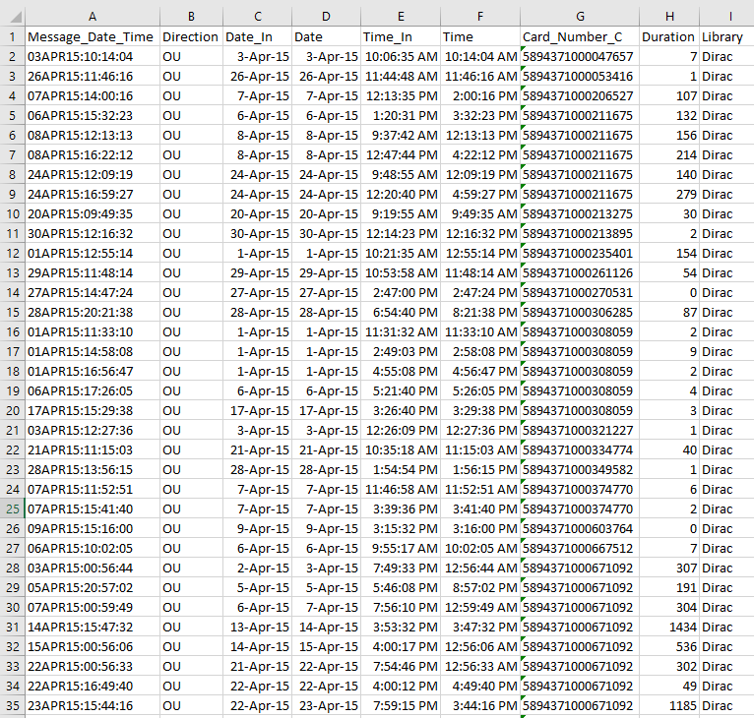
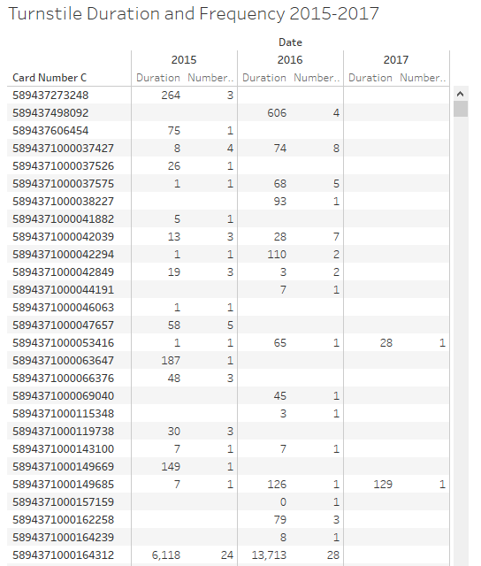
Data Examples
LIBRARIES
Processed Turnstile Data
Turnstile Data in Tableau
(user-specific numbers hidden)
(user-specific numbers hidden)

Slide 16
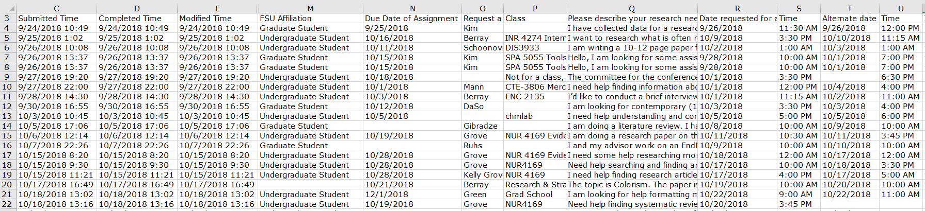
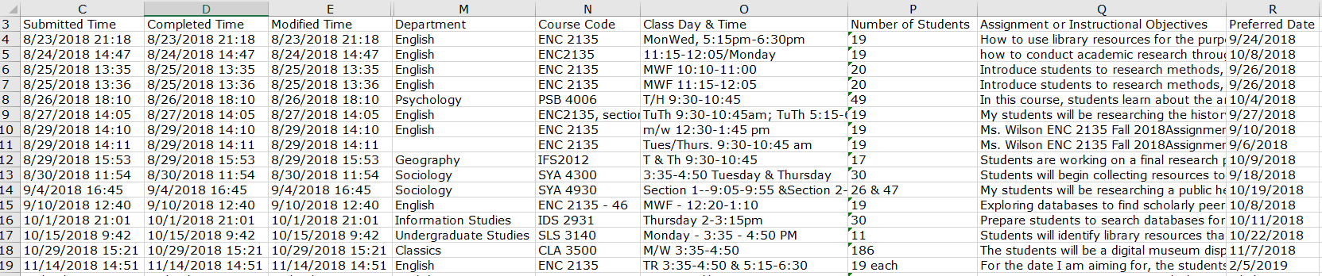
Data Examples
LIBRARIES
Research Consultation Request Form Data
(several columns hidden)
Library Instruction Request Form Data
(several columns hidden)

Slide 17
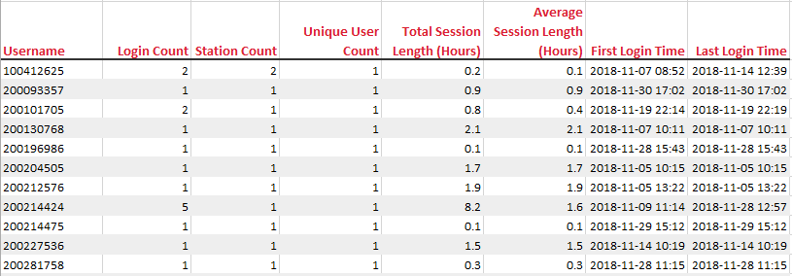
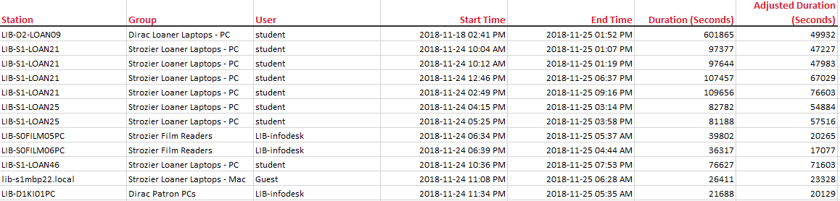
Data Examples
LIBRARIES
LabStats Session Summaries by User
(user-specific numbers hidden)
LabStats Sessions by User and Station

Slide 18
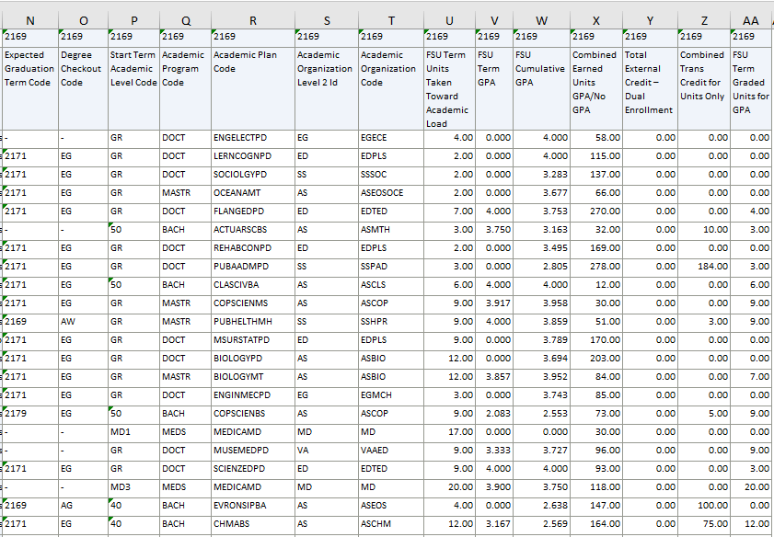
Data Examples
LIBRARIES
OIR Term Statistics Module in Campus Database
STUDENT-SPECIFIC, SENSITIVE VARIABLES
Card Center
Student Id
FSUID
Student Last Name
Student First Name
Student Campus Email Address
Student Birth Date
Student Gender Code
Athletic Participation Desc
Citizenship Status Desc
Student Military Status Desc
Student Ethnic Group Desc
Citizenship Country Desc

Slide 19
Discussion
LIBRARIES
IDENTIFY
PROCESS
STANDARDIZE
MERGE
STORE
QUERY
VISUALIZE
REPORT
Where are we now?
Continuing to identify data sources for inclusion and subsequent data processing
Currently, merging several datasets that have been processed using Student ID/EMPLID as the standard identifier
MERGE

Slide 20
Discussion
LIBRARIES
IDENTIFY
PROCESS
STANDARDIZE
MERGE
STORE
QUERY
VISUALIZE
REPORT
Where are we now?
Considering linking Access database to frontend data visualization program Tableau to create data dashboards where internal stakeholders can create tables and graphs to report on their services
Library ITS will assist with secure and regular backups of data in all forms
Merged data is being combined using an Excel spreadsheet—the Master File
Considering Microsoft Access for backend database management
Access database will have restricted parameters so only backend users will have access to standard identifiers for data rows
STORE

Slide 21
Discussion
LIBRARIES
Interest in using LibCube-style data warehouses in library assessment is growing
Previous examples informed our development of the FSU Libraries’ LibCube
Adding to the extant literature, we have revealed new areas for consideration, including:
Using data inventories to help identify organizational data and build community buy-in
Working with campus partners to develop proper research ethics and protocols
Exploring best practices for processing and standardizing data in consultation with methodologists and statisticians
Developing data privacy and technical workflows in partnership with library and campus ITS
Considering types of end-users for various levels of interaction with the data
Several phases still to work through
Questions remain about analyses that are ethical, possible, and empirically sound
We hope our experience will help others in exploring this option for their library!
Notes:
Interest in using LibCube-style data warehouses in library assessment is growing
Following trends in Big Data and Analytics in several sectors
Previous examples informed our development of the FSU Libraries’ LibCube
Adding to the extant literature, we have revealed new areas for consideration, including:
Using data inventories to help identify organizational data and build community buy-in
Working with campus partners to develop proper research ethics and protocols
Exploring best practices for processing and standardizing data in consultation with methodologists and statisticians
Developing data privacy and technical workflows in partnership with library and campus ITS
Considering types of end-users for various levels of interaction with the data
Several phases still to work through
Questions remain about analyses that are ethical, possible, and empirically sound
We hope our experience will help others in exploring this option for their library!

Slide 22
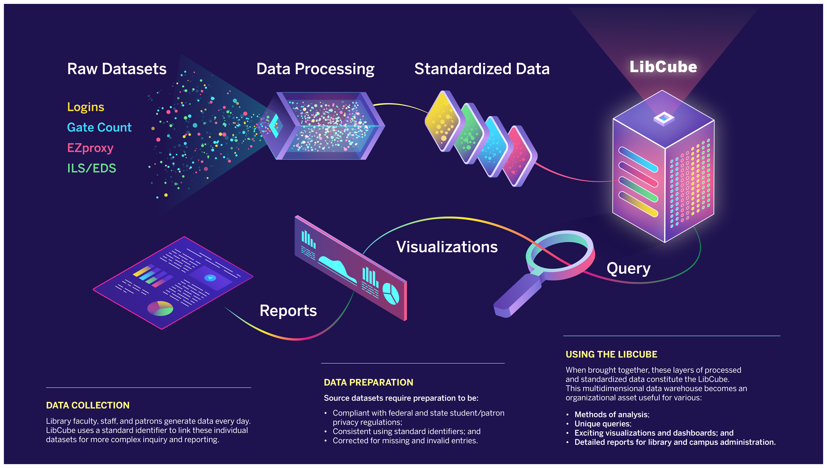
Building the LibCube
BUILDING A ‘LIBRARY CUBE’ FROM SCRATCH

Slide 23
References
LIBRARIES
Barocas, Solon, and Helen Nissenbaum. "Big data's end run around procedural privacy protections." In Privacy, Big Data, and the Public Good: Frameworks for Engagement, edited by Julia Lane, Victoria Stodden, Stefan Bender, and Helen Nissenbaum, 44-75. Cambridge: Cambridge University Press, 2014.
Collins, Ellen, and Graham Stone. "Understanding Patterns of Library Use Among Undergraduate Students from Different Disciplines." Evidence Based Library and Information Practice 9, no. 2 (2014): 51-67.
Cox, Brian L., and Margie Jantti. "Capturing business intelligence required for targeted marketing, demonstrating value, and driving process improvement." Library & Information Science Research 34, no. 4 (2012): 308-316.
Cox, Brian L., and Margie Jantti. “Discovering the Impact of Library Use and Student Performance.” EDUCAUSE Review Online, (2012).
Crawford, Gregory A. "The Academic Library and Student Retention and Graduation: An Exploratory Study." Libraries and the Academy 15, no. 1 (2018): 41-57.
Daly, Rebecca, and Lisa McIntosh. "Heresy or Innovation? Transforming culture and service for impact." THETA: The Higher Education Technology Agenda, (2013): 1-12. Hellman, Eric. “Toward the Post-Privacy Library? Public Policy and Technical Pragmatics of Tracking and Marketing.” American Libraries Magazine, June 16, 2015.
Hosseini-Ara, M., and R. Jones. "Overcoming Our Habits and Learning to Measure Impact." Computers in Libraries, (2013): 3-7. Ingham, Joanne. “Data warehousing: A tool for the outcomes assessment process.” IEEE Transactions on Education 43, no. 2 (2000): 132-136.
Jantti, Margie. "One score on – the past, present and future of measurement at UOW Library." Library Management 36, no. 3 (2015): 201-207.
Khoo, Michael, Lily Rozaklis, and Catherine Hall. 2012. "A survey of the use of ethnographic methods in the study of libraries and library users." Library & Information Science Research 34, no. 2 (2012): 82-91.
Kitchin, Rob. "Big Data, new epistemologies and paradigm shifts." Big Data & Society 1, no. 1 (2014): 1-12.
Lambert, April D., Michelle Parker, and Masooda Bashir. "Library patron privacy in jeopardy an analysis of the privacy policies of digital content vendors." Proceedings of the Association for Information Science and Technology 52, no. 1 (2015):1-9.

Slide 24
References (cont.)
LIBRARIES
Mao, Jingying, and Kirsten Kinsley. “Embracing the Generalized Propensity Score Method: Measuring the Effect of Library Usage on First-Time-In-College Student Academic Success.” Evidence Based Library and Information Practice 12, no. 4 (2017): 129-57.
Mathiesen, Kay, and Don Fallis. "Information Ethics and the Library Profession." In The Handbook of Information and Computer Ethics, edited by Kenneth E. Himma, and Herman T. Tavani, 219-244. Hoboken, NJ: John Wiley & Sons, Inc., 2018.
Nackerud, Krista M. Soria, Fransen Jan, and Shane. "Library Use and Undergraduate Student Outcomes: New Evidence for Students' Retention and Academic Success." Libraries and the Academy 13, no. 2 (2013): 147-164.
Neal, James G. “Stop the Madness: The Insanity of ROI and the Need for New Qualitative Measures of Academic Library Success.” Proceedings of the ACRL 2011 Conference: A Declaration of Interdependence. Philadelphia, PA: Association of College and Research Libraries, March 30–April 2, 2011.
Newman, Bobbi, and Bonnie Tijerina, eds. Protecting Patron Privacy: A LITA Guide. Washington, DC: Rowman & Littlefield Publishers, 2017.
Renaud, John, Scott Britton, Dingding Wang, and Mitsunori Ogihara. "Mining library and university data to understand library use patterns." The Electronic Library 33, no. 3 (2015): 355-372.
Rubel, Alan. "Libraries, Electronic Resources, and Privacy: The Case for Positive Intellectual Freedom." Library Quarterly 84, no. 2 (2018): 183-208.
Rubel, Alan, and Kyle M. L. Jones. "Student privacy in learning analytics: An information ethics perspective." The Information Society 32, no. 2 (2016): 143-159.
Scarletto, Edith A., Kenneth J. Burhanna, and Elizabeth Richardson. "Wide Awake at 4AM: A Study of Late Night User Behavior, Perceptions and Performance at an Academic Library." The Journal of Academic Librarianship 39, no. 5 (2013): 371-377.
Soria, Krista M. "Factors Predicting the Importance of Libraries and Research Activities for Undergraduates." The Journal of Academic Librarianship 39, no. 6 (2013): 464-470.
Soria, Krista M., Jan Fransen and Shane Nackerud. "Library Use and Undergraduate Student Outcomes: New Evidence for Students’ Retention and Academic Success." Libraries and the Academy 13, no. 2 (2013): 147-164.
Soria, Krista M., Jan Fransen and Shane Nackerud. "Library Use and Undergraduate Student Outcomes: New Evidence for Students’ Retention and Academic Success." Libraries and the Academy 13, no. 2 (2013): 147-164.

Slide 25
References (cont.)
LIBRARIES
Soria, Krista M., Jan Fransen, and Shane Nackerud. "The impact of academic library resources on undergraduates’ degree completion." College & Research Libraries 78, no. 6 (2017): 812-823.
Soria, Krista M., Jan Fransen, and Shane Nackerud. "Beyond books: The extended academic benefits of library use for first-year college students." College & Research Libraries 78, no. 1 (2017): 8-22.
Stone, Graham, and Bryony Ramsden. "Library Impact Data Project: Looking for the Link between Library Usage and Student Attainment." College & Research Libraries 74, no. 6 (2013): 546-559.
West, Darrell M. Big Data for Education: Data Mining, Data Analytics, and Web Dashboards. Brookings Institute, 2012.
Zimmer, Michael. "Librarians’ Attitudes Regarding Information and Internet Privacy." The Library Quarterly: Information, Community, Policy 84, no. 2 (2014):123-151.

