Slide 1
Measuring Welcomeness
Greg Davis, Assistant Director for Assessment and Planning
Iowa State University Library
Library Assessment Conference
Building Effective, Sustainable, Practical Assessment
October 2020

Slide 2
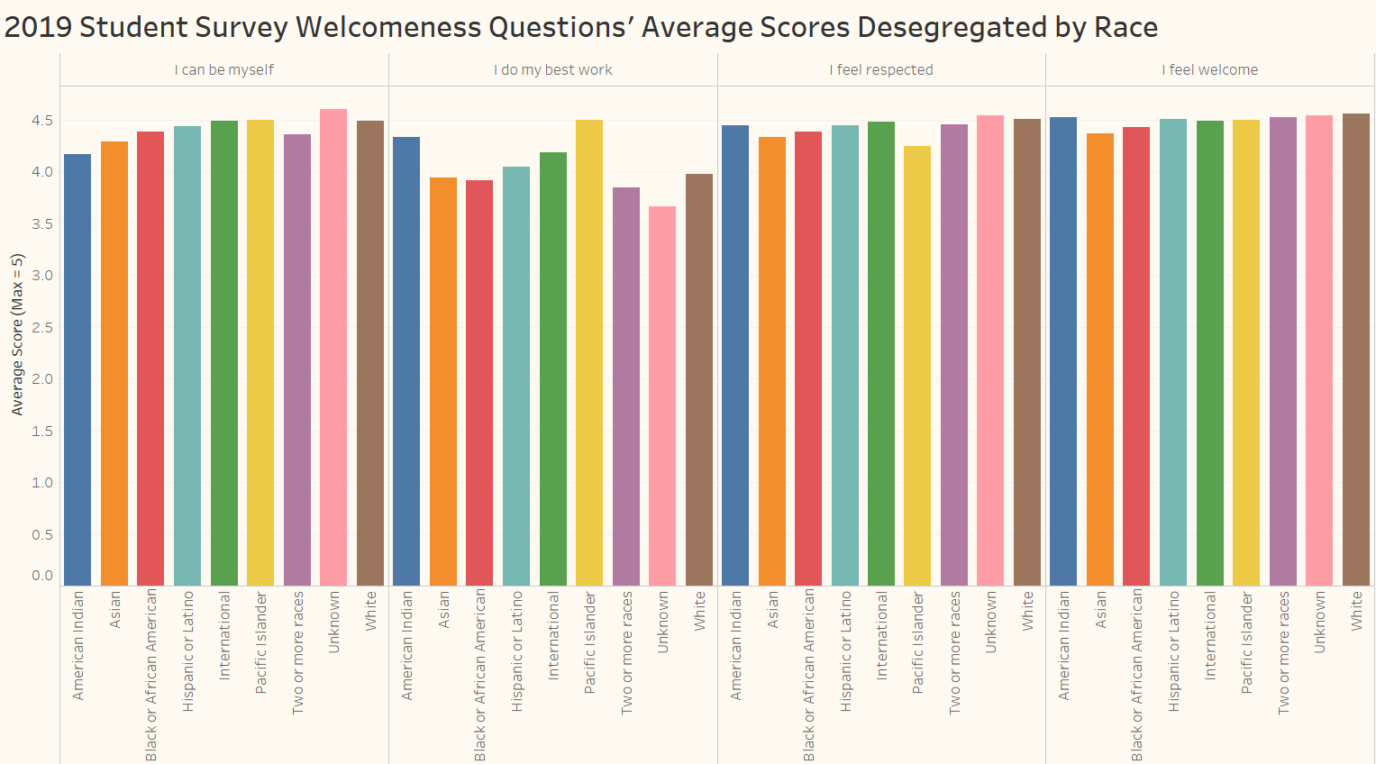
The library is in the early stages of identifying metrics related to the "welcomeness" of the library. In the chart below, data obtained from a library survey of students during the Spring 2019 semester is shown. Students were asked their level of agreement that they can (1) be themselves in the library, (2) do their best work in the library, (3) feel respected in the library, and (4) feel welcome in the library. The average scores desegregated by race/ethnicity, on a five point scale, were calculated and shown in the chart below.

Slide 3
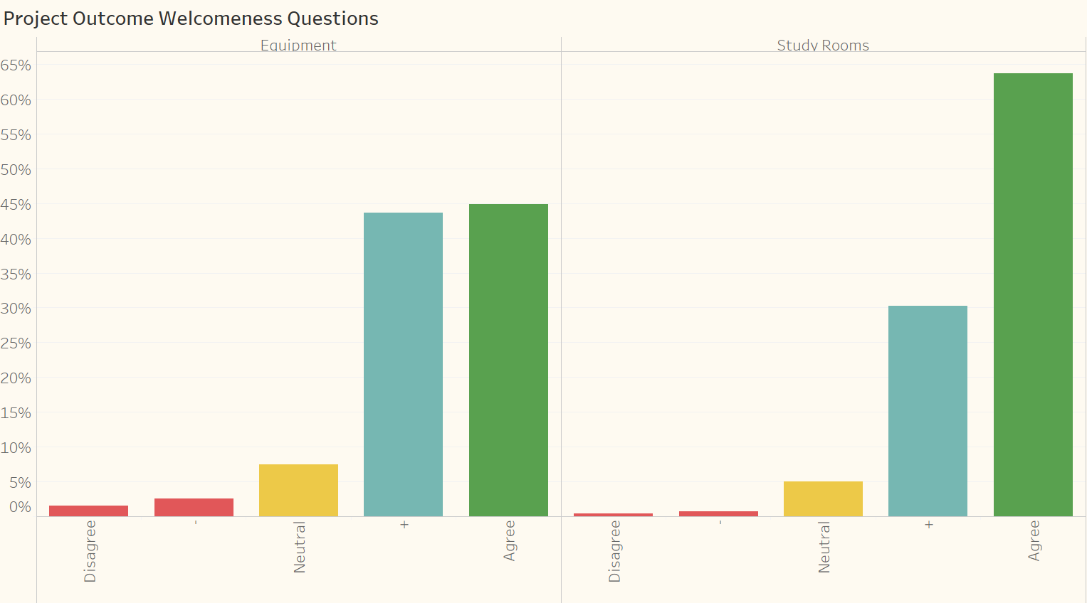
Parks Library is also using ACRL Project Outcome to collect information related to welcomeness. A question asking if the equipment lending services and group study room reservation services are welcoming is included in the survey. The chart below shows that most patrons responding to the survey agreed that these services were welcoming.

Slide 4
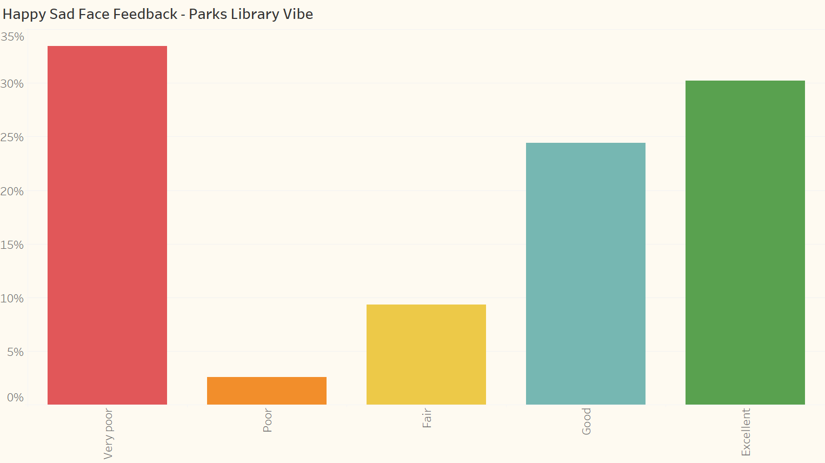
The survey Parks Library used on the happy/sad device was not designed to collect feedback about specific library services. It just sought to find out more about the state of patron feelings as they passed by the device in the library. While we received a lot of positive responses, we were a little surprised to also see so many patrons respond "very poor" to the question "How are you feeling today". Even though their feelings may have nothing to do with their library experience. it begs the question "What can we do to turn these sad feelings for some of our patrons in a positive direction?"

Slide 5
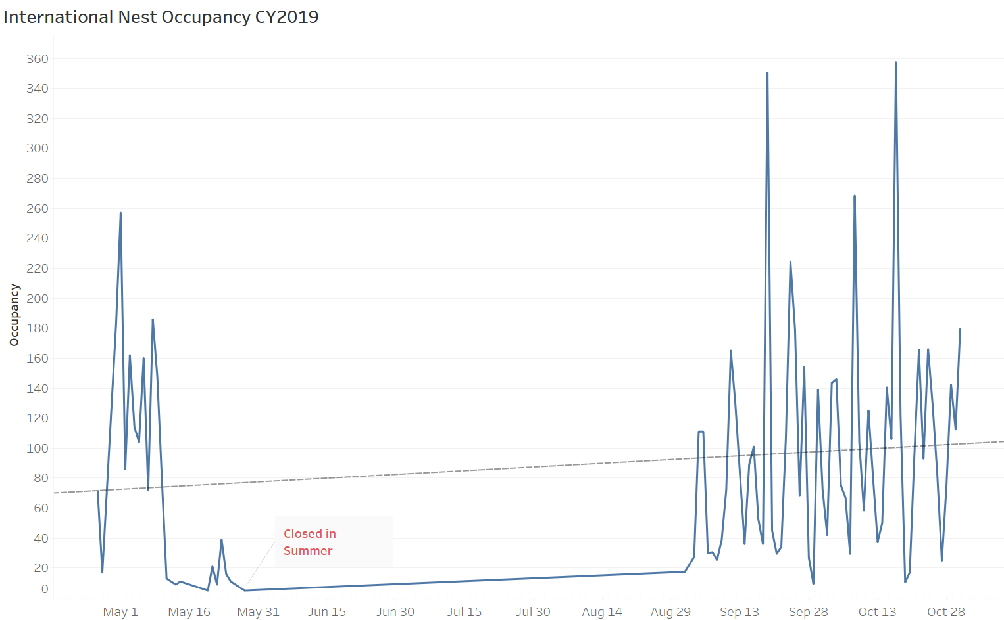
During the 2018-2019 school year, Parks Library opened a new space for international student use, called the International Nest. A traffic counter for the space was installed late in the Spring semester, and occupancy counts were tracked during the Spring 2019 and Fall 2019 semesters. The counts showed a increasing trend in usage of the International Nest. It was good to see the increasing usage of a space designed to support the welcomeness objectives of Parks Library.

