Slide 1
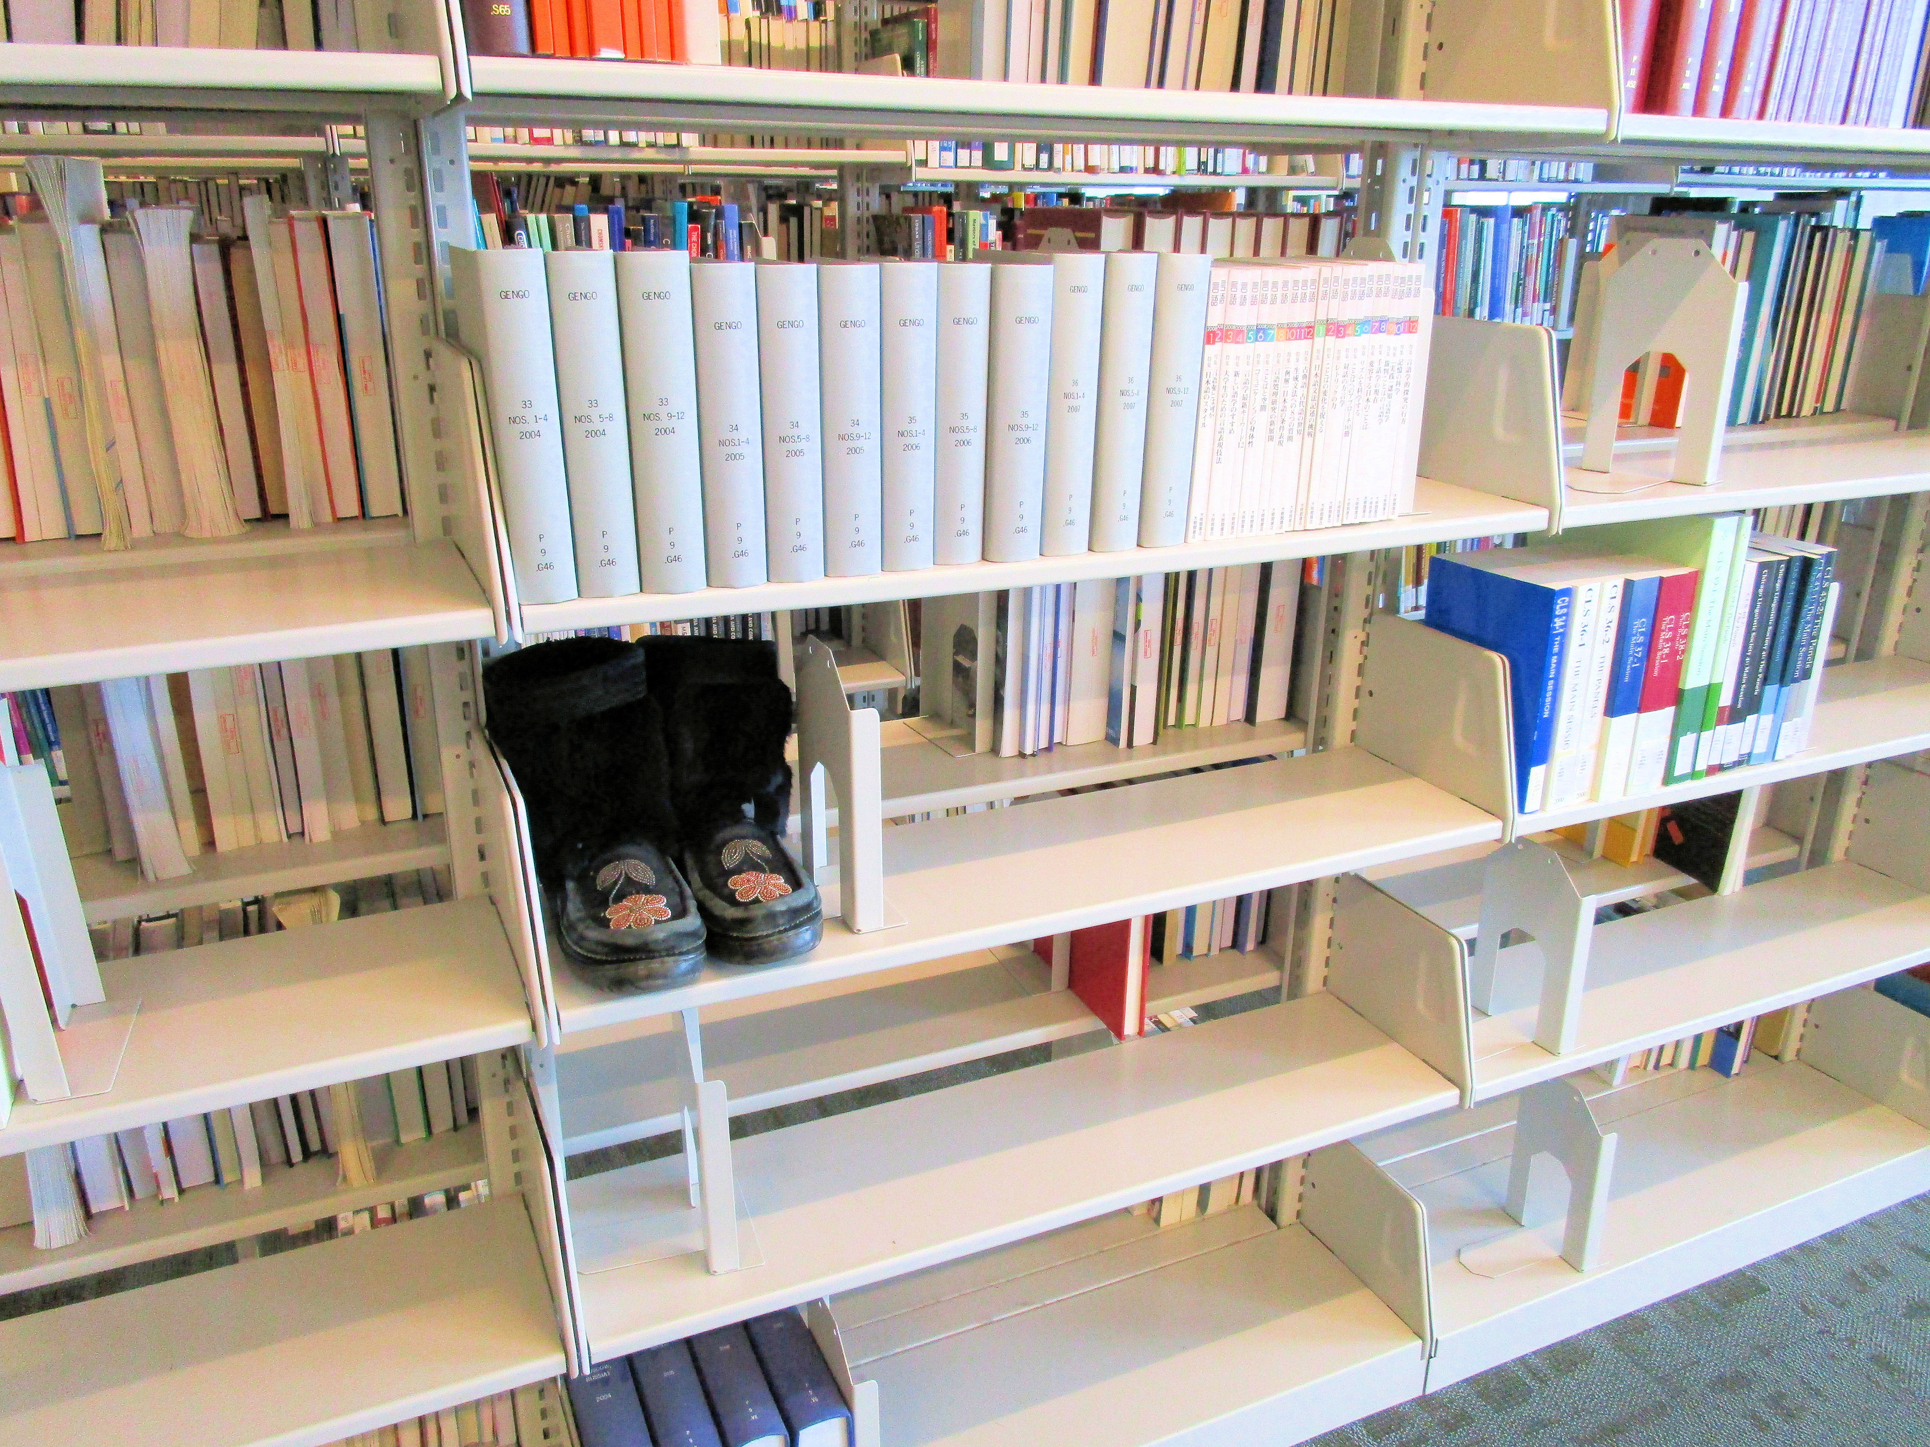

Indigenous student voice & photo

Slide 2
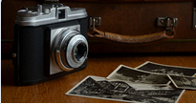


Indigenizing Library Spaces Using Photovoice Methodology
Library Assessment Conference December 16, 2020
Susan Beatty, Librarian K. Alix Hayden, Librarian Cheryl Jeffs, Educational Developer University of Calgary, Calgary Alberta, Canada

Slide 3
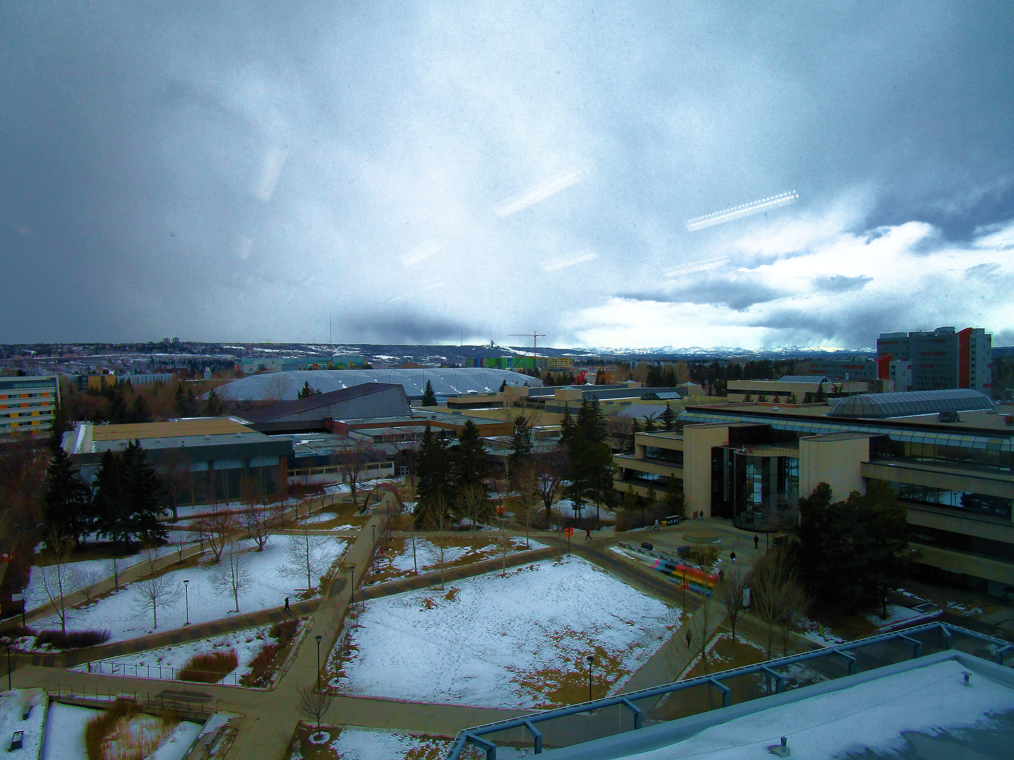
Territorial Acknowledgement
We would like to take this opportunity to acknowledge the traditional territories of the people of the Treaty 7 region in Southern Alberta, which includes the Blackfoot Confederacy (comprising the Siksika, Piikani, and Kainai First Nations), as well as the Tsuut’ina First Nation, and the Stoney Nakoda (including the Chiniki, Bearspaw, and Wesley First Nations). The City of Calgary is also home to Métis Nation of Alberta, Region 3, Canada
University of Calgary Cultural Protocol https://www.ucalgary.ca/indigenous/cultural-protocol

Slide 4
In this session we will
Photovoice
Methodology SUSAN
The Process "Working together in a Good Way“ CHERYL
Key Learnings &
Next Steps ALIX
Indigenizing Library Spaces ALIX
Explore the relationship between library spaces and Indigenous students’ learning experiences

Slide 5
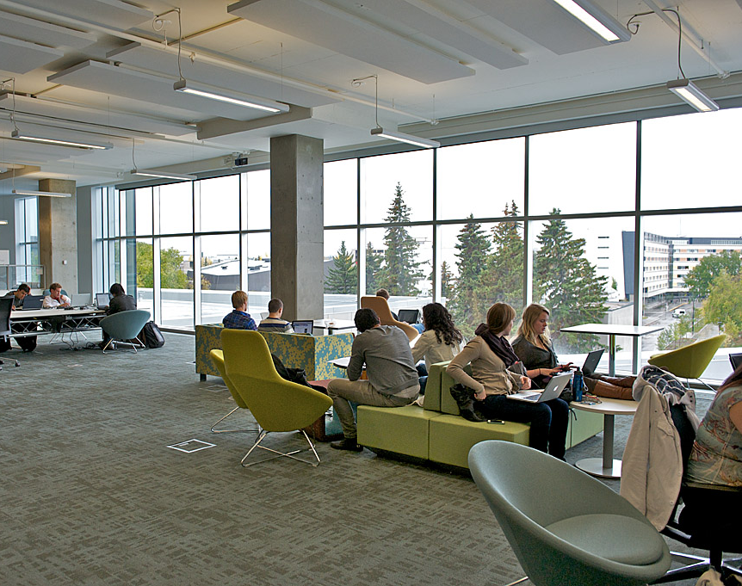
Purpose and Background
The purpose of our study was to explore and understand how Indigenous undergraduate students at the University of Calgary experience their informal learning and library spaces.
Taylor Family Digital Library stock photo

Slide 6
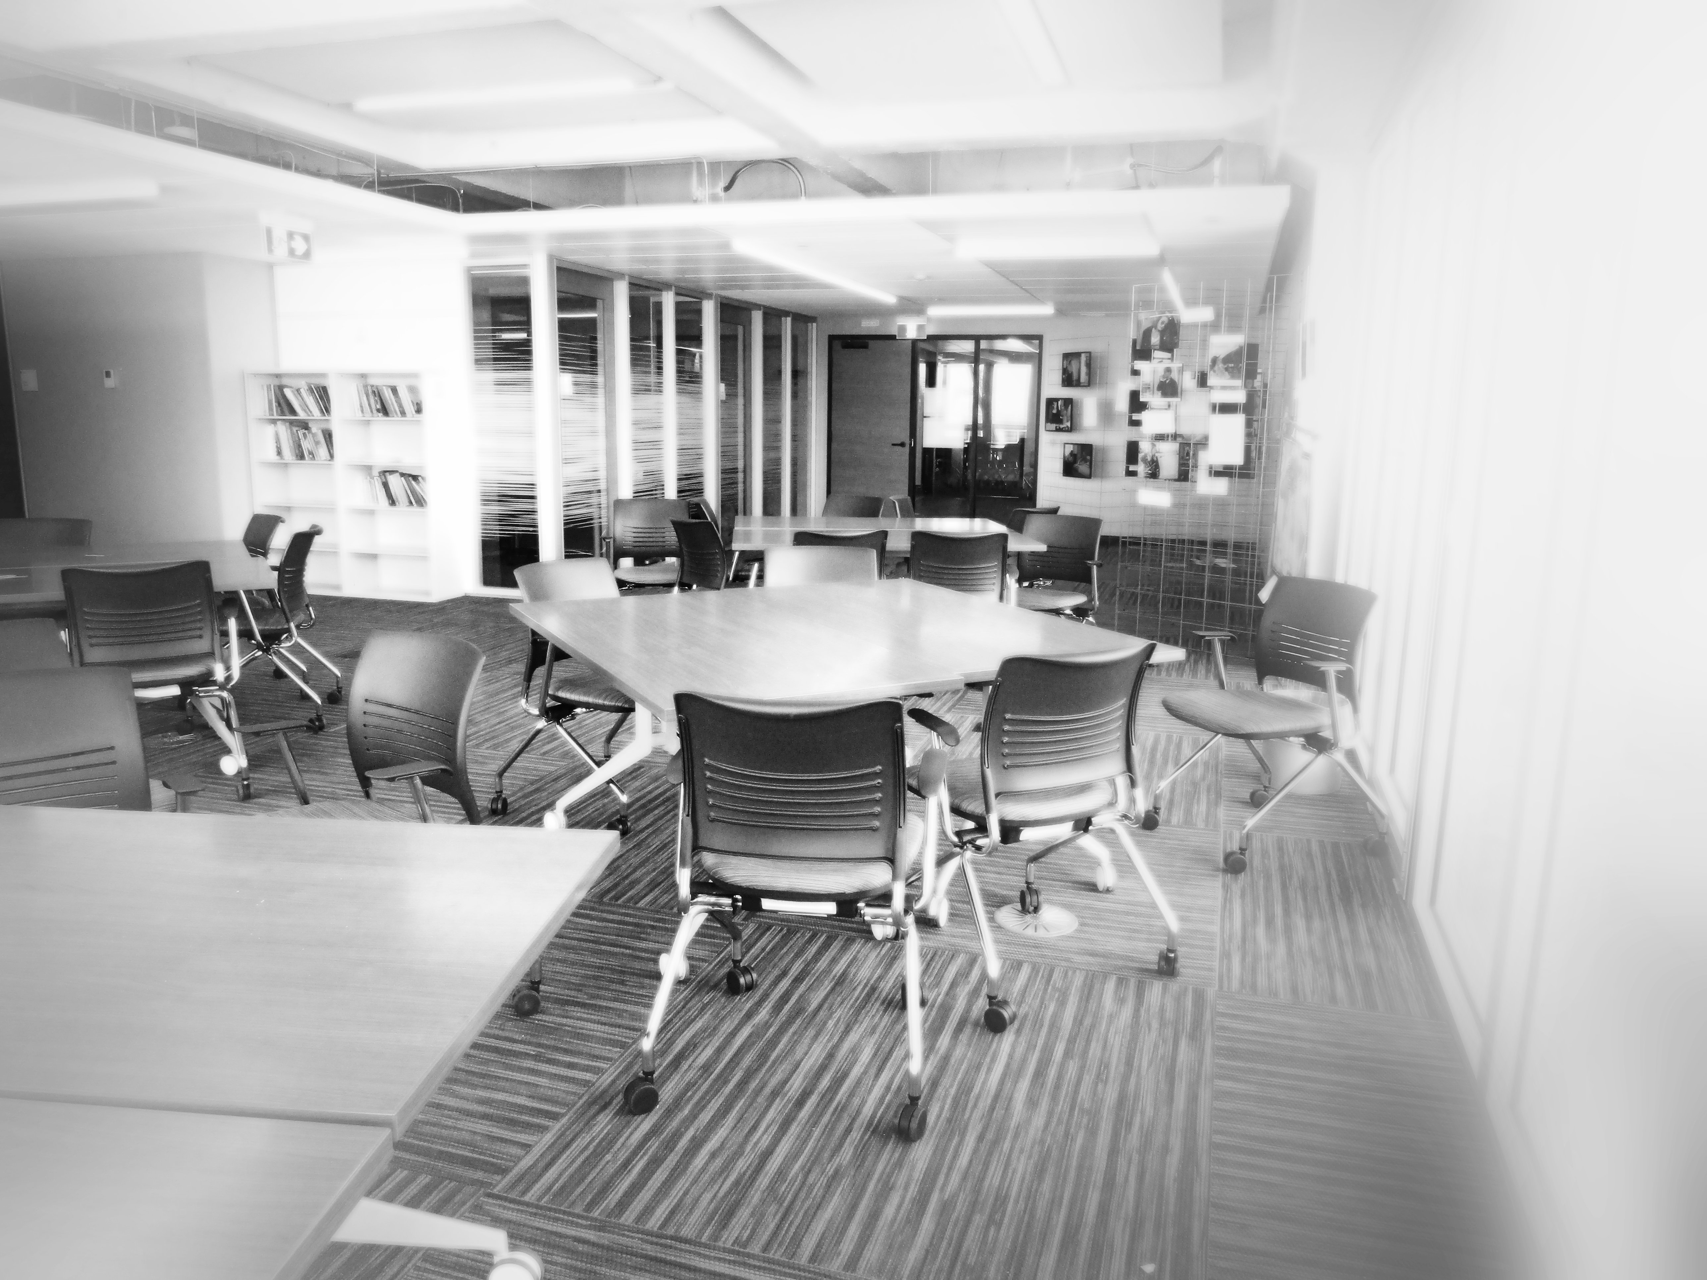
Library Spaces & Informal Learning
Informal learning happens outside of the classroom
Informal learning spaces need to be student-centered
Students learn in different ways and therefore need different spaces, and they need different spaces for different learning tasks
Diversity of learning spaces
quiet spaces for studying, collaborative learning spaces, and social gathering spaces
Beatty (2017)
Cunningham & Walton (2016)
Indigenous student photo

Slide 7
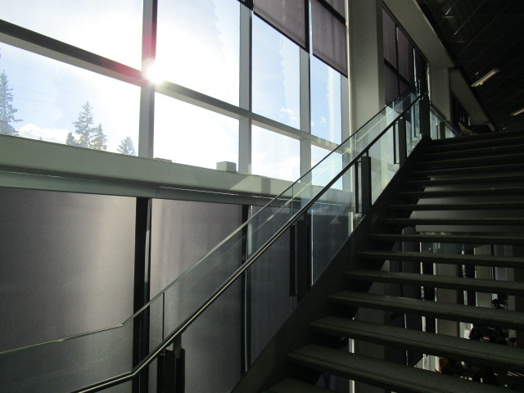
Indigenous Students and Learning Spaces
“Indigenous students must contend with this relationship of a colonially fixed learning environment on the surface of a multifaceted and dynamic perspective of Indigenous landscapes.”
(Brown, 2019)
Indigenous student photo

Slide 8
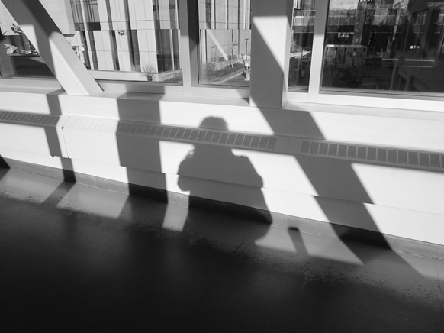
Photovoice: Community-based Participatory Research (CBPR)
We selected a research methodology that places students’ voices at the centre of the research.
We are non-Indigenous librarians and educators who are novices in Indigenous Ways of Knowing.
CBPR has the potential to contribute to efforts to decolonize the university-Indigenous community relationship. (Castleden & Garvin, 2008)
"I worry sometimes about losing myself. As an Indigenous person coming to an educational institution, I'm always riding that line and existing in both worlds“
Indigenous student voice & photo

Slide 9
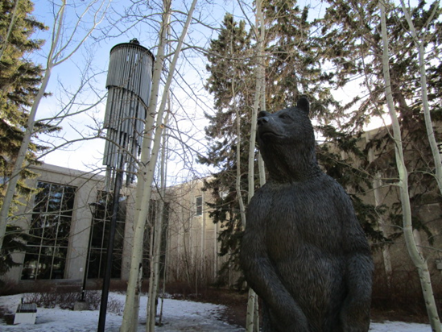
Student Recruitment
We aimed to recruit 8-10 students.
After a vigorous recruitment effort we recruited three Indigenous undergraduate students.
We conducted a pre-study interview on their preferred learning, and their motivation.
The three students were equally engaged in the project, wanting to learn and to contribute to change on campus.
Significantly none were familiar with the library spaces.
"I volunteer a lot, and I want to stay connected to my culture“
"I can change the school for others, so it won't be like when my grandma came here.“
Indigenous student voice & photo

Slide 10
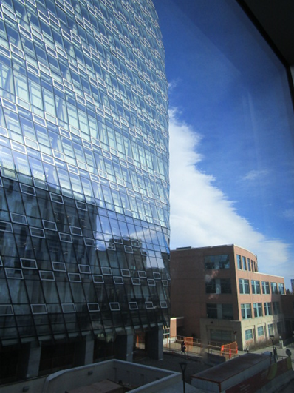
Photovoice : Building relationships through workshops
Review purpose of study
Establish research question collaboratively
Review ethics
Review of process:
Students as researchers take photos of their informal learning spaces on campus
Who am I as a learner?: review, summarize and analyze photographs
“You can see the reflection was kind of shadows on the other building and I just thought of how I want my learning spaces to be a reflection of myself. “
Indigenous student voice & photo

Slide 11
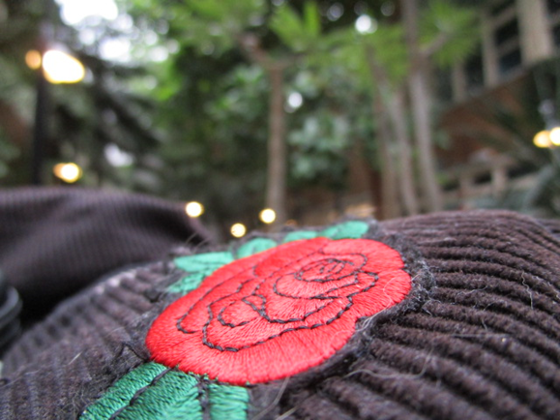
Photovoice: Value
Students became researchers
Each had a personal and individual point of view (POV)
Each recognized the POV of the other
We learned from them
"This is my backpack ...it is my knowledge“
Indigenous student voice & photo

Slide 12
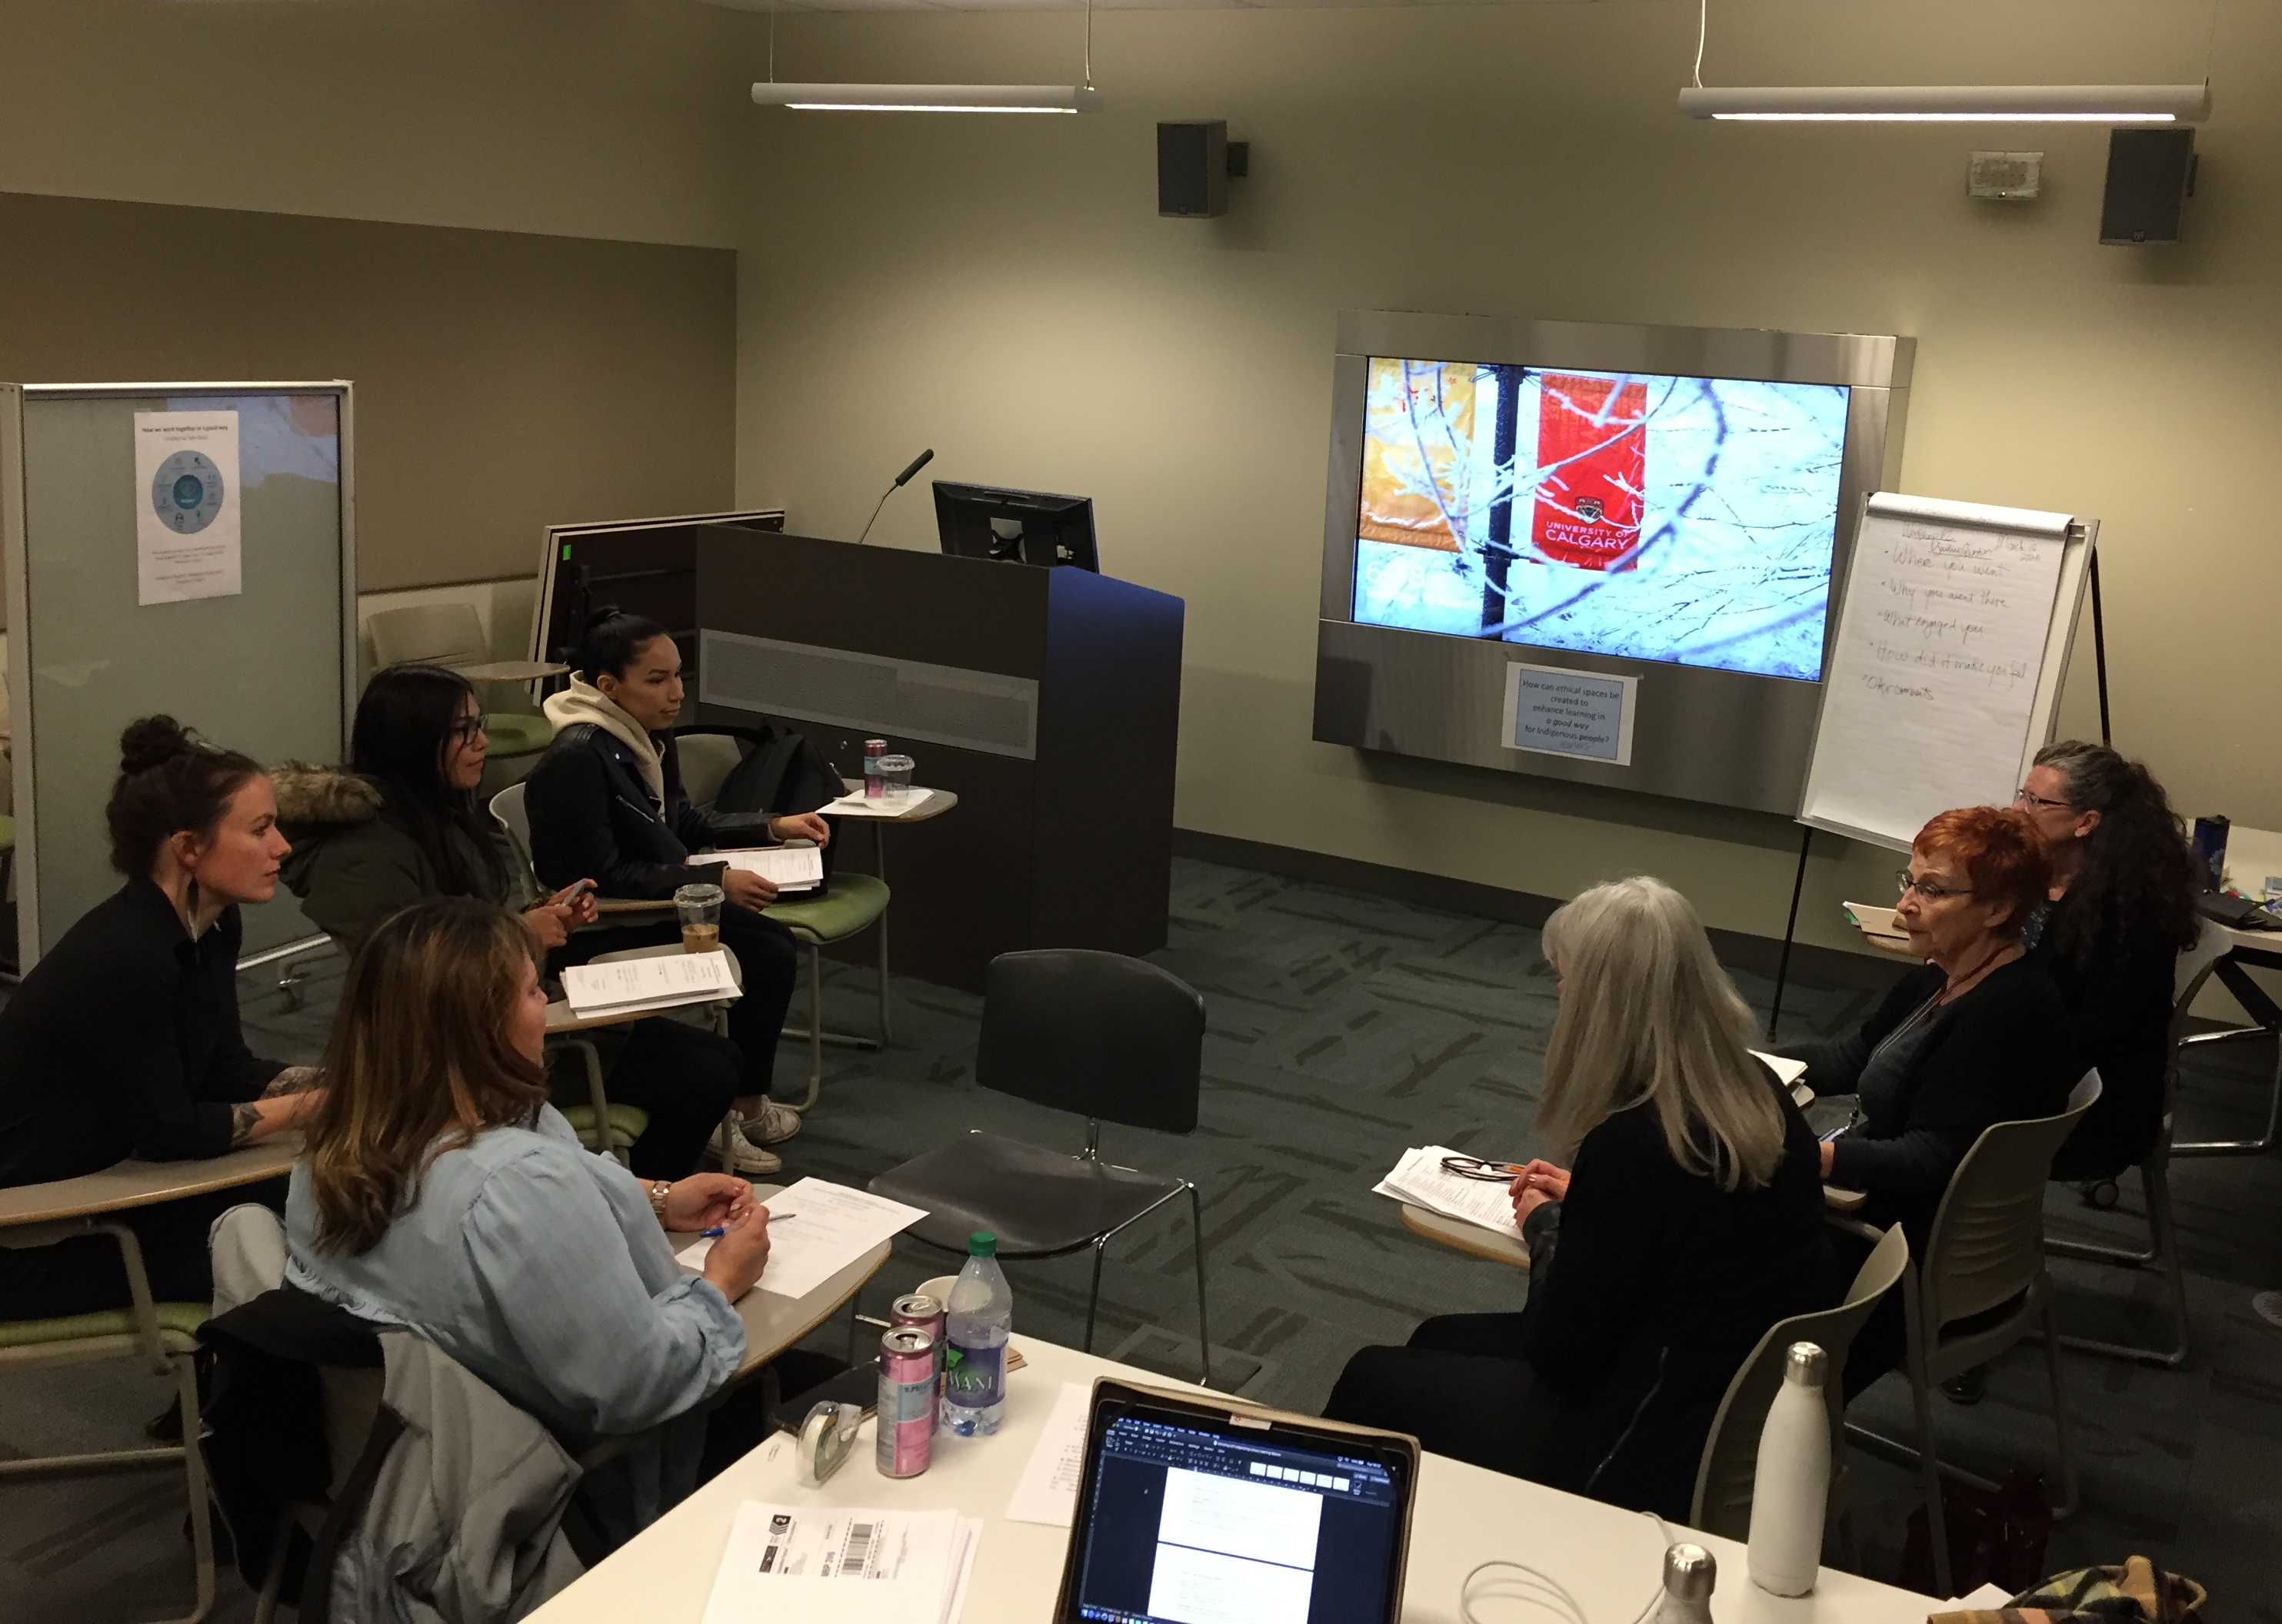
Our Workshops. Getting to know one another, sharing a meal, developing our research question as co-researchers, and defining how to “work together in a good way”
Research team photo

Slide 13
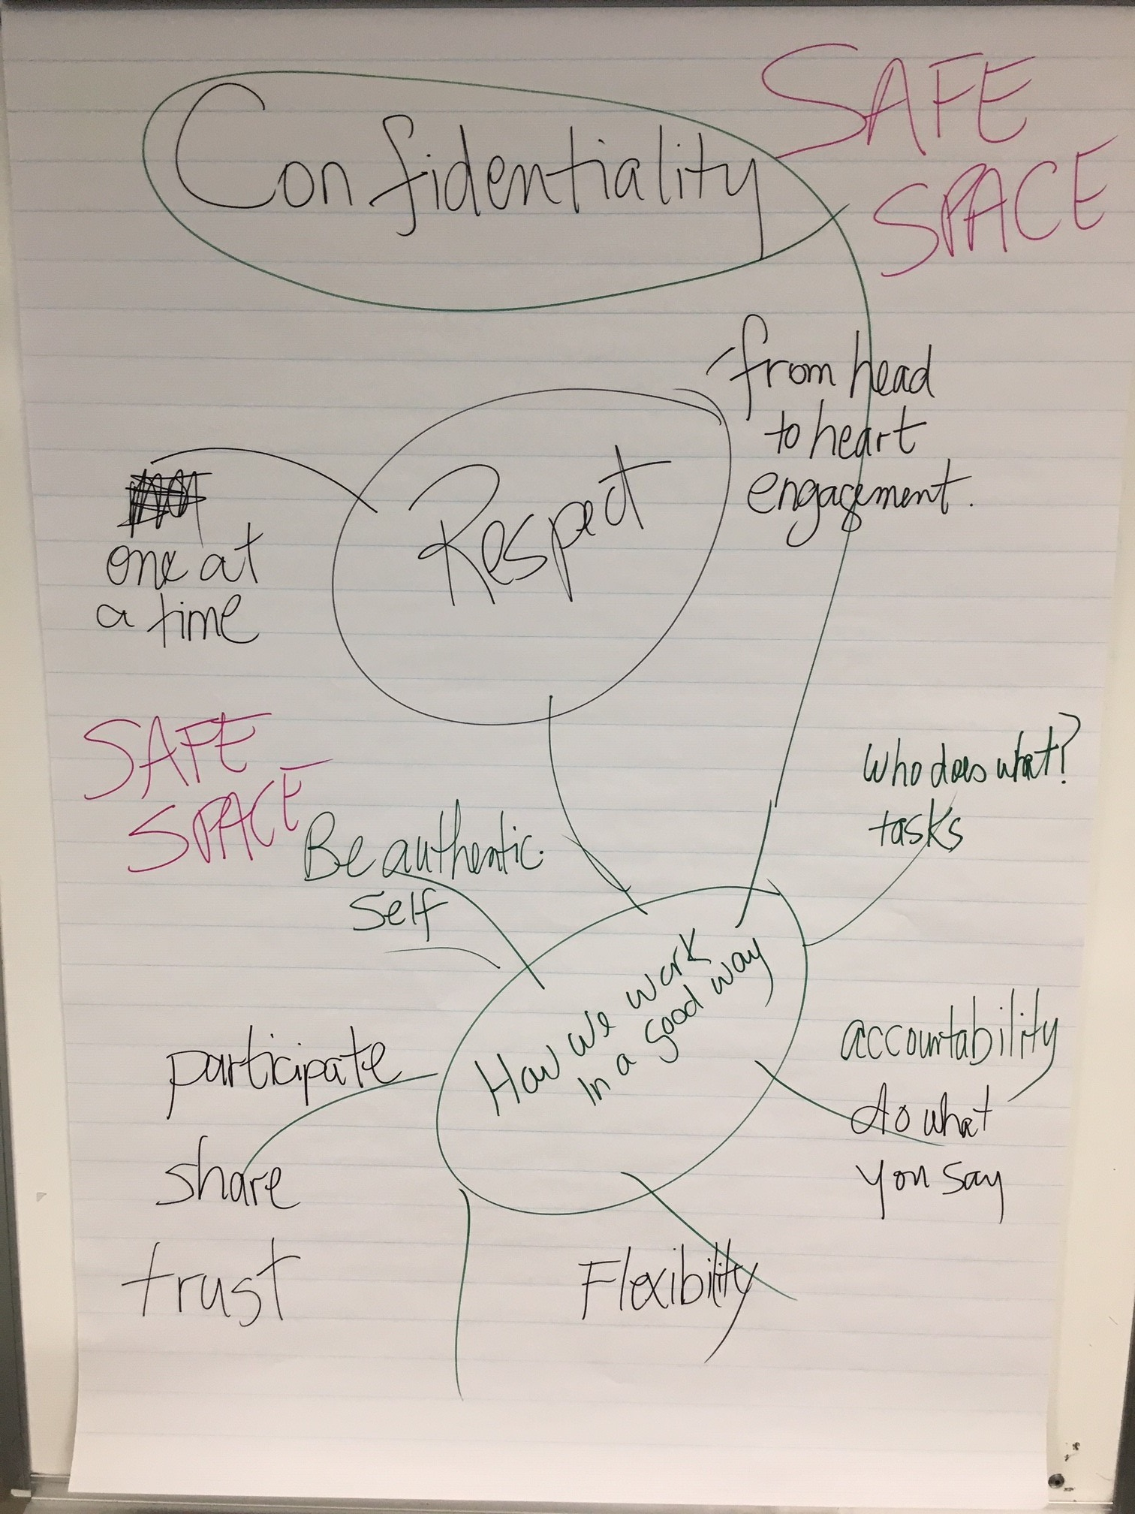
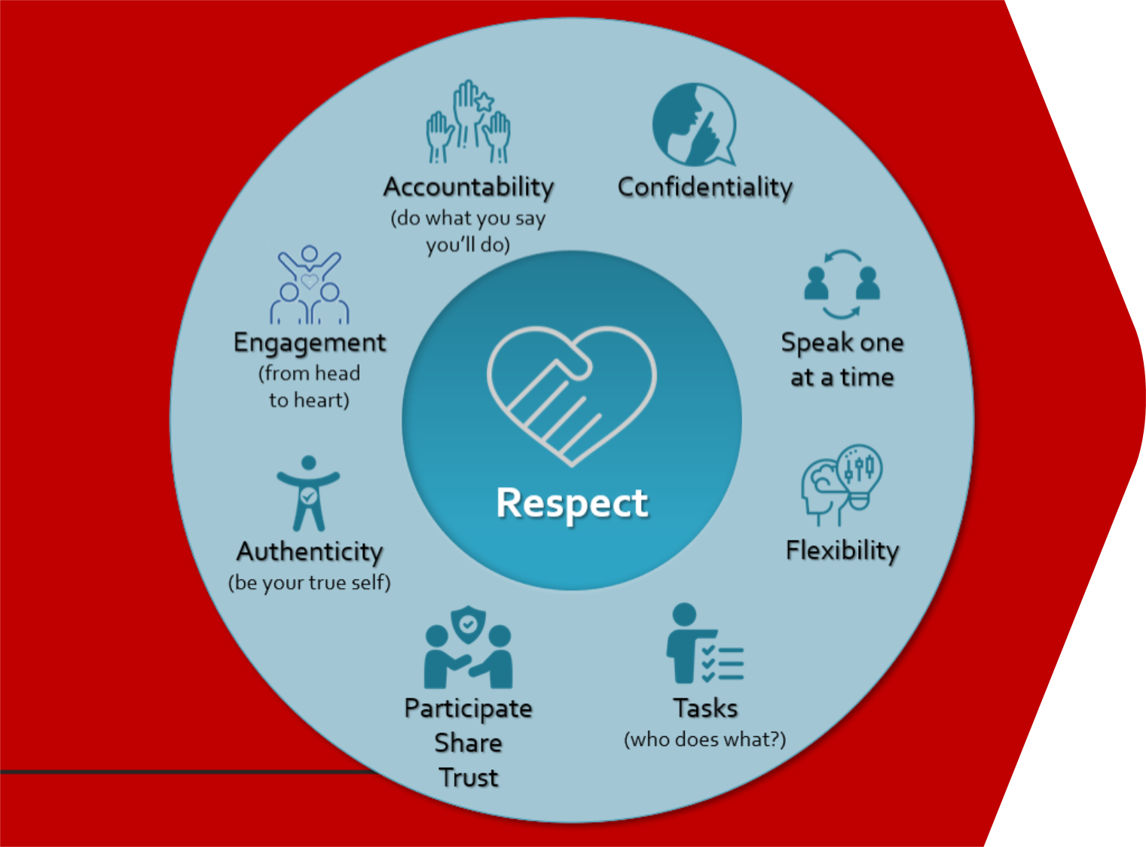
Principles to Create a Safe Space to “Work together in a good way”
Activity to brainstorm how to work together on the research project. Participants identified expectations and principles. Paramount was working together in a safe space
Research team graphics

Slide 14
Indigenous students’ generated the research question
"How can ethical spaces be created to enhance learning in a good way for Indigenous learners at University of Calgary?"
Original research question
Who am I as a learner?
Indigenous student photo

Slide 15
Findings & Implications: Indigenous students as learners
Each told a personal story
Feeling not at home on campus
Feeling that they do not belong
Value relationships
Value learning and growing
Value their community
Learning spaces
Seek comfort, light, and nature
Representations of themselves and their culture
Space to learn with support: task support, people, surroundings

Slide 16
And then came Covid
Our study came to an abrupt halt in March 2020
We had collected photos and held 2 workshops, plus the pre-study interviews
While the students were engaged, it became clear that they were done with the project.
Phase 2
Using photos of our current library spaces and recruiting a new group of Indigenous students we hope to gain further understanding by inviting the students to comment on the library spaces and the meaning of the spaces in terms of their learning. (Stay Tuned)

Slide 17
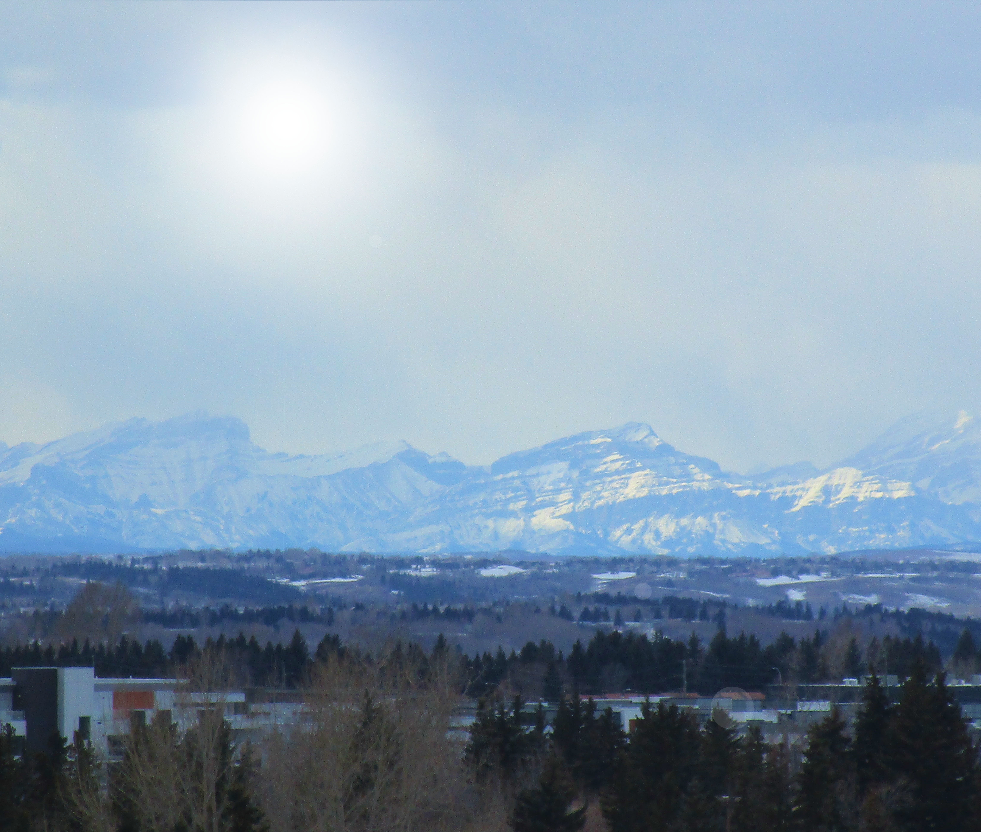
THEME: Nature Can we see ourselves in this space? The [mountains] allow us to flourish within their space. The university can do that for us. They [the University] can allow us to flourish within that space and provide us the opportunity to do so, and the space to do so.
Indigenous student voice & photo

Slide 18
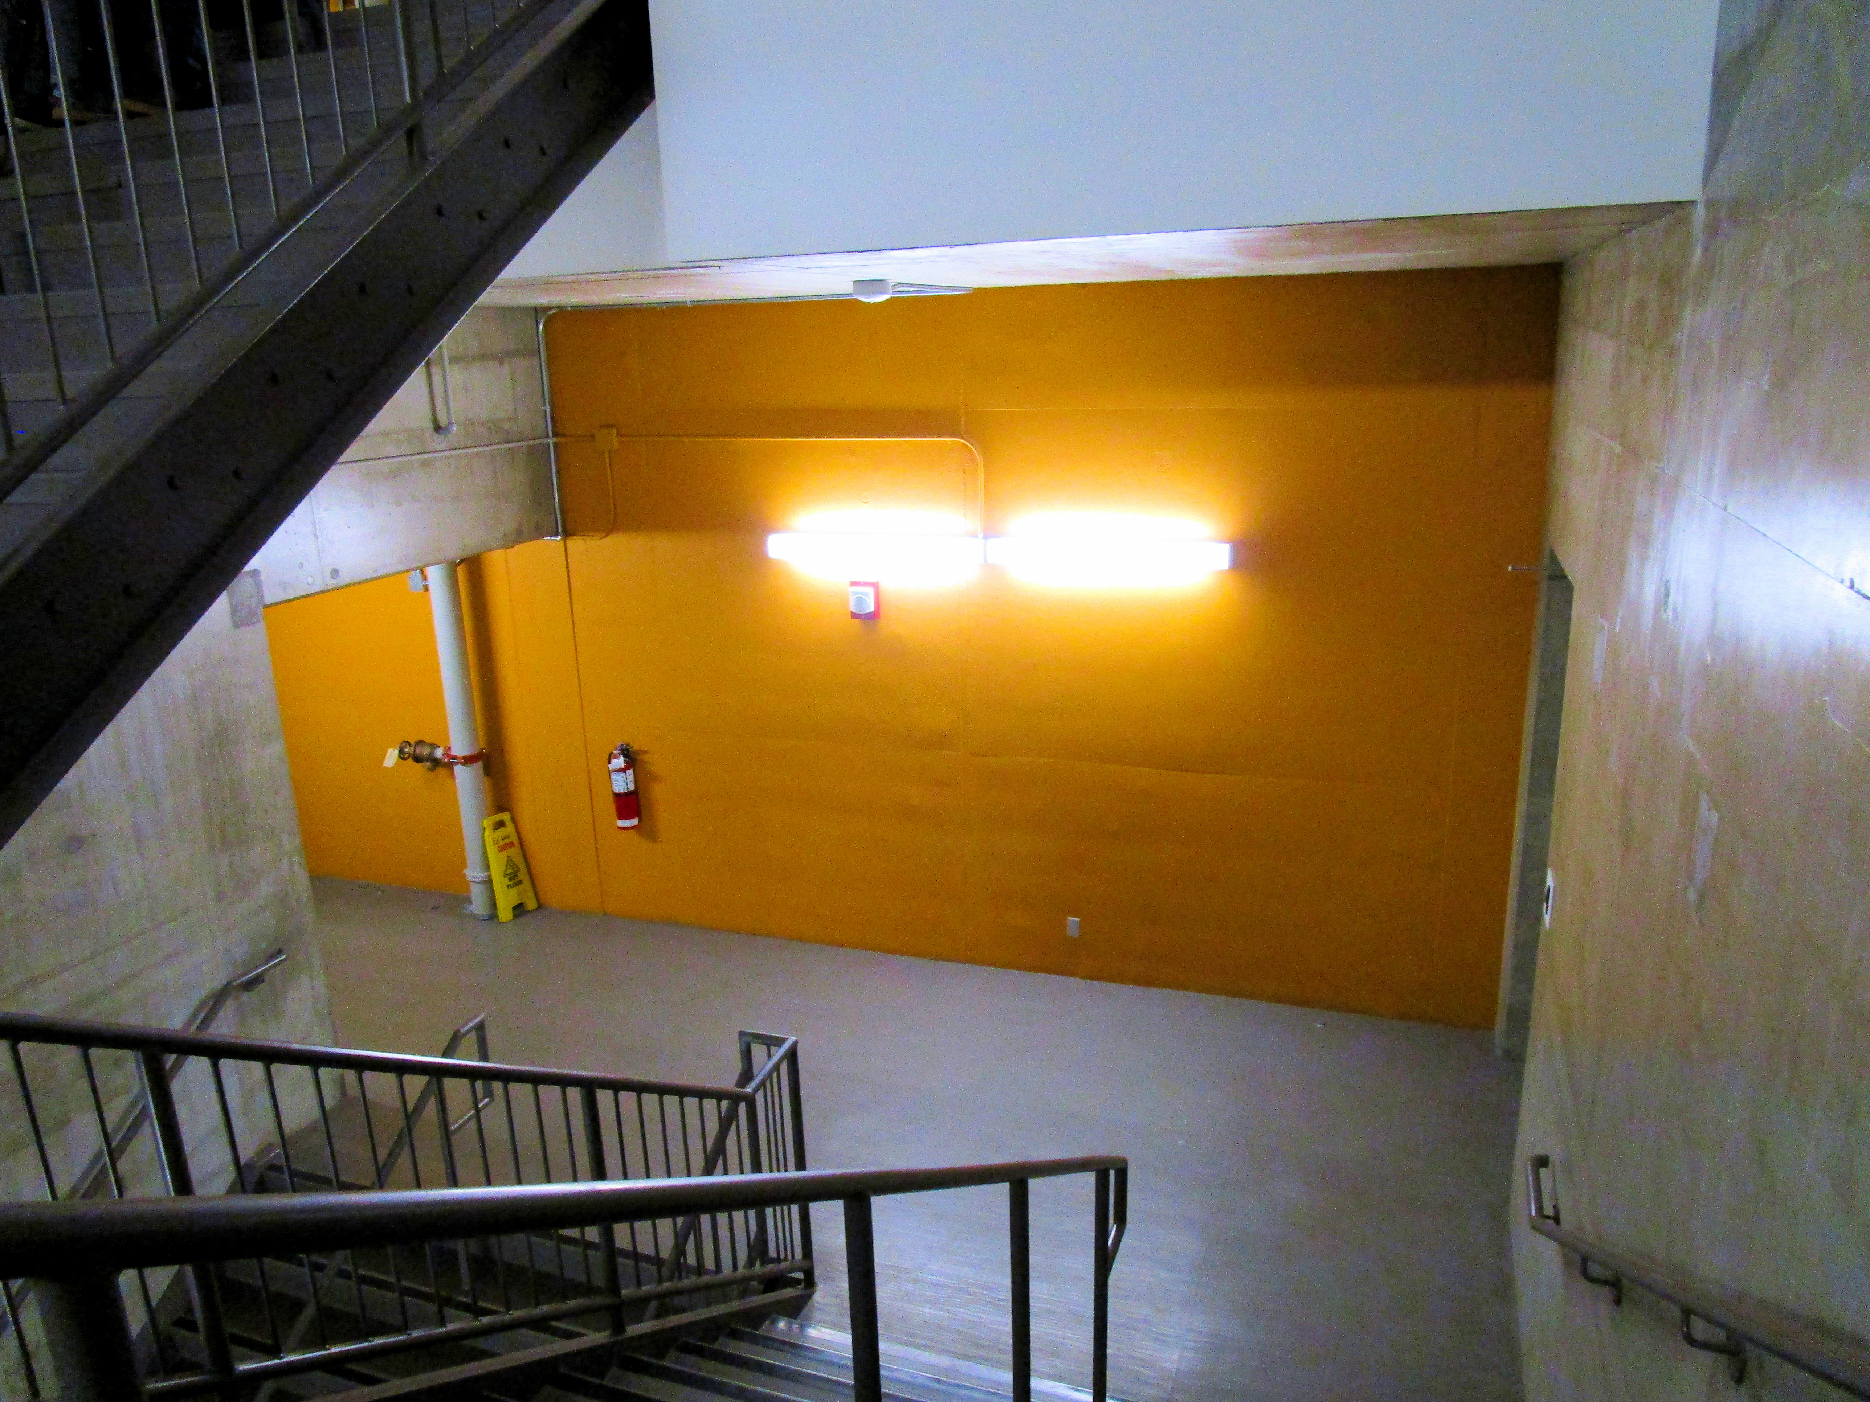
THEME: Representation
To me when I see blank walls, I see an opportunity to use up that space and make it purposeful.
When I think about more inclusive space for Indigenizing space, it's not only about nature, but it's about representation and where we can feel that space is comfortable and homey.
Indigenous student voice & photo

Slide 19
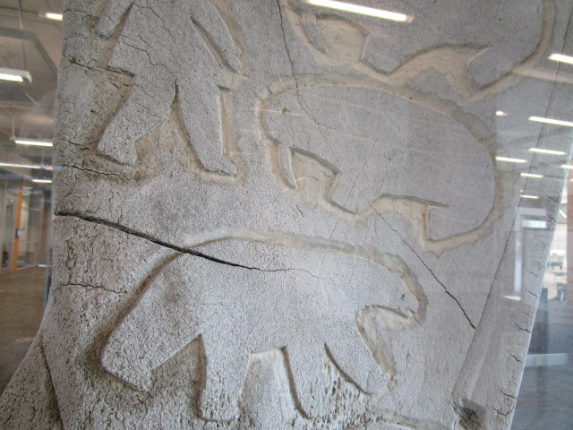
THEME: Acknowledgement
First, I want to look around and see where I'm acknowledged in the first place before I begin to decolonize library space, right?
And I saw this. It [the sign] just said, in your way, "carving on whale bones" but I didn't like seeing it because it’s "Oh this was from my people", I'm not Inuit, but . . .
And then I just felt acknowledged and, we have space here, we're here already.
Indigenous student voice & photo

Slide 20
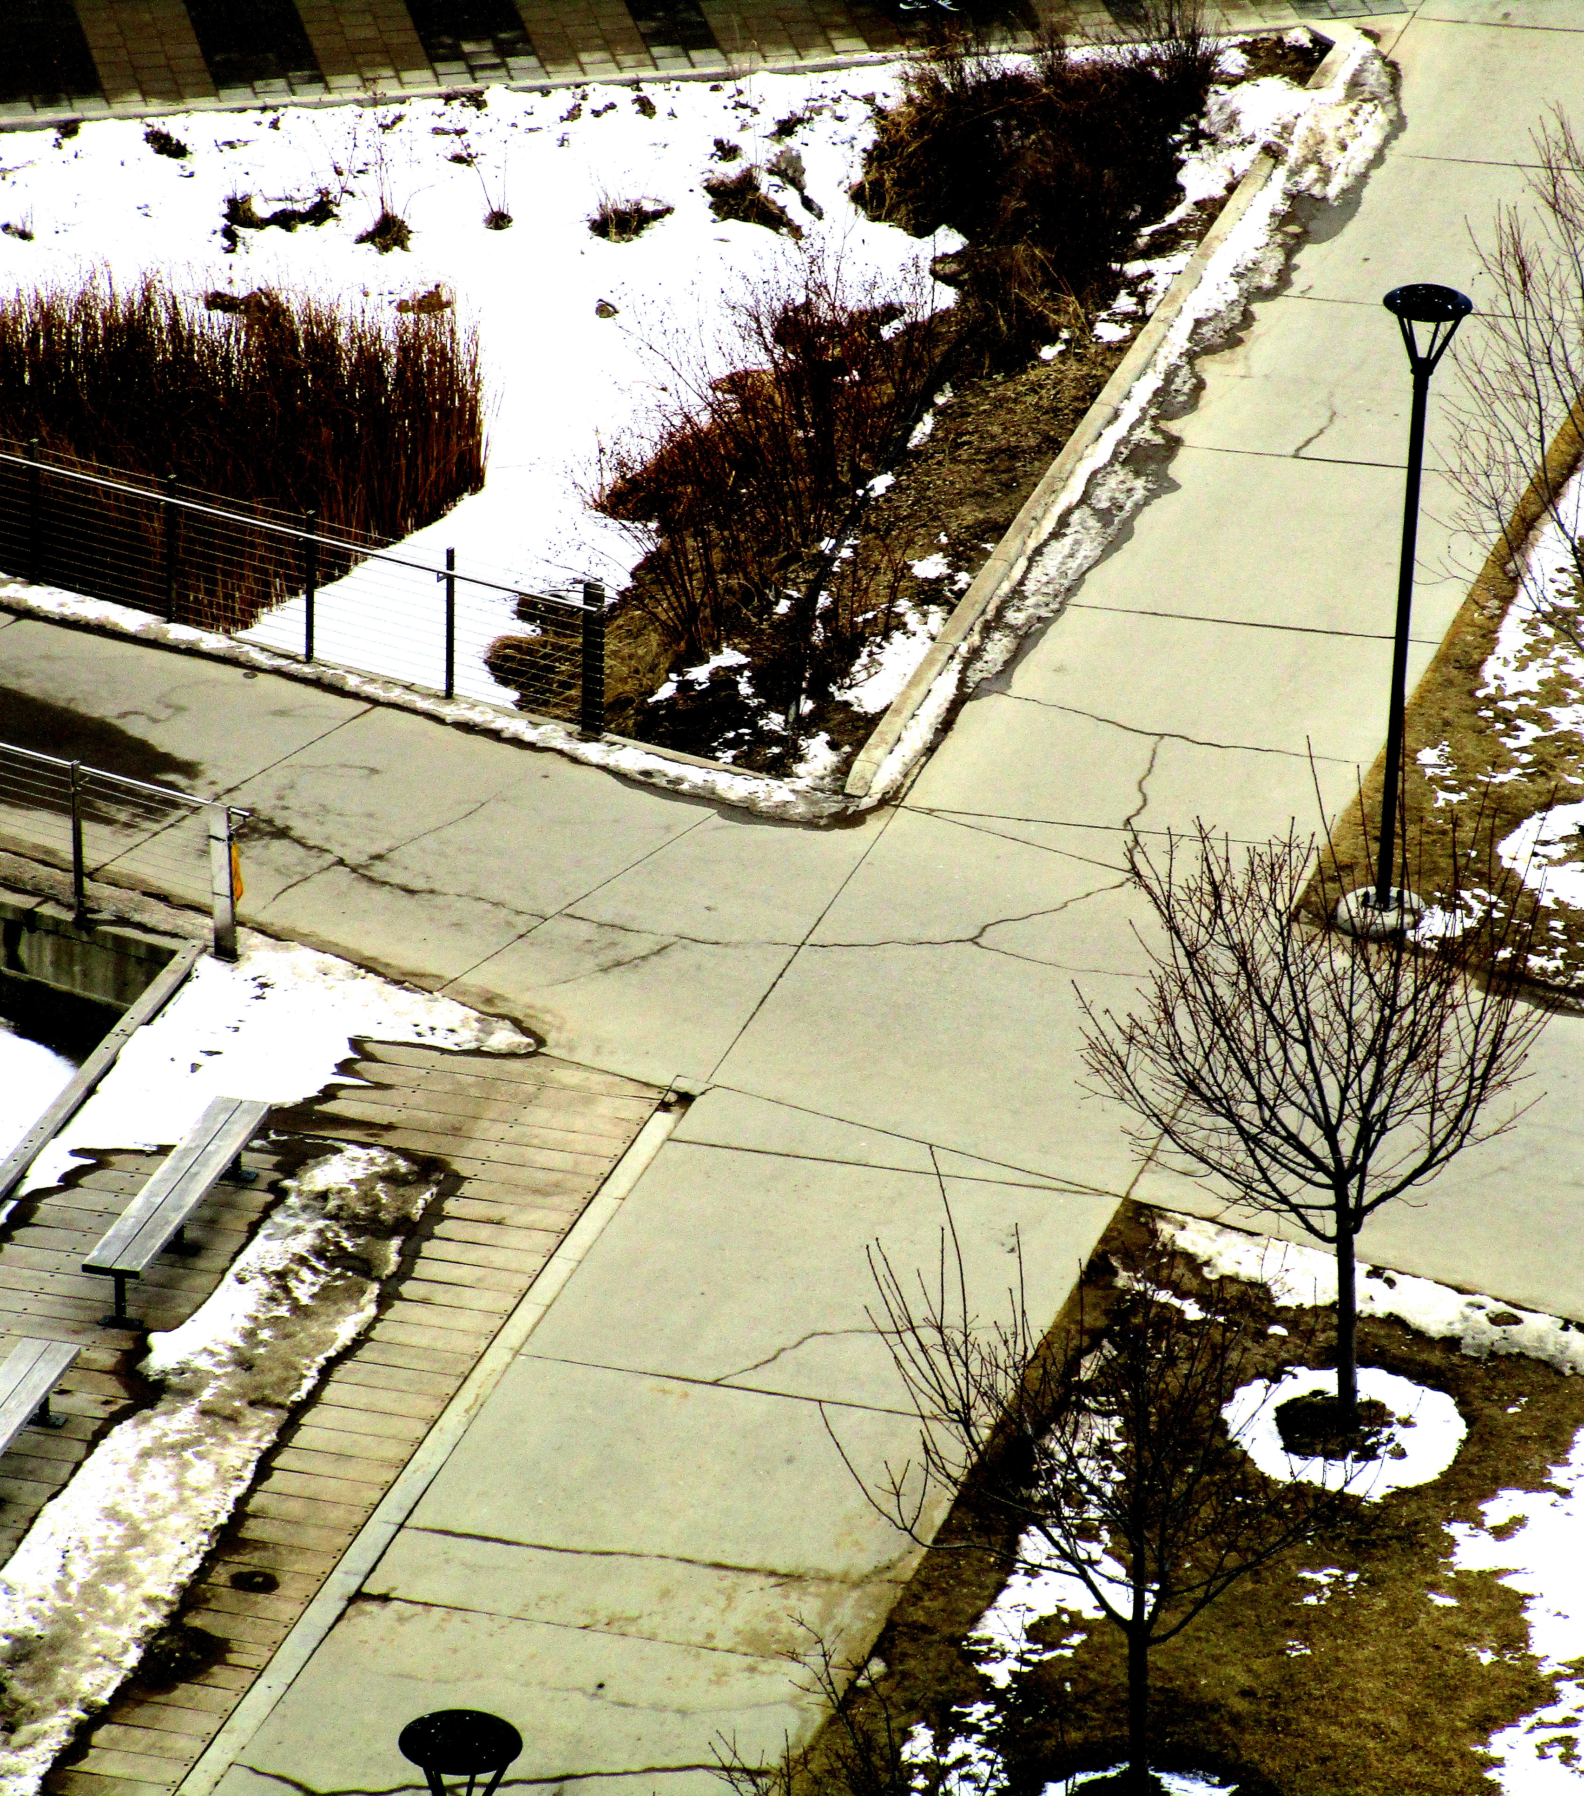
Stop! and start the conversation
X marks the spot. That's what I got from that.
We're all on the same path towards the same destination of knowledge, and learning, and being inclusive and respectful. We can either walk by each other and say, "Hey," or we can stop and have the conversation.
Which is what I think this project is doing, saying, "let's stop," acknowledge each other and have a discussion and collaborate and find better ways to Indigenize these learning spaces here on campus.
Indigenous student voice

Slide 21
References & Further Readings
Beatty, S. (2017). Students’ perception of informal learning spaces in an academic library; An investigation into the relationship between learning behaviours and space design. Proceedings of the IATUL Conferences. Paper 1. http://docs.lib.purdue.edu/iatul/2016/spaces/1
Boys, J. (2014). Building better universities: Strategies, spaces, technologies. New York: Routledge.
Brown, K. (2019). Creating culturally safe learning spaces and Indigenizing higher education. Journal of Learning Spaces, 8(2).
Castleden, H., & Garvin, T. (2008). Modifying Photovoice for community-based participatory Indigenous research. Social Science & Medicine, 66(6), 1393-1405.
Cunningham, M.,, and Walton, G. (2016). Informal learning spaces (ILS) in university libraries and their campuses. New Library World 117(1/2):49-62.
First Nations Centre. (2007). Considerations and templates for ethical research practices. Ottawa: National Aboriginal Health Organization, retrieved from https://achh.ca/wp-content/uploads/2018/07/Guide_Community_FNC_ConsiderationsandTemplates.pdf
Julien, H., Given, L. M., & Opryshko, A. (2013). Photovoice: A promising method for studies of individuals’ information practices. Library & Information Science Research, 35(4), 257-263.
MacDonald, M. (2018). Lessons from the first summit for mentoring indigenous graduate students. University Affairs, https://www.universityaffairs.ca/career-advice/career-advice-article/lessons-first-summit-mentoring-indigenous-graduate-students/
University of Calgary, Office of Indigenous Engagement, Cultural Protocol, https://www.ucalgary.ca/indigenous/cultural-protocol
University of Calgary (2017), Office of Indigenous Engagement, Indigenous Strategy, ii’taa’poh’to’p. https://ucalgary.ca/indigenous/ii-taapohtop

Slide 22
Acknowledgements & Appreciation
Sincere appreciation to the Indigenous students who participated in this study as co-researchers and for permission to use their words and photos.
We acknowledge the Scholarship of Teaching and Learning (SoTL) funding, University of Calgary Teaching and Learning Grants, 2019 – 2022
Thank you to David Brown, Taylor Family Digital Library for his photography.
Indigenizing Library Learning Spaces Using Photovoice Methodology Contacts at the University of Calgary, Calgary, AB, CANADA Susan Beatty, Librarian. sdbeatty@ucalgary.ca Alix Hayden, Librarian. ayayden@ucalgary.ca Cheryl Jeffs, Educational Developer. cljeffs@ucalgary.ca
Taylor Family Digital Library. https://library.ucalgary.ca/ Taylor Institute for Teaching and Learning. https://taylorinstitute.ucalgary.ca/

