Slide 1
Envisioning Our Future and Living It
New Library Space and How It Works for Us
Nancy B. Turner
nancy.turner@temple.edu
Library Assessment Conference
December 16, 2020
Notes:
Hello Everyone. I’m Nancy Turner, at Temple University Library, and I’ll be starting off today’s session with a presentation on our research project, “Envisioning our Future and Living It: New Library Space and How It Works for Us.

Slide 2
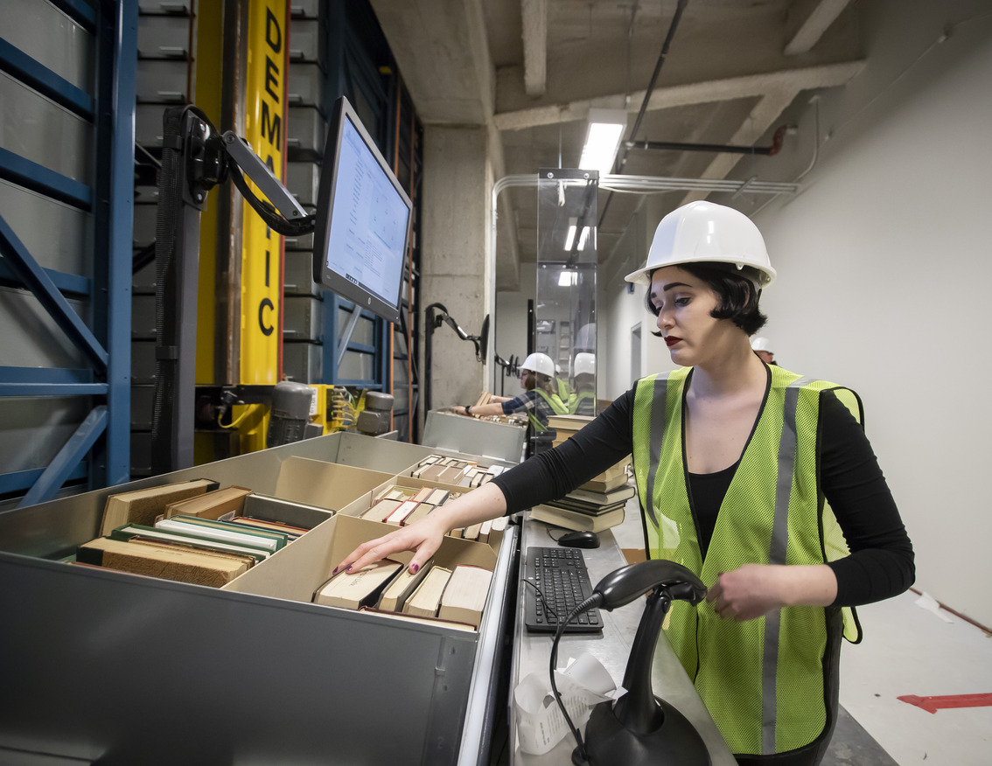
How do library spaces facilitate innovative research, creative thinking and problem solving?
Notes:
In 2019 the Association for Research Libraries initiated an assessment effort, calling for proposals to address several key questions facing libraries today. Our project addressed the question of “How do library spaces facilitate innovative research, creative thinking and problem-solving?”
At that time, Temple University was preparing to move to a new main library, The Charles, a building that was designed with technologies and spaces that would indeed, faciliate these activities. But I was interested in looking at this question from a slightly different angle. How do we support staff in their work to faciliate innovative research? We’ve got the physical capacity, but are staff trained and prepared?
The move provided us with a perfect opportunity to explore these questions

Slide 3
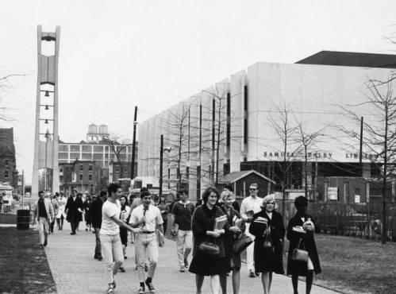
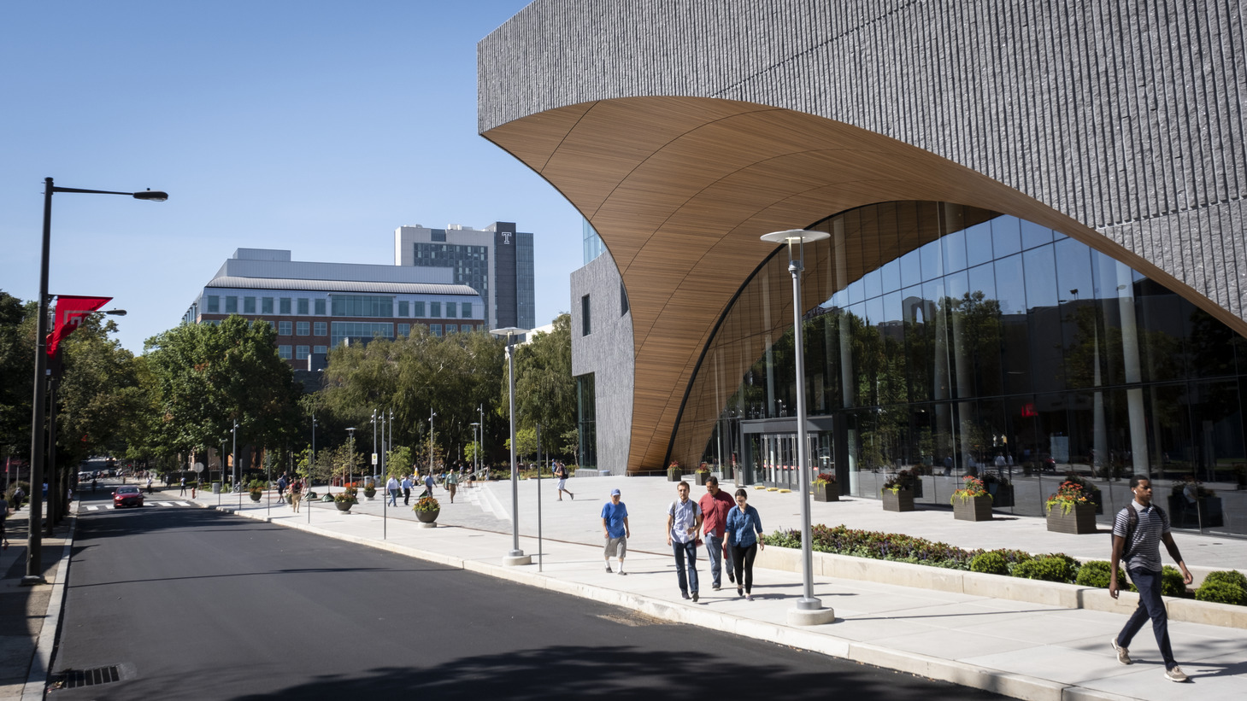
The spaces: past and present
Charles Library, 2019
Courtesy of the Special Collections Research Center. Temple University Libraries. Philadelphia, PA
Notes:
While the move included transporting 2.5 million physical books and archival materials, and 106 staff, the change was more than a physical change.
What was also changing was how we accessed collections, our capacities for conducting instruction, a new partnership with the Student Success Center, a focus on specialized spaces for collaboration and technology-rich project work – and for many – the loss of private offices. Except for the dean, we are all in an open office environment.

Slide 4
Methodology
Two phases : Pre- and Post- move
Semi-structured interviews
Audio-recorded and fully transcribed
Review of transcripts for themes
Selection of quotes for illustration of themes
Notes:
The research was divided up into two phases of semi-structured interviews, the first in the spring and early summer of 2019, prior to the move.
We asked about the current spaces at Paley for individual, group and public-facing work. What were the opportunities in these spaces, what were the challenges? We asked how people imagined how the their work would be changed by the new spaces. Finally, we asked about what kinds of support was received for adjusting to the changing spaces. Interviews were audio-recorded, fully transcribed and then analyzed to discern prevalent themes
About six months later, we conducted another set of interviews – 29 participated each time, with some overlap in participation. Here are some of the findings, illustrated with quotes.
.

Slide 5
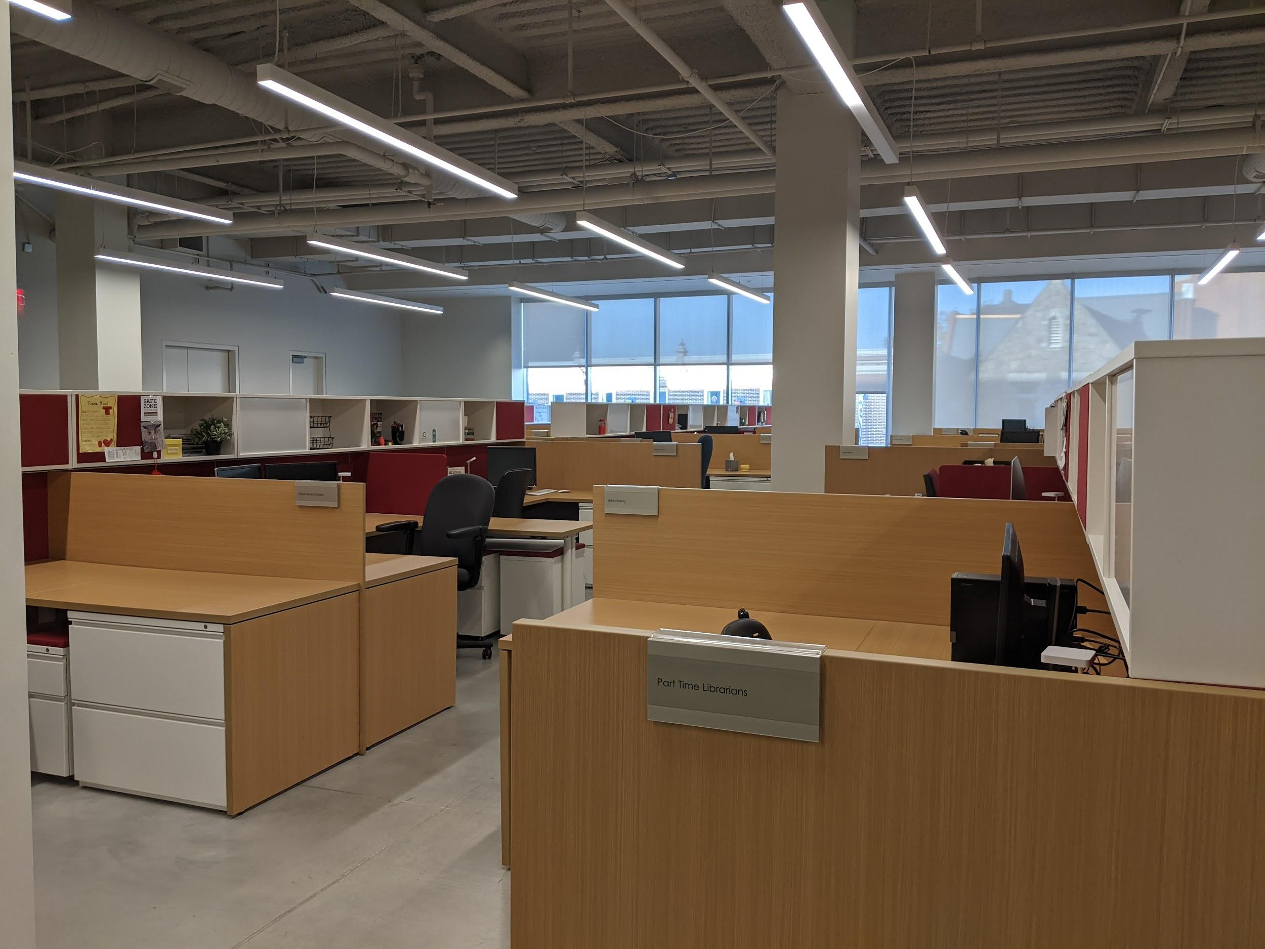
Spaces for individual work
Notes:
When we spoke to staff prior to the move, just about everyone was looking forward to the natural light available in the new library. Paley was described as dark, dingy and dirty.
While many were concerned about how the shared office space would work, for as many this would not be a change for them.
Many staff prepared for the move by purchasing noise-reduction headphones, anticipating a new space where it would be hard to concentrate due to distractions from co-workers.

Slide 6
Light, space and air
“I do love the daylight. I love the brightness of it and the whole space overall. I would say that ambiance, if you want to call it that, is good. ”
“There’s something about the aesthetics of the environment that are much more serious, you know. I feel a little more rejuvenated from moving to this space.”
Notes:
The new spaces felt more professional, clean and many staff liked that they were able to get rid of many years’ worth of clutter.

Slide 7
Togetherness and distraction
“So being in your own office there is a feeling of isolation. So I feel like here it’s a nice feeling of more togetherness and working in a group setting.”
“I’ve been surprised that in the new space the visual distractions actually bother me a lot more than the noise distractions….It’s challenging to me just mentally to feel so seen by other people.”
Notes:
But feelings about the spaces for individual work was mixed. Some staff liked that that could easily scan the room and see who was available. But because of the noise, and privacy issues, and the fear of disrupting others, the casual conversations in this big work area was greatly reduced.
The shared work space had a significant effect on how staff communicate with one another at their desks. In addition to the use of headphones to block out noise, the headphones may signal to others, “I am not to be interrupted now”.
Several use Slack or email in order to keep others from overhearing private communication. There is a self-imposed unwillingness to “disturb the peace” by talking loudly

Slide 8
Privacy
“Everybody is very respectful of other people's privacy in that just because you're there doesn't mean they're going to, you know, stop and say something and interrupt you.”
“I feel like I'm in a fishbowl sometimes.”
Notes:
Privacy came up a lot.
In an open environment, one is always visible. Many staff described feeling self-conscious at times about this exposure, particularly the open display of work on their computer screen. Some mentioned physical movements of colleagues around the space as distracting.
Of all the noises noted in the staff work areas, telephone calls were most disruptive to others. Staff feel severely constrained when using the telephone, a special challenge for those whose job entails handling requests (and complaints) from patrons by telephone

Slide 9
Establishing norms for shared space
“We’ve come up with a new set of cultural norms to do our work in, and it’s working.”
“When we moved in, [with the building in] that state and dealing with those things was a challenge for myself and others – in addition, on top of us trying to figure out our working dynamics in the new spaces. So I think that first couple months, I was very high anxiety.”
Notes:
We had not thought ahead about establishing norms for use of shared resources. Like who decided whether the blinds should be closed or not? Who decides what was okay to do in the breakout rooms – lunch? Personal phone call?
While these things seem trivial, when we spoke to staff these were the issues that arose.
What we did not have, prior to the move, was a norm for discussing these issues in a safe, neutral way.

Slide 10
Spaces for connecting
Notes:
Prior to the move, many staff were looking forward to a larger number of meeting spaces, equipped with state-of-the art technology. Some assumed the open environment would lead to more collaboration across departments.

Slide 11
Meeting rooms
“It’s almost always pretty easy to find a room to go work in with colleagues.”
“You expect to spend five minutes jostling with the technology at the beginning of a meeting.”
Notes:
Clean this up
At Charles, rooms must generally be scheduled for those purposes. There were definitely some adjustments made after we moved in and learned more actual needs.
While it was widely recognized that Charles offers a greater number of meeting rooms, with better variety and technical capacity, there is a lack of clarity as to who is able to schedule rooms, which rooms are schedulable and which are not, and who makes those decisions. There is uncertainty about how rooms can be used, including whether having lunch in a room was allowed, or using a room for a private phone call. This is an area where a more widely shared resource is visible and potentially available to all, but processes for developing norms, and policies for managing that resource, are not clear to all staff.

Slide 12
Collaboration and the serendipitous meetup
“I think the one thing that I think I might’ve said, ‘Let’s do differently’, in the planning of the office space is having people that work together sit next to each other.”
“You’d think with the open office space, everybody’s together, that would increase a sort of intimacy or frequency of communication between people. But it’s actually had the opposite, because it negates people’s freedom to choose to interact with other people.”
Notes:
The open office environment at Charles has not yet contributed directly to collaboration among staff. In terms of communication and interpersonal dynamics, some felt it the opposite effect. One participant expressed a hesitancy about brainstorming to generate new ideas in a public area, where those ideas, not ready for “public consumption”, may be overheard.

Slide 13
Spaces for working with users
Notes:
The new library is designed to make many service areas more visible. Special Collections and the events space are located on the main floor, rather than the lower level. There’s an exhibition space for Special Collections. The technology rich Scholars Studio occupies half of the 3rd floor. The variety and increased number of instruction spaces and consultation rooms were frequently mentioned as positives when working with users.

Slide 14
Visibility
“It is just pretty exciting to be in a brand-new building and a building that's much more aesthetically pleasing than the kind of drab, yucky interiors of Paley.”
“It’s kind of psychologically oppressive to continually inhabit the shadows under the stairs…. And it’s almost like they didn’t – like they want you hidden.”
Notes:
It was exciting to be a new center of attention on campus. We hosted thousands of visitors in those first weeks. But this attention did not come without challenge. The primary service desk was under the main stair case and lacks a direct sightline from the main entrance.

Slide 15
Staff as frustrated ambassadors
“I work with students and faculty a lot, and I'm often their only point of contact at the library. And I've gotten a lot of negative feedback, particularly from students about things that aren't in my control or that I don't understand that have been communicated to me, and that's been a challenge. “

Slide 16
What is a library?
“I do know a lot of our students complain about the lack of space to sit and a lot of lack of space to study in private quietly. ... I do think there should be more consideration for different types of studying. It is a library.”
Notes:
Once at Charles, many of the staff we spoke with had very positive feelings about the new spaces. The openness, the light, the clean and fresh spaces seemed a stark contrast to the old Paley building. Staff expressed optimism about the space and its potential for transforming the library’s place on campus.

Slide 17
On change and communication
“And talking to [colleagues] about their experiences with the transition has helped me just feel like I’m not imagining that I’m having a hard time.”
“If you want people to be able to find the support they need, they have to be able to voice unpleasant emotions about things. ”
Notes:
This was a challenging transition. Our time to adjust to the new space was very short. So while there was excitement and pride when we opened,
it was uncomfortable for staff, or they felt disloyal, in expressing concerns – even for obvious things like loud HVAC system noises disrupting consultations with users.
Some staff felt like frustrated ambassadors. when students asked where the quiet study was located, – or faculty complaining about the lack of open stacks, they had no ready answers.
In retrospect, it seems we might have been talking about these issues all along. As we were preparing for the move, staff appreciated the regular updates on the progress towards the building construction, but would have also found useful more substantial discussions of how the spaces were intended to be operarational. Perhaps we didn’t realize how much time it would take

Slide 18
Postscript​
Notes:
This picture was taken in October. On a given day now, there may be just one person working here.
For the many remote workers, it is ironic that just a few months ago we expressed concerns about a noisy colleague nearby, and now that noise may be a crying baby, a barking dog, or construction outside our city windows. For those of us who wished for more freedom to work from home, we’ve received that in spades.

Slide 19
Always evolving
“After three, four months I’m starting to feel like this is where we are. This is our future.”
“You come into work, and you just feel good. It’s inspiring.”
Notes:
Our final report to the staff was shared just before the Library building re-opened in early August, although most staff continue to work from home. So our recommendations were divided into two sections: those related to the physical space (set aside for now), and others related to communication.
As an example, recognizing that all staff need ready access to authoritative information about library policies and procedures, even when change is happening rapidly.
Whenever possible, make more transparent and communicate about decision-making processes, particularly as they affect spaces for staff work.
As we have learned less than one year after the move, the conditions of work are volatile and require clear communication, dialog and trust – whether we are moving to a new building or enduring a pandemic.

Slide 20
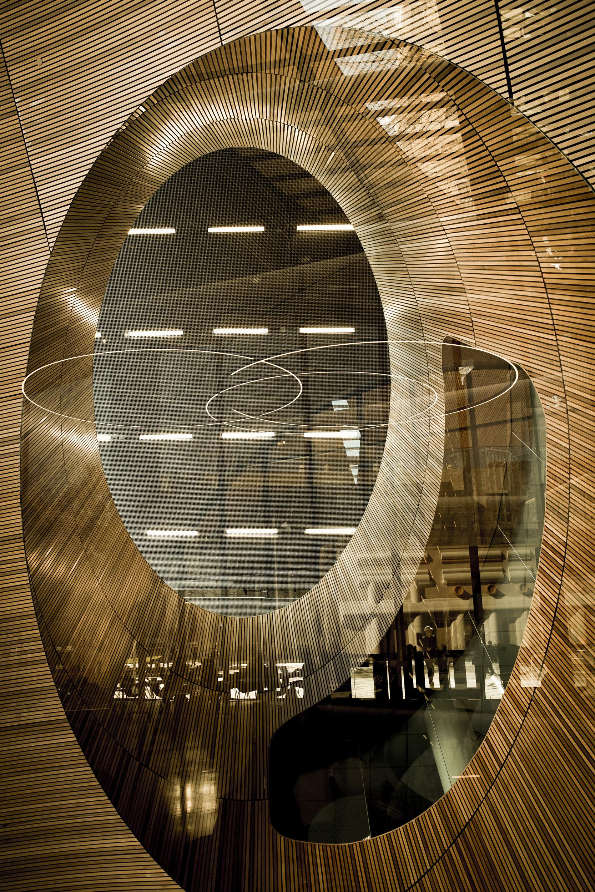
Acknowledgements:
Research Team Phase I: Olivia Given-Costello, Rachel Cox, Jessica Martin, Urooj Nizami, Jenny Pierce, Jackie Sipes, Caitlin Shanley, Stephanie Roth
Research Team Phase II: Karen Kohn, Rebecca Lloyd, Caitlin Shanley
Project Lead: Nancy Turner
Participants: 40+ anonymous
Other stuff
And this stuff too!
Notes:
Finally, this kind of intensive qualitative research would not be possible without
the research team members who spent time conducting interviews, analyzing transcripts and reviewing multiple drafts of the final report. It’s important, but also sensitive work. I also need to thank our colleagues who participated and entrusted us to share their experiences.

