Slide 1
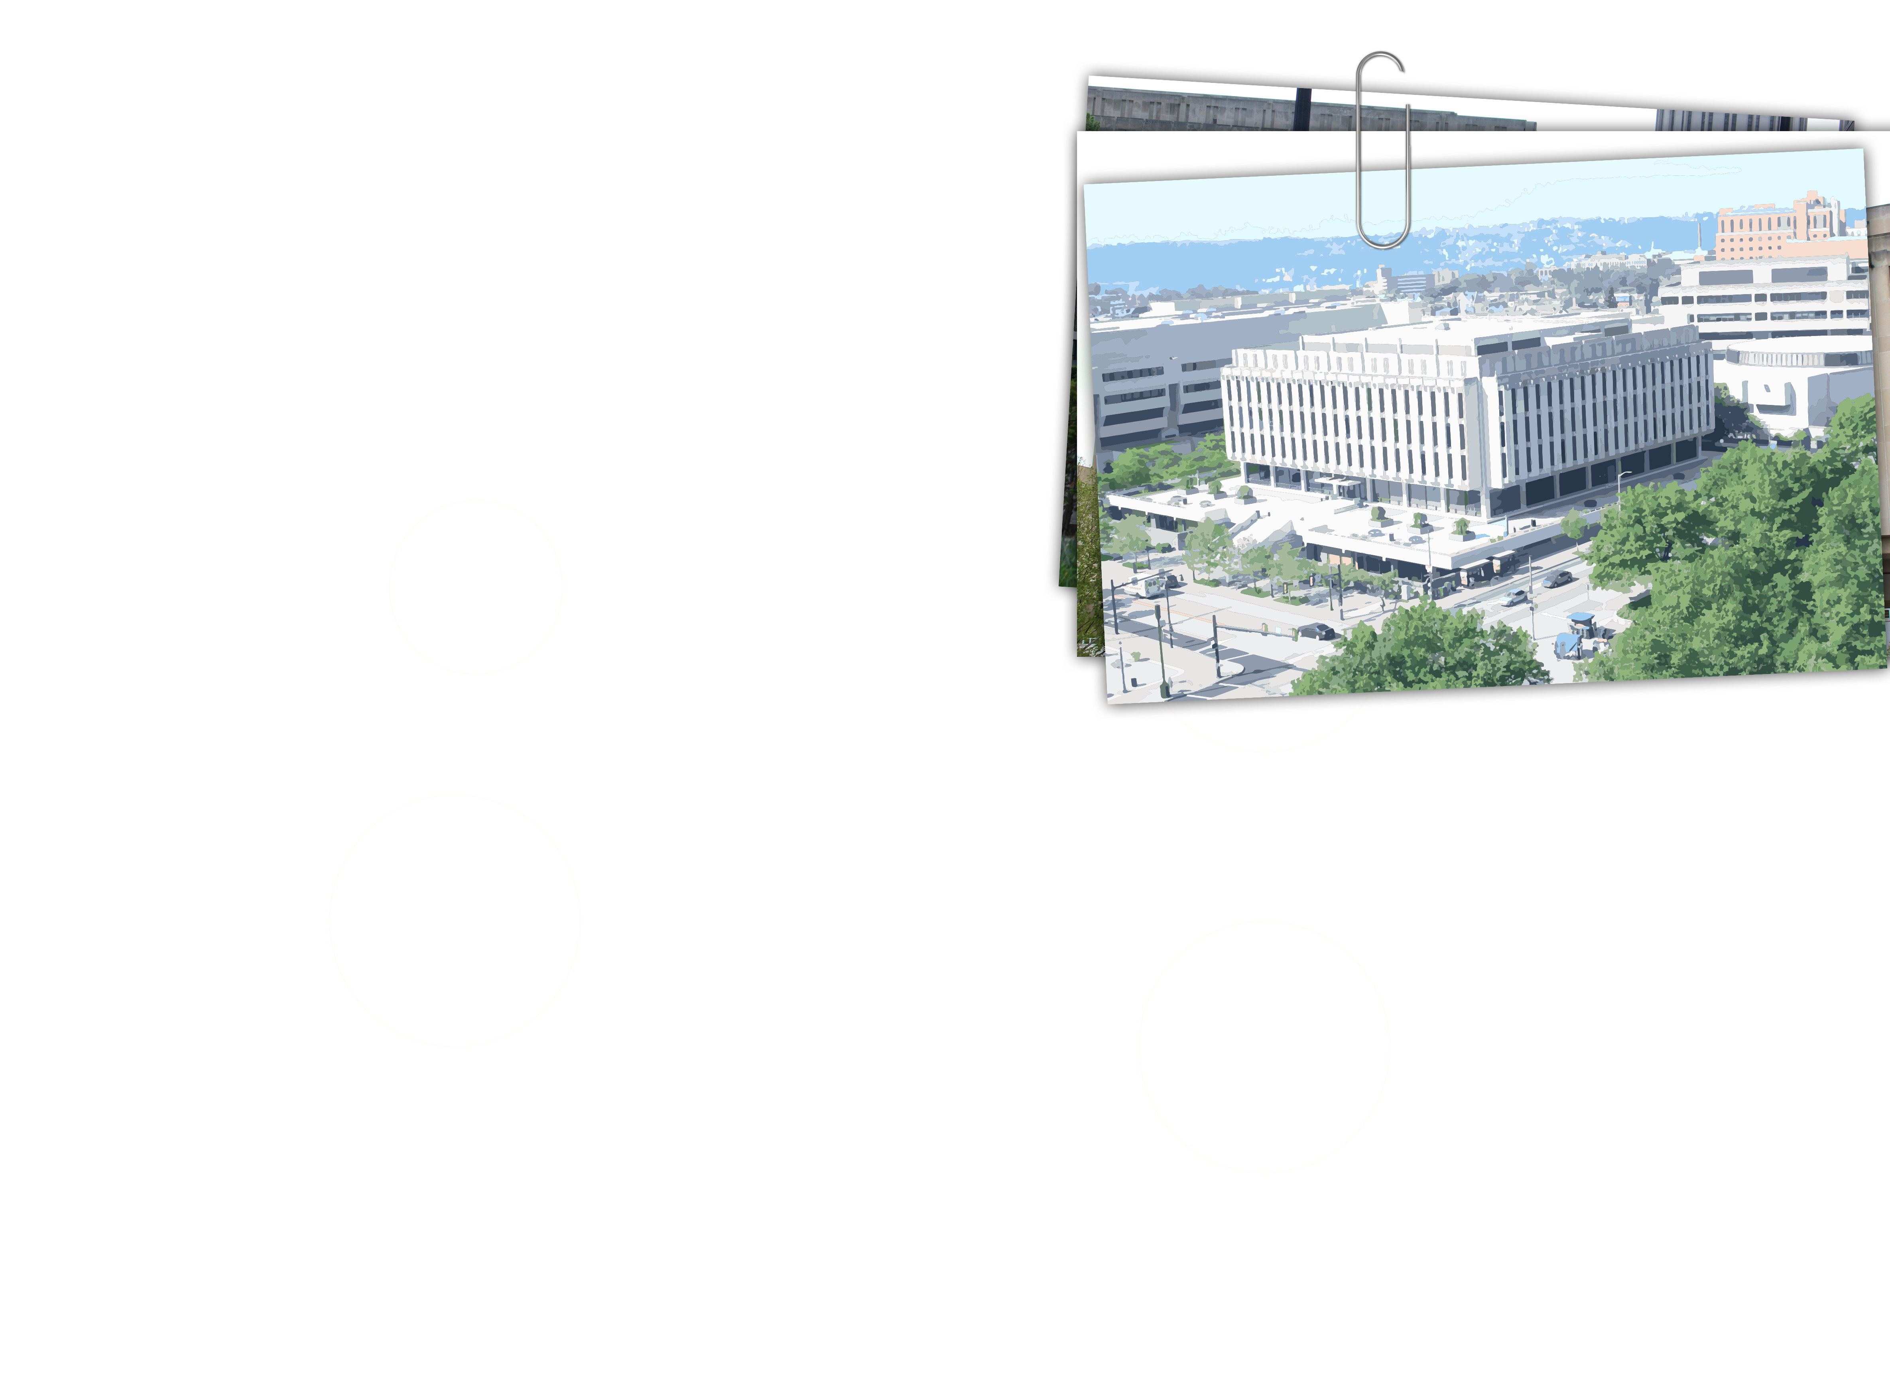

Where do we go from here?
managing collection moves with data visualization
Berenika M. Webster (bwebster@pitt.edu)
Anne Koenig (amk979@pitt.edu)​
Notes:
SLIDE 1:
At the heart of every great university sits a great library! However, what makes a great library has been transformed by the digital revolution. On the one hand, almost all new scholarly content is available in electronic form, and on the other, teaching, learning, and research have become increasingly interactive and interdisciplinary requiring new spaces and technologies.
Against this backdrop, academic library leaders are re-imagining their libraries.
In 2016, the University Library System at the University of Pittsburgh was given such an opportunity. The university approved funding for extensive renovation of Hillman Library to address the aging infrastructure in the building including asbestos abatement, HVAC replacement, lighting improvements, and adequate electricity and WIFI supply; and to reduce overcrowding. Apart from addressing badly needed infrastructure improvements, Library management successfully argued for funding to respond to the changing research and educational needs of its academic community.
In this presentation, I will give an overview of the project and its goals, and my colleague Anne Koenig will speak about the tools we developed to meet the challenge of relocating some 1.5 million items housed in Hillman Library and ultimately, reducing the collections footprint in the building by 80%.

Slide 2
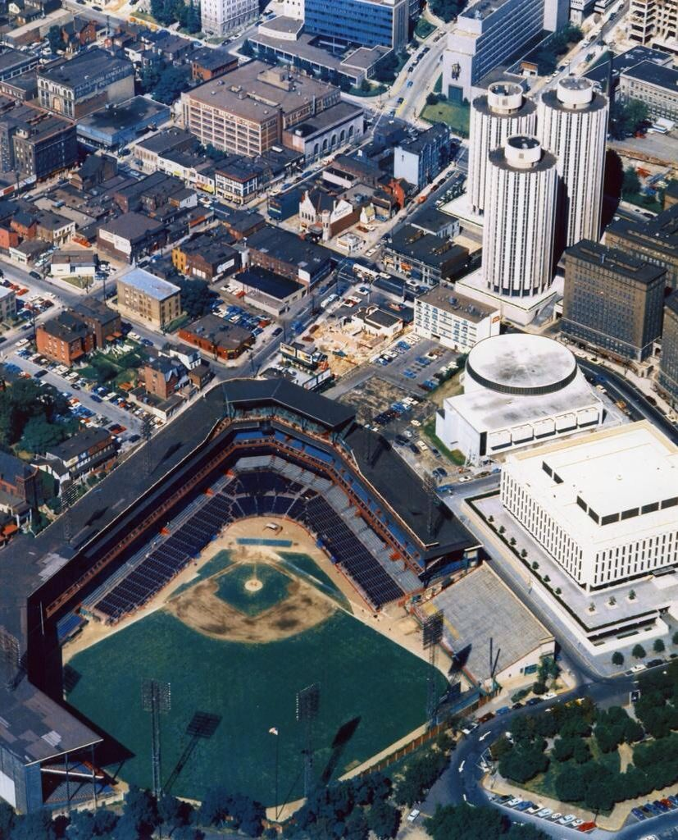
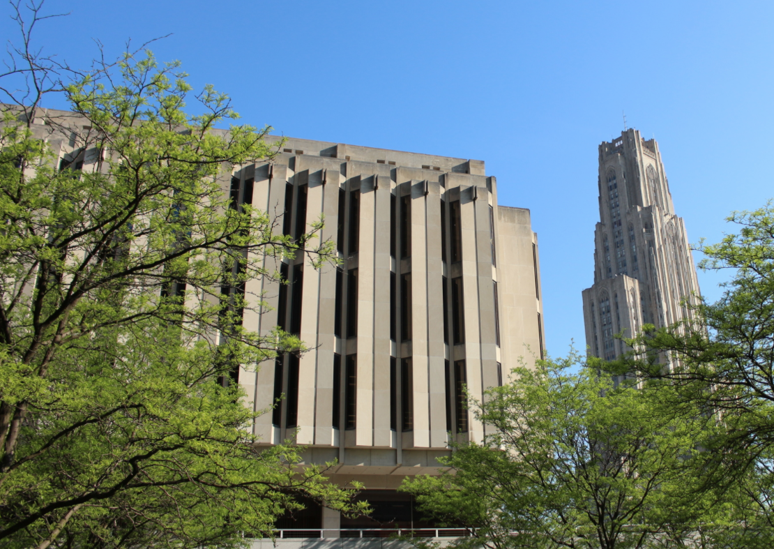
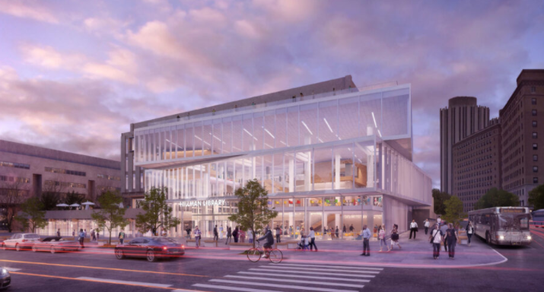
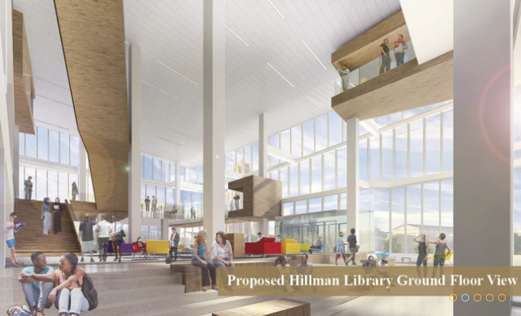
2023
1960 - 1970
2020
2023
Notes:
SLIDE 2:
Let me begin with a bit of context. The University of Pittsburgh is a research-intensive institution with a population of 35,000 students, nearly a third of them in graduate and professional programs. Pitt researchers publish more than 9,000 peer reviewed publications per annum, with particular strengths in biomedical sciences. They are supported by 12 libraries, with a combined collection of nearly 6 million titles.
Hillman Library, built in 1967, serves as the main library for the university, and is situated in the heart of the Oakland campus in Pittsburgh. It was designed to complement the architecture of the immediate area – Forbes Field, former home of the Pittsburgh Pirates, the modified renaissance style of the Carnegie Library of Pittsburgh, and the neo-gothic Cathedral of Learning – all iconic landmarks of the city. Hillman like many other libraries of its era prioritized the safe storage of books over reader comfort

Slide 3
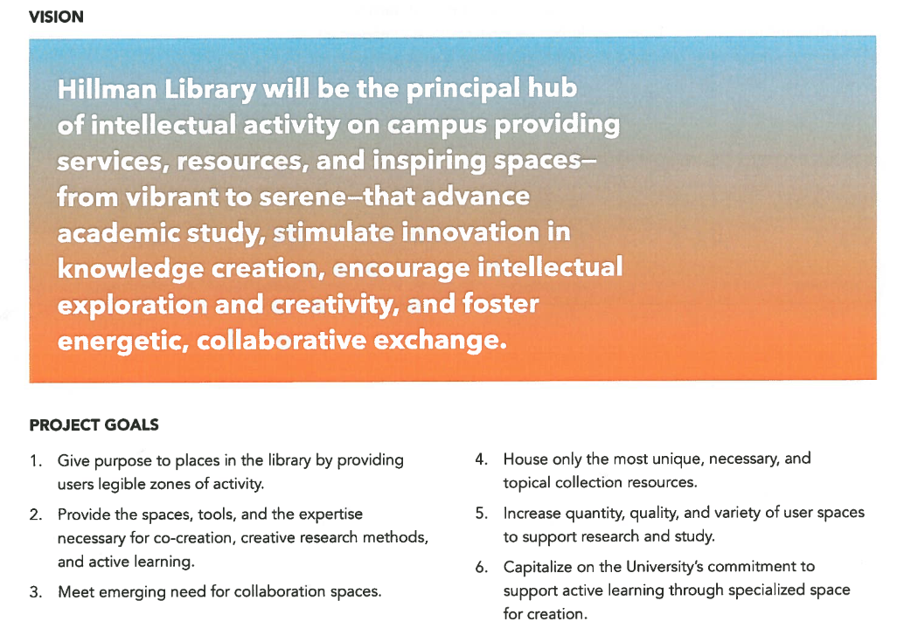
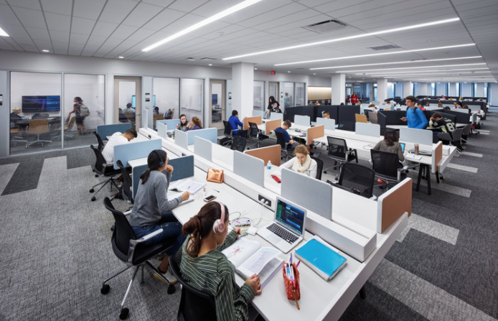
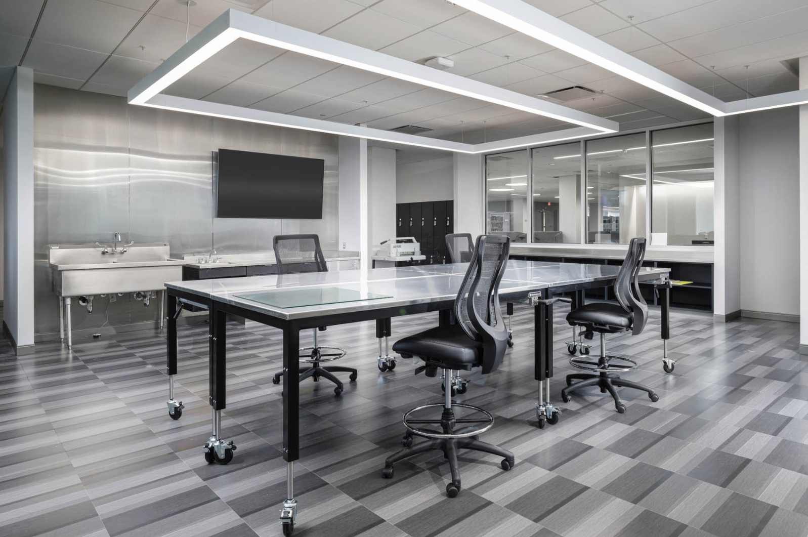
4th Floor user spaces
Text and conText Lab
brightspot. Hillman Library Renovation and Programming Brief, Nov 2016
Notes:
SLIDE 3:
To help assess community needs and program the renovated building, we retained brightspot consultants.
Spaces and services for creativity, collaboration, and active learning, and a showcase for community achievements all emerged as top priorities for the renovated building. For instance, we increased the footprint for user spaces by 60%, which provided for the creation of nearly 100 group study rooms, and by 40% for partner and specialized services such as media creation and maker spaces.
To achieve these design goals, we needed to reduce the footprint taken up by physical collections by 80%.

Slide 4
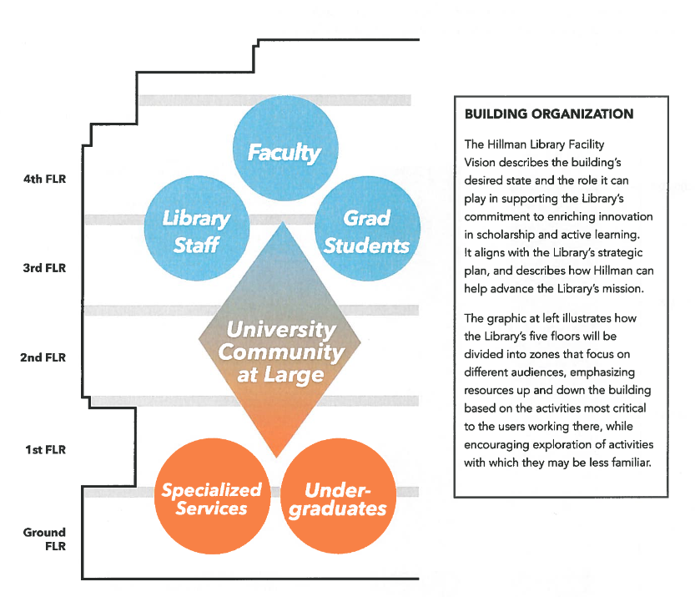
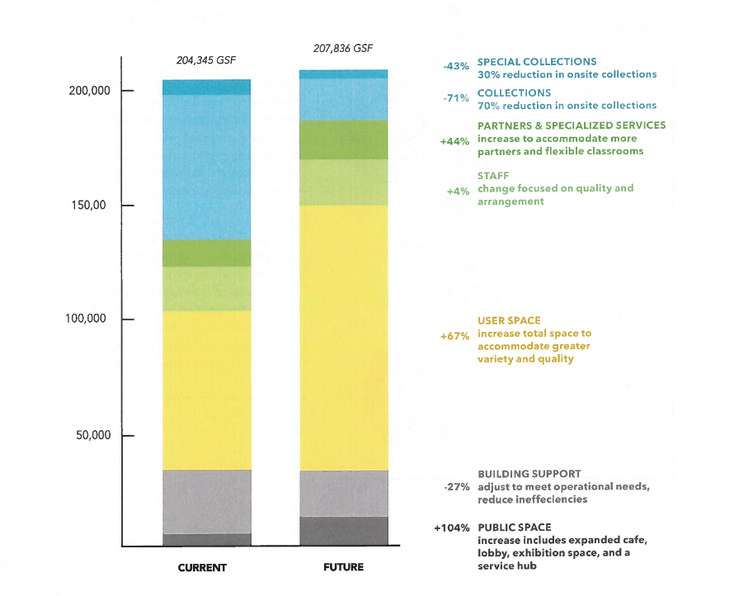
brightspot. Hillman Library Renovation and Programming Brief, Nov 2016
Notes:
SLIDE 4:
Each floor would focus on different aspects of the vision. Lower floors are dedicated to creativity and partnerships, housing maker spaces and labs, classrooms, recording facilities and a cafe.
Upper floors were designed for contemplative work and serious scholarship, with physical and digital displays for special collections and current research, dedicated graduate student spaces, meeting rooms, and the residue of the general collection.

Slide 5
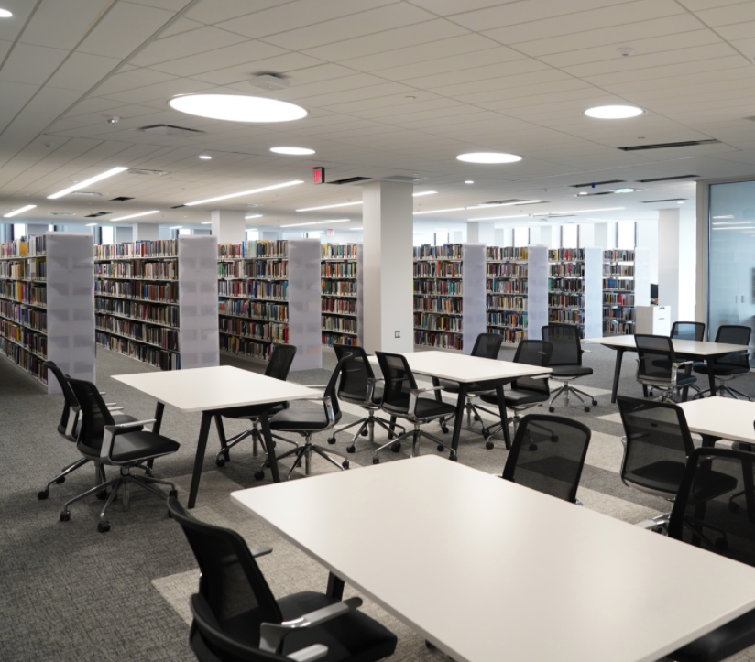
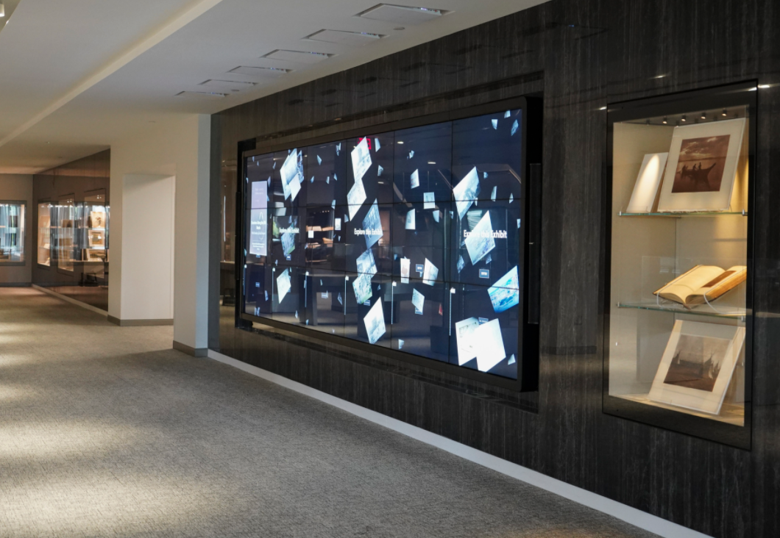
Minimize disruptions for patrons
  Wayfinding tools
Reduce collections footprint by 80%
  Modelling outcomes of different selection criteria
Maintain policy of “zero footprint growth”
  Pre-empt overcrowding
General collections
Digital/physical exhibits
Notes:
SLIDE 5:
In 2017, the Hillman collection move group was formed to address both the policy issues of what the general collection should comprise, and the practical aspects of the move. The group work was informed by the following principles:
The building will remain open to the public throughout the renovation.
Disruptions to patron access will be kept to a minimum.
3. Hillman’s overall collections footprint will be reduced by no less than 80%.
5. The collection’s distribution of subjects and material types will reflect current and future Pitt scholarship needs.
6. After the renovation, the size of the Hillman collections footprint will be managed over time by implementing a “zero-growth” policy.
It quickly became clear that to achieve these goals we needed more than massive excel spreadsheets containing shelf lists and usage data. We needed a good way to analyze this data and allow modeling of different scenarios to minimize patron disruption and maximize the efficiency of physical handling of the materials.
Now, Anne will describe a couple of tools that the Assessment Unit developed to assist in this process.

Slide 6
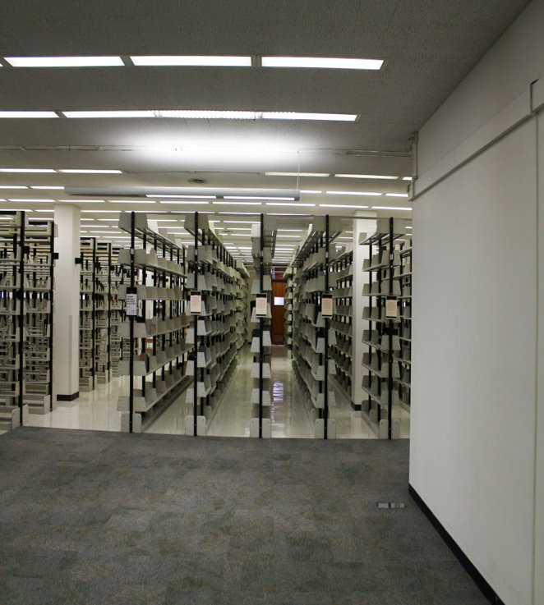

Focus of 1st year of move:
Speed, keeping collections accessible, identifying improvements
Established priorities for new tools:
  Accessible
  Adaptable & readily updated
  Used
  Easily replicated
Notes:
SLIDE 6:
When the preparation work for the renovation began in 2016, we had less than one year to move @ 45,000 LF of books and serials plus the entire microform and map collection, to other floors in the main library, to another campus library, and to remote storage. Emphasis was on identifying swing and remote storage space, and making sure that we had enough room to accommodate the contents of the collection-heavy 4th floor. Understandably, our focus was on moving material as quickly as possible, while keeping it accessible to our users. It was clear to us that we needed to develop wayfinding tools that enabled staff and patrons to locate material that had moved. And we also needed to refine the tools we used to identify which items should remain in the main library. This first year of the move illuminated how we might make key improvements to wayfinding for our patrons and library colleagues, and also cultivate an agile collection modelling tool. Our efforts concentrated on developing tools that were accessible, adaptable and readily updated, actually used, and easily replicated. I will discuss each of these aspects in relation to each tool.

Slide 7
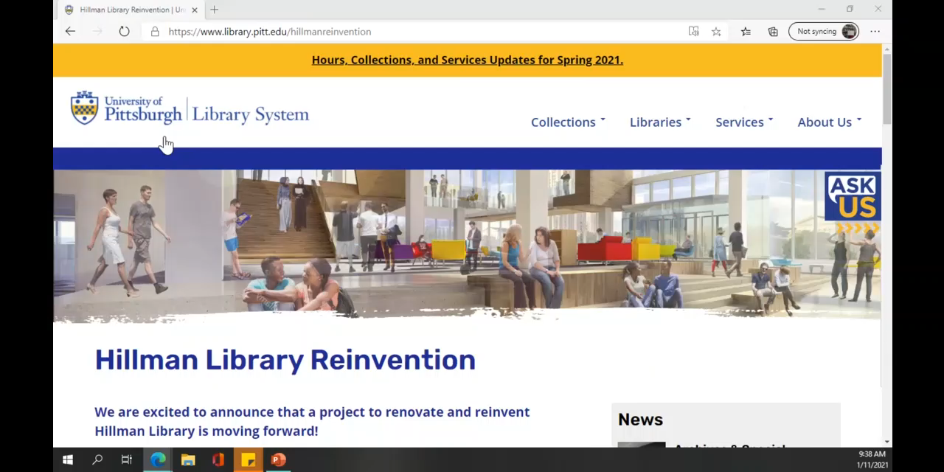

Wayfinding
Interactive map & website
Accessible via web or kiosk in library
Quick & easy to update
Tableau counts usage
Notes:
SLIDE 7:
The first tool that we created was an interactive map, which you can see in action in this slide.
To make up-to-date information quickly accessible to our users and colleagues, we worked with our web services unit to implement two critical components on the library’s website. We included a “What’s moving?” section which indicated which collections were in transit or soon to be moved and this worked hand-in-hand with the interactive map. Since the interactive map was web-based, it was accessible to anyone with an internet connection.
We also wanted the ability to update the map as quickly as possible without requiring a lot of time and effort to develop new floorplans, graphics and complicated website edits. We discovered that it was relatively easy to create a visualization in Tableau by using existing floorplan images and ‘mapping’ call number ranges and services to their respective location on the floorplan. Any movement of materials and services can be updated in a matter of minutes by using the “annotate” feature in Tableau to generate the precise coordinates to plug into the underlying data source. There will be more detailed information on how we created and update the map in the paper, and I’m happy to assist others who may be interested in implementing this at their own institution.
A nice feature with Tableau is that you can see how many times a visualization was viewed. This, along with anecdotal evidence from colleagues and users, indicated people were using the tool and finding it helpful to locate the items they were seeking.
Additionally, once we figured out how to create and implement the interactive map, it was simple to replicate it for other locations and needs. For example, we created another version for use with an iPad kiosk in Hillman Library. This version includes a “you are here” icon and the display is configured to best suit the iPad. The kiosk alone, has received over 1500 views since its launch in the Spring of 2019.

Slide 8
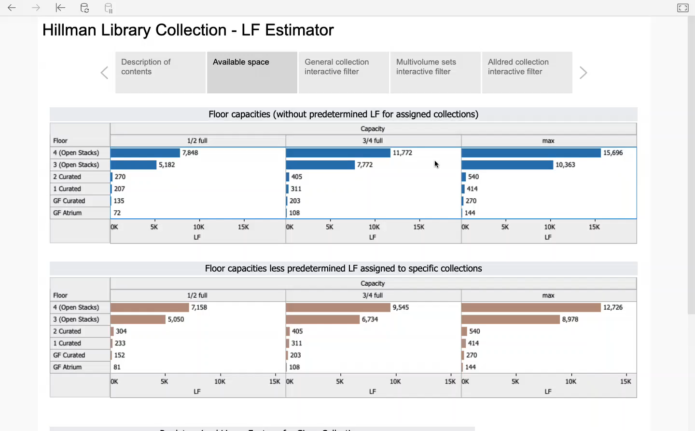
Collection modelling
Model selection criteria in advance of move
Aggregate & granular views
Identify balance or unbalanced collection & what will fit where
Formula estimates LF
Filters easy to add, edit and use
Accessible on-demand
Simple to update, add supplemental info, and adapt to other locations
Can be set-up and used with different ILS
Notes:
SLIDE 8:
Next, we turned to streamlining our collection modelling. When we began the collection move we were using Voyager as our ILS, and we developed criteria for what to send to Storage primarily based on the expertise of our Coordinator for Collection Development. When the initial criteria did not pull enough for storage, we had to go back to the drawing board, and incorporate additional criteria. Getting inventory information for large collections, such as that in the Hillman Library, required IT assistance to extract the data and lots of spreadsheet manipulation to apply criteria and develop lists of items to transfer to Storage. The process was cumbersome.
We turned to Tableau to help us make sense out of the spreadsheets and to create an interactive tool that would enable anyone with access to apply filters, and to sort and review titles to see the impact of different criteria on the existing collection. The visualizations enabled us to develop selection criteria, see if those criteria achieved the reduction in footprint needed, revise if needed, identify balance or imbalance of the collection and do all of this before the actual move of material.
Based on the inventory reports, we created visualizations that calculated linear footage and provided a graphical representation of the collection make up (e.g how much of the collection consisted of literature vs. Social sciences). Filters included: LC Class, Beginning Publication Date, Historical Charges, Last Charged. Linear footage estimates were based on our observations and measurements and the very helpful table in the appendices of Moving Library Collections: A Management Handbook by Elizabeth Habich. We also included views to show estimated linear footage footprints available based on the number of shelves and shelf capacity that would exist in the renovated space. Incorporating the inventory reports into Tableau also enabled us to generate pick lists directly from the worksheet/title lists.
Once the views were developed, data could be refreshed as needed with extracts from Voyager. Now that we recently migrated to Alma, we are working to develop methods to automatically update the data on a set schedule.
Data from Tableau shows this visualization tool is being used, by whom and when. Its usefulness was recognized by colleagues on other campuses and we have since expanded the tool for use at other locations. We were able to easily replicate the basic model, and included some additional filters to meet the specific needs of the users, for example a filter to show if an item was part of a shared print repository agreement, or if the item was duplicated at another location/campus.
As with the interactive map, our paper will include greater detail on how we created the visualizations, and I can help answer questions you have if you plan to implement at your location.

Slide 9
Where do we go from here? Plans for future development
Implement at other locations slated for renovation
Identify topical or unique collections to highlight
Use to maintain zero growth
Dynamic via "live" Alma integration
Ongoing learning process and improvements based on user needs and feedback
Notes:
SLIDE 9:
Where do we go from here, and what are our plans for future development? Our interactive map is continually updated as collections move, and we foresee using this tool at other locations undergoing collection moves and renovation. We hope to use the collection modelling tool to identify topical or unique collections to feature in rotating spotlight shelving. Additionally, because of the reduced shelf space allocated to collections in the renovated library, we need to maintain a consistent collection footprint. We plan to include data in the collection modelling tool that identifies where we have added the most physical items over the previous year, to proactively identify sections that may be overcrowded and move items to storage to make room. And as already mentioned, we are actively working to automatically update data from Alma on our Tableau server.
Building and implementing these tools has been a learning process for us and we discovered some things have worked better than others, and we continue to learn and improve upon our methods.

Slide 10

Questions?
Sources referenced:
Habich, E.C. Moving Library Collections : A Management Handbook. Westport: Greenwood Press, 1998.(accessed via ProQuest ebrary. Web 2 May 2017)
brightspot. Hillman Library Renovation and Programming Brief, November 2016.
Notes:
We are more than willing to share what we’ve learned about our processes and potential pitfalls to be avoided in greater detail in our paper and are delighted to answer any questions you may have now, or if you wish to reach out to us in future.

